Slide 1
The POWER of Group: Integration of 12 step Recovery and Interpersonal Group Psychotherapy
Chris Stewart, MD
CAPTASA
Embassy Suites
January 27, 2024
Notes:
Another talk brought to you by what is what like, what happened, and what’s it like today productions!

Slide 2
Why group therapy?
Provide positive peer support
Reduce sense of isolation
Enable members to witness the recovery of others
Allow members to see how others deal with similar problems
Provide information to patients who are new to recovery
Provide feedback on group members’ values and abilities
Offer family-like experiences
Encourage, coach, support, and reinforce
Notes:
Wh group therapy? Tip 41

Slide 3
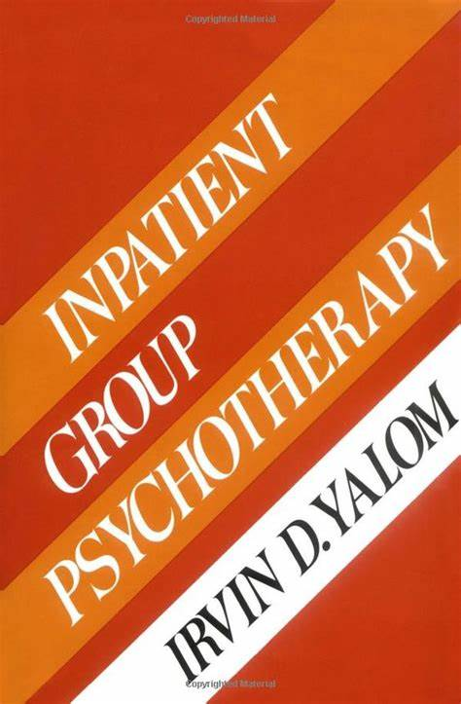
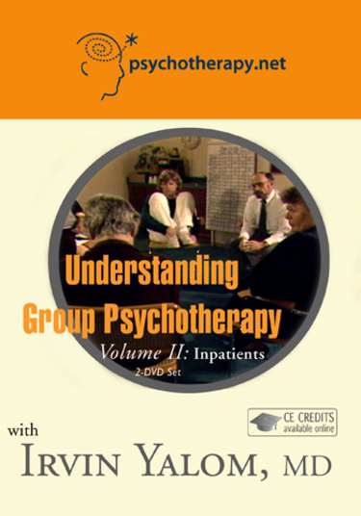
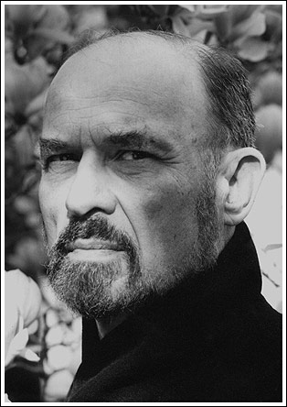
Irvin Yalom, MD
American Existential Psychiatrist
Emeritus Professor of Psychiatry, Stanford University
Author of Fiction & Non-fiction
Group Therapy Master
Existential Psychotherapy
Group Psychotherapy
https://www.yalom.com/

Slide 4
How do groups help?
Yalom (1970s): classification system to empirically measure the efficacy of a members experience in group therapy
Eleven “curative factors” were consistently experienced by members
Renamed “therapeutic factors” (1985, 1995, 2005) to more accurately describe therapeutic benefits leading to change/growth as opposed to cures

Slide 5
Yalom’s Therapeutic factors
Therapeutic Factors | Definition
Universality | Members recognize that other members share similar feelings, thoughts and problems.
Altruism | Members gain a positive view of themselves through extending help to other group members.
Instillation of hope | Member recognizes that other members’ success can be helpful and they develop optimism for their own improvement.
Imparting information | Education or advice provided by the therapist or group members.
Corrective recapitulation of primary family experience | Opportunity to reenact critical family dynamics with group members in a corrective manner.
Development of socializing techniques | The group provides members with an environment that fosters adaptive and effective communication.
Imitative behavior | Members expand their personal knowledge and skills through the observation of Group members’ self-exploration, working through and personal development.
Cohesiveness | Feelings of trust, belonging and togetherness experienced by the group members.
Existential factors | Members accept responsibility for life decisions.
Catharsis | Members release of strong feelings about past or present experiences
Interpersonal learning-input | Members gain personal insight about their interpersonal impact through feedback provided from other members.
Interpersonal learning-output | Members provide an environment that allows members to interact in a more adaptive manner.
Self-understanding | Members gain insight into psychological motivation underlying behavior and emotional reactions.

Slide 6
12 step Meetings Compared to Group Therapy
12 Step meetings are not interpersonal group therapy
12 step meetings can be understood as reference groups
12 step meetings are structured with agendas and formats (traditions) that are consistent, plus meetings do not have therapeutic leaders (only trusted servants).
12 step meetings are nonprofessional

Slide 7
Group Relations
Gordon Strauss, MD
Professor of Psychiatry UofL SOM
Former UofL Psychiatry Residency Training Director
Co-Founding Faculty for UofL Addiction Psychiatry Residency Program
Member of the A. K. Rice Institute
Promoted the participation of group relations work in psychiatry
Provided for annual experience in group relations for UofL psychiatry residents
Helped pay for attendance at outside conferences for residents
Notes:
Dr. Strauss would bring in a group relations consultant and this individual would provide consultation for the class of residents, a small group of 10. It was difficult to do the work ultimately because of being in group with people that you work with; Many residents did not appreciate this experience or found it very unpleasant. I found it both difficult, uncomfortable and stimulating, and it led me to pursue more conferences in group relations

Slide 8
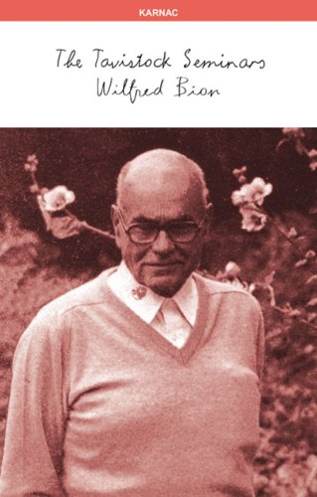
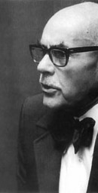
Wilfred Bion, MD
Influential British Psychoanalyst
Second Lieutenant in Tank Corps in WW1 (France)
Known for Psychoanalysis of Group Process
Group Experiments
Group dynamics – basic assumptions: dependency, fight/flight, and pairing
Systems approaches
https://psychoanalysis.org.uk/our-authors-and-theorists/wilfred-bion
Notes:
Groups – work group and the assumption group : Three basic responses to the task are fight flight, pairing, and oneness
I first attended a three day group relations conference in Cincinati Ohio as a PGY 2 resident, and again as a PGY-3. It was recommended that I begin individual supervision by one of the facilitators. These group relations experiences are known for both large group and small group experiences, where the leaders only address the group as whole in their interpretations, and according to Bion, this leads to certain phenomena. The learning for individuals comes from discovering how you personally respond in this setting, and what valences you exhibit. It can also be a way for motivated learners to work on expanding or changing their inhabited roles and understanding how they function in organizations.
On these conferences, I noticed that several participants and staff would drink alcohol excessively in the evenings, and would talk about it/mention it during the day. Later this would be an important observation.

Slide 9
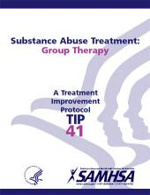
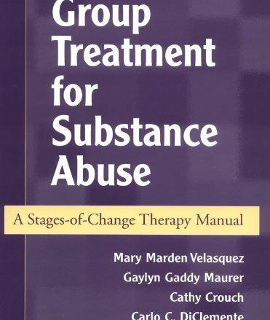
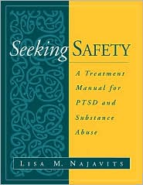
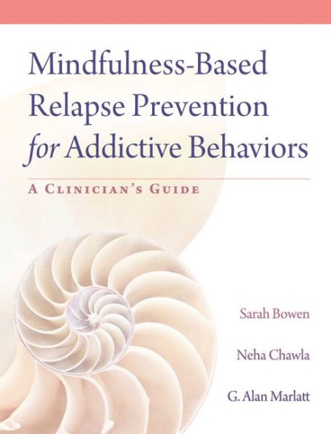
Types of groups
Skills/education/manualized
Ensures a uniform set of services
Can more easily be evaluated
Enhances training capabilities
Facilitates research to practice
Process
Systems, Interpersonal, Jungian
Support
Others…
Notes:
Many more – DBT, CBT-RP
There are many different group formats. Honorable mention here in residency to CBT groups, manualized group for skill building, inpatient psychiatry groups, inpatient addiction groups focused on skill building and relapse prevention,
During my psychiatry residency Irv Yalom came to the clinic and did several group demonstrations. I don’t remember much about this and didn’t appreciate it at the time. Nor did I take advantage til later of the benefit of CBT groups.

Slide 10
Keith Auerbach, MD
Notes:
I first met Keith, as he asked to be called, was in 2001. I wanted to begin individual psychotherapy supervision formally with someone and was referred to him by one of the faculty in the department. I was finishing my residency and going thru a period of termination anxiety, a major life transition, but wasn’t aware of this at the time. Keith worked with me for six months and then told me I needed to join one of his groups. It was more than a suggestion. I thought that since I was active in 12 step recovery, I wondered what group would have to offer. Keith told me that 12 step members made excellent group members, and that this experience would enhance and facilitate group therapy’s effectiveness in my case. Group met weekly for 90 minutes, and members committed to being on time, agreed to no outside contact, confidentiality, and agreed to a 12 week notice for leaving the group. I would meet with Keith individually for one hour in addition to the group sessions. I remember this quote from that time:

Slide 11
“Group is the Liquid Drano of psychotherapy”
Keith Auerbach, MD
Notes:
I was surprised to experience terror during my first group. I sat very still, and remember the sweat rolling out of my armpits for the majority of the group. I don’t remember saying very much. It was a familiar feeling. I still get this feeling in groups today, especially when I find myself in a new group.

Slide 12
Notes:
I can identify with this picture. One of the members in a subsequent group was talking about themselves. An intense sadness came over me and I began to sob. I later learned from this experience that I qualified as an adult child, having grown up with a parent who had an eating disorder. I didn’t know what I didn’t know. To me, this experience was a surrender to the group process, and mirrored the surrender of the first step.

Slide 13
Surrender
Surrender to the group process can be understood in this context as the willingness to share in the ‘here and now’ emotional experiences with the group.
Willingness is facilitated by the contract negotiations accepted by members for being in the group, and their compliance with the group agreement.
A relationship to a power greater than self for members is allowed to emerge and can be explicitly recognized in real time.
Group members may locate a power greater than themselves with the leader or the group (conscious).
Roth states surrender can be understood as allowing the process of transference with authority to unfold in the group and can be used to frame attachment to recovery process.

Slide 14
Separation
“In outer space, if your ship is leaving the other ship, it looks like they are leaving you.” - Keith Auerbach, MD
Group provides special opportunity to work on attachment, unmet intimacy needs around separation, which many persons with addictions have had traumatic experiences.
Group members leaving and remaining in group provided experiences with positive separations made more possible with “a longer runway”.
Notes:
Persons with addictions or who grew up in addicted family systems where separation is not acknowledged or processed do not develop the ability to properly say goodbye, and thus have more intense problems with transitions in life, loss and develop complicated grief more frequently. This is carried in the body, and therefore the experience of therapeutic separation can be an emotional, spiritual, psychic, and physical experience. It is mostly minimized in the therapy world today, even in places where group therapy is often practiced. The commitment to remaining in group for 3 months is hard to get patients to fulfill.

Slide 15
American Group Psychotherapy Association (AGPA)
MISSION STATEMENT: The American Group Psychotherapy Association is a dynamic, thriving community of mental health professionals of all disciplines dedicated to advancing knowledge and research, and providing quality training in group psychotherapy and other group interventions, consultation and direct services nationally and internationally.
The Association is a unique blend of practitioner and direct services:
Promoting quality group psychotherapy care as a primary method of treatment that is clinically sound, cost-effective and accessible;
Advancing group psychotherapy training and research;
Providing intervention and outreach to diverse communities nationally and internationally based on group psychotherapy principles and established protocols;
Providing a network of peer support that serves the professional needs of group practitioners; and
Advocating for quality care on behalf of its members, clients/patients and the public.

Slide 16
Jeffery Roth, MD
Working Sobriety
Psychiatry in Private Practice
Chicago, Illinois
“Oxygen is the antidote to shame”
“Can you make a commitment to do that?”
Uses non-conventional approach in bringing awareness to addiction and providing a space in group to explore the role of shame in maintaining addiction.
Uses self as “recovering group psychotherapist” who accompanies the members in their struggle
Notes:
Met Jeffrey in 2006 in San Francisco Annual Meeting of the AGPA
He provided a demo group and there you are encouraged to participate “playing a patient or yourself (playing a patient) and he was the coleader. He performed an intervention where he offered a patient in the role of an active alcoholic to make a commitment to drinking, in a response to their voicing the desire to drink, and he further worked on establishing a possible agreement with this individual to agree to call another member of the group while they were drinking to be accountable. Then they would return to group and report on their progress. The idea being that shame requires hiding behavior, and he was modeling the opposite of isolation, but also invites patients to examine themselves more in depth this stance. He used physical positions and exercises as well with patients, often giving ‘homework” around making the internal external, thereby demonstrating the insanity of addiction while giving the patient freedom to fully explore this with the leader and group’s support.

Slide 17
Tony Sheppard, PsyD, CGP, FAGPA
Private Practice Child Psychologist in Louisville
Author of Group Psychotherapy with Children, Official AGPA Curriculum
Former Chairman of the International Registry for the Certification of Group Psychotherapy
Fellow of the AGPA
Candidate for president of the AGPA 2024
Notes:
Tony was my formal group psychotherapy supervisor for several years, and helped me in obtaining certification in group psychotherapy. Despite his work primarily with adolescents and children, he was apt in supervising group therapy for adults with trauma and addiction.

Slide 18
Social microcosm model
A true miniature laboratory for interpersonal experimentation
Wonderful modality for helping patients come to know themselves and their relationships with others, because group is a social microcosm of the family, society, and civilization

Slide 19
What is a Certified Group Psychotherapist (CGP)?
A Certified Group Psychotherapist (CGP) is a clinical mental health professional who meets internationally accepted criteria of education, training and experience in group psychotherapy. A CGP is an ethical practitioner who is an expert in group psychotherapy and is committed to group psychotherapy as an autonomous treatment modality. The International Board for Certification of Group Psychotherapists offers this certification in group therapy for practicing clinicians. This credential requires a master's degree or higher in a designated mental health specialty and clinical group experience with supervision/consultation. The CGP is valid for two years and then needs to be renewed. The CGP provides formal recognition that the practitioner has a specialty expertise in Group Therapy practice.
Promote and protect the public's health safety and welfare through the dissemination of information which will enable the pubic to make informed decisions regarding appropriate group psychotherapy practices;
Assess health care trends which impact group psychotherapy;
Enhance the professionalism of group psychotherapists by establishing and advancing standards of professional practice, ethics and education;
Define, establish and promote criteria for the certification of professional qualifications in the field of group psychotherapy;
Grant recognition to and promote professional accountability for clinical mental health professionals who are certified;
Encourage group therapists lifelong learning through continuing education;
Promote cooperation among public and private organizations interested in the certification of group psychotherapists;
Conduct assessments of the effectiveness of certification including the impact of certification on group psychotherapy, the role of certification in mental health and the benefits of such certification.

Slide 20
Group Psychotherapy and Recovery From Addiction: Carrying the Message
In this book, the reader becomes a member of the group and is invited to explore and experience interpersonal group psychotherapy with the author as leader of the group, and other group members represented with different fonts. In this book Dr. Roth’s ideas about 12 step recovery and how the 12 steps and traditions are represented in the experience of interpersonal group psychotherapy.
Notes:
I read this book before in preparation for an institute with Jeffrey – and the ideas in this book combined with working more closely with Jeffrey over two days ultimately led me to the decision to move to Chicago and work on developing my skills in group psychotherapy and devoting my practice to this approach. We also got to know one another more in the realm of attending 12 step open meetings for anyone in any form of 12 step recovery to attend after the conference meetings were concluded for the day. We discovered that we both were also interested in group relations work, and Jeffrey had been sponsoring a group relations conference dedicated to the integration of 12 step recovery with group relations work.. He also gave a workshop during this conference on dealing with dual relationships, that is, seeing people or even your therapist in group, and seeing them in a 12 step meeting as a peer. Not making this explicit or unspeakable would reenact the secret, and therefore their needs to be acknowledged in group when this occurs and made explicit.

Slide 21
Group (film series featured on YouTube) Dr. Eliot Ziesel (left)
You don't really know yourself until you look through someone else's eyes. In a room with Dr. Ezra, eight New Yorkers explore hidden truths about their own intimacy, loneliness, sexuality, and fears. Inspired by Irvin Yalom’s novel “The Schopenhauer Cure”, GROUP is a fly-on-the-wall experience of a kind you've never seen before. (Drama series in 7 episodes).
https://www.youtube.com/channel/UCZ7ya7sIWTlRpIgx3ycpHWg
Notes:
Using a modern psychoanalytic approach, influenced greatly by Lou Ormont, his teacher and mentor, this approach attempts to elevate primal aggression and libidinal forces to the surface in a workable manner to move the group forward.
Eliot sayings “Unconscious incompetence, conscious incompetence, conscious competence, unconscious competence
“Make 10 mistakes a day”
“You were in a prison before COVID”

Slide 22
Working Sobriety @2015

Slide 23
Group Psychotherapy with Addicted Populations Philip Flores, Jeffrey Roth, and Barney Straus
Recognize how surrender as a manifestation of transference to authority supports attaching to the recovery process.
Identify how meditation can facilitate receiving help from the recovering community by listening to the group-as-a-whole. Recognize how to operationalize authority in the service of recovery using the concept of a Higher Power as the relationship with authority. Describe the concepts of unmanageability and resistance to end the stigma of addictive processes. Discuss the concepts of powerlessness with free association to support experiential learning about recovery from addiction in the present.
Examine prayer as speaking to the whole group to facilitate the recognition of authority as distributed among all group members. Contrast inventory-taking with resistance to transference to support using the relationship with authority to examine dysfunctional patterns of behavior. Integrate the concept of carrying the message of recovery with using oneself in a role to enhance the effectiveness of clinical practice.
Notes:
Vignettes in this book are very helpful; Vignette about the “Maze” and how asking for help and experiencing powerlessness manifested in the finally surrendering to the need to ask for help as the only way out of the Maze.
Vignette about patient who wouldn’t get the COVID vaccine and allowing the process for group as a whole to unfold leading the member to connect this resistance to being attached to having a father with a gambling addiction.
Allowing one group member to feed another member in the group with both dealing with active eating disorders

Slide 24
Integration of Group and 12 Step Recovery: Other Areas of Emphasis from ROTH
Negotiation of confidentiality and other boundaries in the group
Dual relationships
Recommendation for group therapists to be in group therapy and recovery, group relations
Examine the financial boundary
Notes:
Setting up given rules on confidentiality in the group takes away from the ability for the group to examine its own process in negotiating the boundaries explicitly – and not simply going along with the suggested boundaries – but having an opportunity to explore this around what payment means, the negotiation of the space, and helping members with asserting their boundaries and being responsible for their boundaries is very important to Roth
Confidentiality with ZOOM elevated this issue with group recently and makes this an important practice – Roth asserts that this never goes away, like most issues its an ongoing process
Dual relationships are inevitable in life and in recovery – previous dual relationships with family and sometime professionals are associated with abuse, boundary violations, and trauma; Therefore it is important to acknowledge to real phenomenon of dual relationships in recovery and that this can be negotiated – this is another way of dealing with shame ands it impact
Finances are important to discuss and pay attention to – and make explicit as part of the therapy for Roth – does the member authorize the leader and group by addressing their agreement to pay, be on time, be present in the group?
All group therapists in Roth’s opinion have ambivalence about being group therapists- can we accept this – do we participate in group ourselves? Are we working our own program? Do we not have contempt for group in the same way our patients may?

Slide 25
Glenn Siegel, MD
Cofounder of the Elmhurst Professionals Program with Mary Pittman RN

Slide 26
Elmhurst Professionals Program
Under the umbrella of Awareness:
Open, honest and direct communication
Respect for self and others
Accountability to others and willingness to hold others accountable
Responsibility for one’s choices
Inclusion of all parts of self and others
Values Model
Mary Pittman and Glen Siegel
Notes:
I took over as medical director of the program in 2014. I took this job as a way to transition to Chicago for my private group psychotherapy practice, but had some of the best experiences in group psychotherapy up to this day. Patients in the program all received comprehensive evaluations prior to or on admission from the comprehensive assessment program. This allowed for a serious in depth knowledge of the individual’s character and background that informed group interventions. Team meetings took place in a fishbowl where all community would be present to listen to treatment planning and even witness spirited discussions regarding their case. It ultimately was closed due to, in my opinion, one fatal flaw in the program that failed to keep up with the times; unstaffed residences for the patients/clients as the program was a partial hospitalization program. Before the opioid epidemic this model worked for professionals, but the program attempted to expand its patient population and could not be successfully adapted after it was acquired by an outside organization.

Slide 27
Top ten most helpful for members
1. Discovering and accepting previously unknown or unacceptable parts of myself
2. Being able to say what was bothering me instead of holding it in
3. Other members honestly telling me what they think of me
4. Learning how to express my feelings
5. The groups teaching me about the type of impression I make on others
6. Expressing negative and/or positive feelings toward group members
7. Learning that I must take ultimate responsibility for the way I live my life no matter how much guidance and support I get from others
8. Learning how I come across to others
9. Seeing that others could reveal embarrassing things and take other risks and benefit from it helped me do the same
10. Feeling more trustful of groups and of other people

Slide 28
Sheridan Correctional Center
Corrections Setting for Addiction Treatment for Male Inmates
Operated by West Care
The Sheridan Correctional Center is a medium-security state prison for men located in Sheridan, LaSalle County, Illinois, owned and operated by the Illinois Department of Corrections.
Opened: (Re-Opened) January 2, 2004 *Operational Capacity: 2,107 Population: 1,036 (as of 6/30/23)
Utilizes CBT, relapsed prevention, motivational interviewing in a therapeutic community overlay
Interpersonal psychotherapy was not an effective approach with this population when compared to established and experienced approach that was developed over many years in this setting.

Slide 29
Marcia Nickow, PsyD, CADC, CGP
Marcia leads 15 weekly ongoing process groups—men’s, women’s, multigender, professionals, artists/writers and clinical supervision groups; she also co-leads two couples' groups.
Specializes in intergenerational trauma, eating disorders, addictions, other process addiction, racism trauma, religious trauma
Strongly involved at the leadership level in AGPA regarding anti racist organizational transformation.
Group process provides the vehicle for “coming out of role” but requires substantial process time and higher dose of group than most realize to accomplish this.
“Make It speakable”
Notes:
We co led several groups together during my time in Chicago, including a couples group, a women’s group, and supervision group, and several other mixed gender groups. I worked most closely with her during my time. She worked for many years as a newspaper reporter in Chicago before becoming a therapist,
Having worked on reporting about gang activity in the city for many years. We worked together with patients who survived gang and other organized crime culture, religious cults, and saw addiction as a process that helps persons cope with unsustainable roles in the family of origin systems. In order to begin to make progress in coming of these roles it could take several groups a week for 9-12 months, while also engaging in active 12 step recovery, often involving several different 12 step recovery programs, including AA, NA, SLAA, Alanon, ACA, WA, EDA; SAA; during this time the digital and cell phone world was increasing in Chicago, and the number of Apps dedicated to facilitating sex addicted behaviors were significantly on the rise and being utilized by our patients. However patients were also using cell phones more to connect to each other outside of the group and Dr. Nickow really encouraged this, and encouraged sharing with group both successes, but also failures regarding abstinence or relapse.

Slide 30
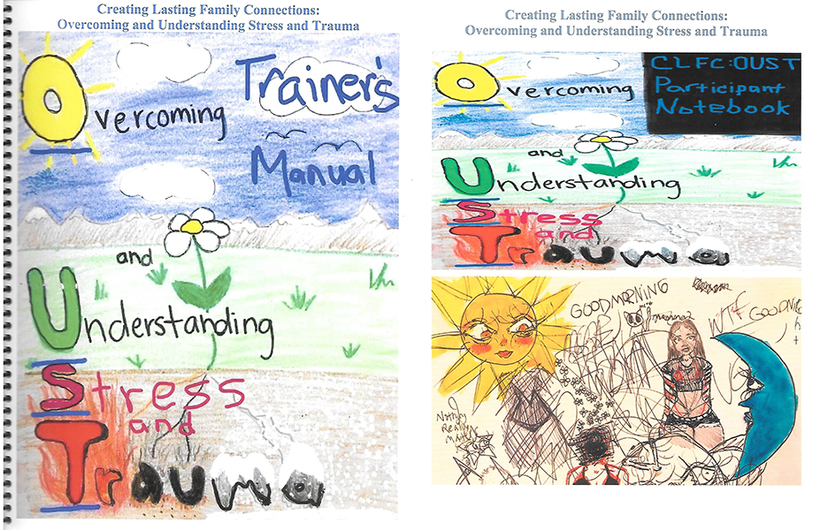
CLFC: Overcoming and Understanding Stress and Trauma
Manualized Group Treatment for PTSD as part of substance use prevention intervention
Authors: Ted Strader, Fred Ward, Teresa B Strader, Patrick McKiernan, EdD., and Chris Stewart, MD.
Can be found on COPES website at this time.
Notes:
Royalties from this book go back to the non profit COPES. Manualized approaches are very helpful in providing the possibility for evidence based approaches made available in areas with less access, and helps to train novice therapists in essentials. Not a replacement for interpersonal approaches, but can be used to induct persons to the group process and provide foundation or skills needed for a group process.

Slide 31
Primary references
Substance Abuse and Mental Health Administration. Substance Abuse Treatment: Group Therapy Inservice Training. HHS Publication No. (SMA) SMA-11-4664. Rockville, MD: Substance Abuse and Mental Health Services Administration, 2012.
Roth, J.D. (2004). Group Psychotherapy and Recovery from Addiction: Carrying the Message (1st ed.). Routledge. https://doi.org/10.4324/9781315809007
Flores, P.J., Roth, J., & Straus, B. (2023). Group Psychotherapy with Addicted Populations: An Integration of Theory and Practice (4th ed.). Routledge. https://doi.org/10.4324/9781003398684
Yalom, I. D., & Leszcz, M. (2005). The theory and practice of group psychotherapy. New York: Basic Books.
American Group Psychotherapy Association. (2007). Practice guidelines for group psychotherapy. New York, NY: Author

Slide 32
Training opportunities
American Group Psychotherapy Association (AGPA) http://www.agpa.org
American Psychiatric Association http://www.psych.org
American Psychological Association http://www.apa.org
American Society of Addiction Medicine (ASAM) http://www.asam.org
Association for Specialists in Group Work (ASGW) http://asgw.org
Association for the Advancement of Social Work with Groups (AASWG) http://www.aaswg.org
NAADAC—National Association for Addiction Professionals http://www.naadac.org
National Association of Black Social Workers (NABSW) http://www.nabsw.org
National Association of Social Workers (NASW) http://socialworkers.org

