Slide 1
Relapse Prevention
CAPTASA January 26, 2024
Embassy Suites Lexington, KY
Notes:
NOTE:
To change the image on this slide, select the picture and delete it. Then click the Pictures icon in the placeholder to insert your own image.

Slide 2
Disclosures and Objectives
No financial Disclosures
I will not be promoting any off label or untried procedures* Thank God!
Objectives
Review what Relapse is. No relapse if there’s no Recovery to start from.
Review Standard Relapse Prevention plans
Share Relapse Prevention plan that I have seen work the best.

Slide 3
Relapse is not a requirement
Some folks have had a sufficient beatdown from their disease that they are willing to follow suggestions. Suggestions that when followed result in a new way to thinking about themselves and the world around them. They are transformed.
Burns was a little more blunt about it.

Slide 4
Foreword to Second Edition of the Big Book p. xx
“Of alcoholics who came to A.A. and really tried, 50% got sober at once and remained that way; 25 % sobered up after some relapses, and among the remainder, those who stayed on with A.A. showed improvement.”

Slide 5
First, we need to define Recovery and that’s not a simple thing. For this talk, I will be focused on #1
Abstinence from all mood-altering drugs or substances. Additionally active engagement with others in Recovery and practice of Spiritual principles for a happy new way of living. This is what most folks in long term Recovery would support, if they are happy being Recovered.
Ostensibly controlled use of certain drugs or substances. Managing one's use. Sort of a “California sober” approach.
Medically managed Recovery. This seems to be the most frequent form now. With heavy support(mandated) from organized medicine, governments and payors. It’s primarily a business model and decision. Medical professional as Higher Power
Not sure how you would tell if Relapse occurred with #2 or #3

Slide 6
So what is Relapse?
After some period of -Abstinence from all mood-altering drugs or substances. And active engagement with others in Recovery, with the practice of Spiritual principles for a happy new way of living- returning to substance use.
Relapse is not usually a sudden incident. Can be but most times there is a process which occurs prior to use of substances. Watching for and responding to the warning signs is my idea of Relapse Prevention.
3 Staged Relapse- Emotional, Mental(Behavioral) then Physical Relapse

Slide 7
Where 12 Step Recovery began

Slide 8
And continues

Slide 9
Sixteen relapse symptoms to watch out for: -- Akron Intergroup News, December 1998
1. Exhaustion - Allowing oneself to become overly tired. Often as Human Doing vs Human Being *2. Dishonesty - Begins with pattern of little lies; escalated to self-delusion and making excuses for not doing what's called for. 3. Impatience - I want what I want NOW. Others aren't doing what I think they should or living the way I know is right. 4. Argumentative - No point is too small or insignificant not to be debated to the point of anger and submission.

Slide 10
Sixteen relapse symptoms to watch out for: -- Akron Intergroup News, December 1998
5. Depression - All unreasonable, unaccountable despair should be exposed and discussed, not repressed: what is the "exact nature" of those feelings? 6. Frustration - Controlled anger/resentment when things don't go according to our plans. Lack of acceptance. See #3. 7. Self-pity - Feeling victimized, put-upon, used, unappreciated: convinced we are being singled out for bad luck. *8. Cockiness - Got it made. Know all there is to know. Can go anywhere, including frequent visits just to hang-out at bars, boozy parties.

Slide 11
Sixteen relapse symptoms to watch out for: -- Akron Intergroup News, December 1998
9. Complacency - Like #8, no longer sees value of daily program, meetings, contact with other alcoholics, (especially sponsor!), feels healthy, on top of the world, things are going well. Heck may even be cured! 10. Expecting too much of others - Why can't they read my mind? I've changed, what's holding them up? If they just do what I know is best for them? Leads to feeling misunderstood, unappreciated. See #6. **11. Letting up on disciplines - Allowing established habits of recovery - meditations, prayer, spiritual reading, AA contact, daily inventory, meetings - - to slip out of our routines; allowing recovery to get boring and no longer stimulating for growth. Why bother?! ***12. Using mood-altering chemicals - May have a valid medical reason, but misused to help avoid the real problems of impending alcoholic relapse.

Slide 12
Sixteen relapse symptoms to watch out for: -- Akron Intergroup News, December 1998
13. Wanting too much - Setting unrealistic goals: not providing for short-term successes; placing too much value on material success, not enough on value of spiritual growth. ***14. Forgetting gratitude - Because of several listed above, may lose sight of the abundant blessings in our everyday lives: too focused on # 13. 15. "It can't happen to me." - Feeling immune; forgetting what we know about the disease of alcoholism and its progressive nature. 16. Omnipotence - A combination of several attitudes listed above; leads to ignoring danger signs, disregarding warnings and advice from fellow members.

Slide 13
I think it’s usually these 5. The rest are products of or sideshows in my experience.
Dishonesty - Begins with pattern of little lies; escalated to self-delusion and making excuses for not doing what's called for. Often picking up a behavior or process that leads to more dishonesty.
Cockiness - Got it made. Know all there is to know. Can go anywhere, including frequent visits just to hang-out at bars, boozy parties. Testing oneself to show how strong they are.
Letting up on disciplines - Allowing established habits of recovery - meditations, prayer, spiritual reading, AA contact, daily inventory, meetings - - to slip out of our routines; allowing recovery to get boring and no longer stimulating for growth. Skipping meetings, no sponsor, isolating.
Using mood-altering chemicals - May have a valid medical reason but misused to help avoid the real problems of impending alcoholic relapse. I see lots of folks having a medical issue or seeing healthcare professionals without telling them of their addiction.
Forgetting gratitude - Because we lose sight of the abundant blessings in our everyday lives. Amen

Slide 14
Any plan that doesn’t have checks and confirmations is not going to be a successful

Slide 15
Standard Relapse Prevention Plan
Identify your personal goals in recovery and motivations for positive changes.
Make a plan to manage cravings and triggers by naming specific challenges and methods for overcoming them.
Find ways to improve self-care and maintain a healthy lifestyle.
Prepare communication tools and set up a support system.
Devise strategies to keep yourself accountable to the plan.
Methods for coping with stress and minimizing triggers:
None of this is bad, but the problem is it’s based on the individual managing their disease with new found self knowledge and resolve. Not bad, just usually not enough.

Slide 17
Willingway Four Truths
The total Cause of Alcoholism and Drug Addiction is Unknown.
Alcoholism is at least in part a Chemical illness.
There is a relationship between Alcoholism and Addiction to other drugs.
Alcoholism is an illness of the total person (physical, mental and spiritual).
www.willingway.com
Notes:
I did my Fellowship in Addiction Medicine at Willingway Hospital which is in Statesboro, GA. Willingway Hospital’s founders where Dr. John Mooney and his wife Dot (Miss Dot to those of use fortunate enough to have known her). The family still owns and operates the hospital.
My treatment philosophy is based on these truths. And it works.

Slide 18
Cross, Morgan and Mooney- Ten-year Follow-Up Willingway, 1990
Abstract
Two hundred male and female patients, selected at random from all patients admitted to an inpatient alcoholism treatment facility in 1973-1974, were surveyed 10 years following treatment. Response rate was 80%, and a validity check was done. Of the 158 unstable responses, 61% reported complete or stable remission of their alcoholism for at least 3 years prior to the survey and 84% reported stable psychosocial status. Successful outcome was possible regardless of severity of drinking history or psychosocial status. Seventy-six percent (76%) of those still alive at follow-up reported remission; at most, 23% of the deceased were reported in remission prior to death. Involvement in Alcoholics Anonymous (AA) predicted abstinence, suggesting successful outcome for patients who undergo a treatment regimen, which bridges patients into AA involvement. Of those respondents who continued to sponsor other AA members throughout the follow-up period, 91% were in remission at the time of survey.

Slide 19
Relapse Prevention Plan I have seen work best
Must start with adequate removal of substances, detox almost always required. If there isn’t a definite process for this, the mind has no chance to heal, away from chemical distraction. If possible, and this is really hard these days, clear of all CNS active chemicals at least for a few months till the brain clears.
Education is not immunity but basic information about addiction is required. Especially that you don’t have to know why there is addiction, just that it is present. Also, the cross-addiction piece is critical, else they just get on a medical merry go round and use up resources and what little resolve they have.
Early and often exposure to those who have the same illness but are in Recovery. This includes introduction for the written Recovery basics. Becoming familiar with the language of Recovery. I believe this is why programs that employ Recovering individuals have better outcome. A Recovery Apgar per Dr. Al Mooney
Written plan that includes- Testing, Meetings, Sponsor, Step Work, Home Group, Working with others and outside help as needed.

Slide 20
Written plan
Agreeing to random and for cause testing. Needs to be for long enough to be meaningful. 2 years might work, longer is better.
Agreeing to minimum number of Recovery meetings per week and documenting this. Very often to start but 3 per week for a long period. Hopefully the experience of Recovery meetings becomes so ingrained they continue for life. I find about half of those under 5 year required meetings and testing, continue meetings after the requirement is up.
Recovery meetings in person are better protection, but Zoom meetings are better than nothing. Using both is very common now. Have a Home Group
Agreeing to have a sponsor. Crucial and highly corelated to continued Recovery once plan is over. Becoming a sponsor for others even more strongly corelated to longer term sobriety. Documenting sponsor. Becoming a sponsor eventually.
Encourage significant others to attend Alanon. Least successful part of plans in my experience.

Slide 21
Easy to remember formula for long term Recovery
Don’t drink or use drugs.
Go to lots of Recovery meetings. There are more folks with longer term Recovery in AA than any of the other Fellowships. Even if a person considers other substances their primary issue, a desire not to drink is a low barrier to being a member. I’ve seen lots of people begin just that way.
Get a sponsor. And work through the 12 steps with that sponsor. I believe women do best with other women. Men with men. I’m old fashioned but I believe there is spiritual benefit to it, regardless of how a person identifies. And I know folks who have more than one sponsor and involvement in more than one fellowship.
Be grateful. Best way to be grateful is to act like a grateful person.
Help others, includes being a sponsor. Service work is insurance. And it’s a way to live gratitude.

Slide 22
Being Grateful is very strongly corelated to continued Recovery

Slide 23
My 25 second test of stable Recovery
Sobriety Date
Sponsor’s name
Home Group
* Often add- What step have you worked on most recently?

Slide 24
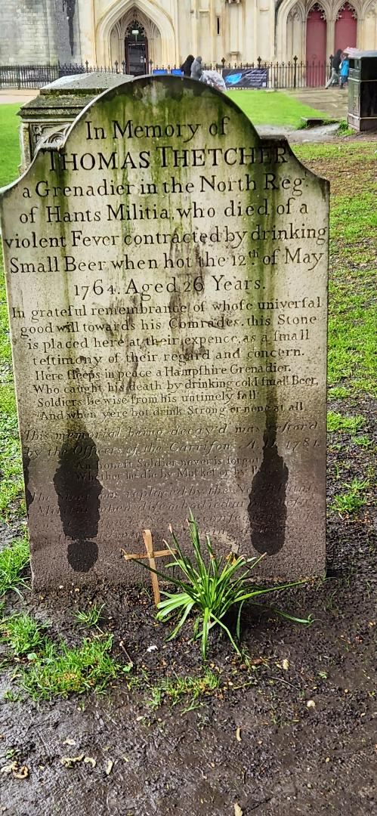
Thank You
I really appreciate the CAPTASA Committee asking me to present.
Thank you to all of you out there working with folks who suffer from Addictions. It’s hard work but so very rewarding when you see the lights come back on in their eyes.

