Slide 1
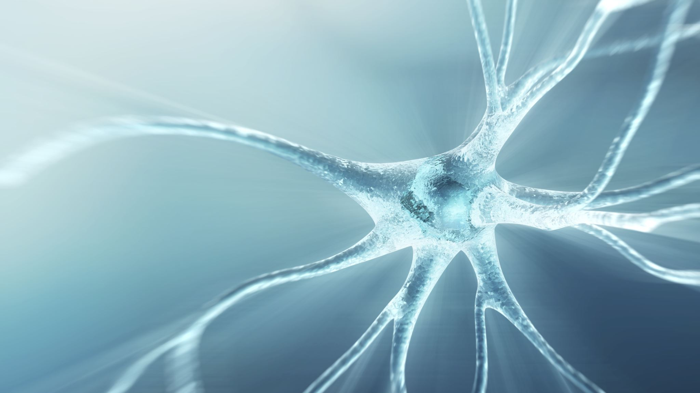
Treating Intergenerational Trauma in SUD patients
Mike Eiden LCSW, LCADC, CSAT, CCS
502-544-4258
Eiden.integrative@gmail.com

Slide 2
objectives
Review epigenetic research and its implications for treating SUD patients
01
Provide a contextual overview of inter-generational trauma and its affect on individual patterns, family systems, and culture
02
Discuss treatment methods for intergenerational trauma work
03

Slide 3
Patient example: Steven
49 year old male presents to treatment for substance use disorder and reports of chronic relapsing and trouble in relationships with women. Client reports having had multiple stints of years in sobriety, gets into relationship with women, and once intimacy or a deepening of the relationship occurs he feels insatiable cravings to use that baffle him and his support people. Client reports that he is “still taking care of his mother” as she ages and feels resentful towards his position in the family. Through course of treatment, it’s learned that the client’s father had Polio and used a wheelchair. As a boy client was sent by the father to live with the mother and “take care of her.” By exploring the dynamics of the father’s life, client is able to identify that the father felt extreme guilt that he could not “give” to his wife because of his illness. The client begins to understand he was sent in his father’s place to make right the “unpaid debt” to his mother. Client sees that he has taken on his father’s guilt of not being able to ”give” to women and therefore rejects opportunities for women to give to and nurture him. His alcoholism serves the purpose of numbing his guilt, turning away from women as his father’s representative, and forces the system to look at his father again who had long since been forgotten.

Slide 4
Patient Example: Shauna
41 year old female client presents to treatment with chronic marijuana abuse, treatment resistant depression and suicidality, pattern of traumatic bonding in romantic relationships (married multiple men who were sex addicted and not in recovery), and compulsive emotional eating. In exploring her history, the client’s father was not ‘parental’ towards her, as his father was not parental towards him. The client bonded and identified more with her uncle and grandmother who presented as parental figures. The uncle was also an addict and at times abusive. When the uncle passed away the client became intensely suicidal and her addictive behaviors turned more high risk. Through the course of therapy the client was able to identify that a part of her desired to follow the uncle into death to be with him. Client was also able to recognize that part of her wished to not live her fully (continuing in addiction and suffering) just as her uncle did, as a means of honoring and loving him. Client and therapist worked to acknowledge the ways she carried the emotional burdens of previous generations and allow them to return to their proper owners in the family system. Client experienced rapid relief of depressive symptoms and suicidality & increased willingness to get sober.

Slide 5
Epigenetics
Epigenetics is the study of heritable changes in gene expression that occur without alterations to the DNA sequence itself
DNA methylation
Histone modification
RNA interference
Turns genes on or off in response to environmental factors
In the context of intergenerational trauma, epigenetics explains how the effects of traumatic experiences can be biologically transmitted to subsequent generations, potentially influencing their health and behavior without direct changes to their genetic code

Slide 6
Picture of family history
As an unfertilized egg, we all share a cellular environment with our mother and grandmother
When your grandmother was 5 months pregnant with your mother, the precursor cell of the egg you developed from was already present in your mother’s ovaries—3 generations in the same biological environment
Precursor cells formed for father’s sperm also present in his mother’s womb
Primary difference between sperm and egg:
Once your mother’s egg cells formed in your grandmother’s womb that cell line stops dividing
Sperm cells continue to develop up until time of conception, therefore susceptible to environmental imprints up to the time of conception
If trauma and addiction can be passed on, so can recovery & health

Slide 7
Epigenetics & PTSD
Children of Holocaust survivors with PTSD born with low cortisol levels
In chronic PTSD cortisol levels can become suppressed, parents pass these encoded genes to children pre-disposing offspring for PTSD symptoms
Similar findings with war veterans and pregnant mothers with PTSD as result of World Trade Center attacks
Studies found that PTSD, chronic fatigue syndrome, and chronic pain syndrome all associated with low blood levels of cortisol
(Yehuda et al., 2015)

Slide 8
tuning fork instead of binary code
2010 study: prenatal stress and effects on neurodevelopment. Researchers measured cortisol levels in amniotic fluid of 125 pregnant mothers. Babies exposed to increased cortisol levels as early as 17 weeks after conception, showed impaired cognitive development at 17 months follow up (Bergman et al.)
Dr. Bruce Lipton
Research showed that genetic inheritance was not only transmitted by chromosomal DNA
Chromosomal DNA represents 2% of total DNA (hair, eyes, skin, physical traits
Non-coding DNA represents 98%, responsible for emotional, behavioral, and personality traits we inherit
Non-coding DNA is affected by environmental stressors, toxins, and inadequate nutrition

Slide 9
Evolutionary adaptation
Epigenetic changes in our DNA are meant to prepare us for the environmental stressors to come, based on our parents’ and ancestors’ traumas
We are born with an intrinsic skill set or ‘environmental resilience’ that allows us to adapt to stressful situations, epigenetic tags tell cells to either activate or silence gene expression
Evolutionary biologists theorize that genetic alteration as a result of trauma is a way for the body going through the trauma to prepare subsequent generations to better survive the current ordeal
(Yehuda et al., 2015)

Slide 10
Epegenetic inheritance in mice
Male mice were trained to fear a cherry-blossom like scent called acetophenone
10 days of having that scent waft into their cage and then receiving a slight electrical shock
Those mice developed more smell receptors for that particular scent and could pick it up at lower concentrations than other mice
Researchers found that the gene responsible for acetophenone detection was packed differently in the sperm of the the shocked mice than the control group
The sperm of the scared mice was used to inseminate the females and their offspring, who never met their father, had more acetophenone receptors and when exposed to the smell became frantic and agitated. The same was true for the subsequent generation of grandpups.
(Nuwer, 2013)

Slide 11
Culture or traumatic retention?
“After months or years, unhealed trauma can appear to become part of someone’s personality. Over even longer periods of time, as it is passed on and gets compounded through other bodies in a household, it can become a family norm. And if it gets transmitted and compounded through multiple families and generations, it can start to look like culture. But it isn’t culture. It’s a traumatic retention that has lost its context over time. Though without context, it has not lost its power.”
(Menakem, 2017)

Slide 12
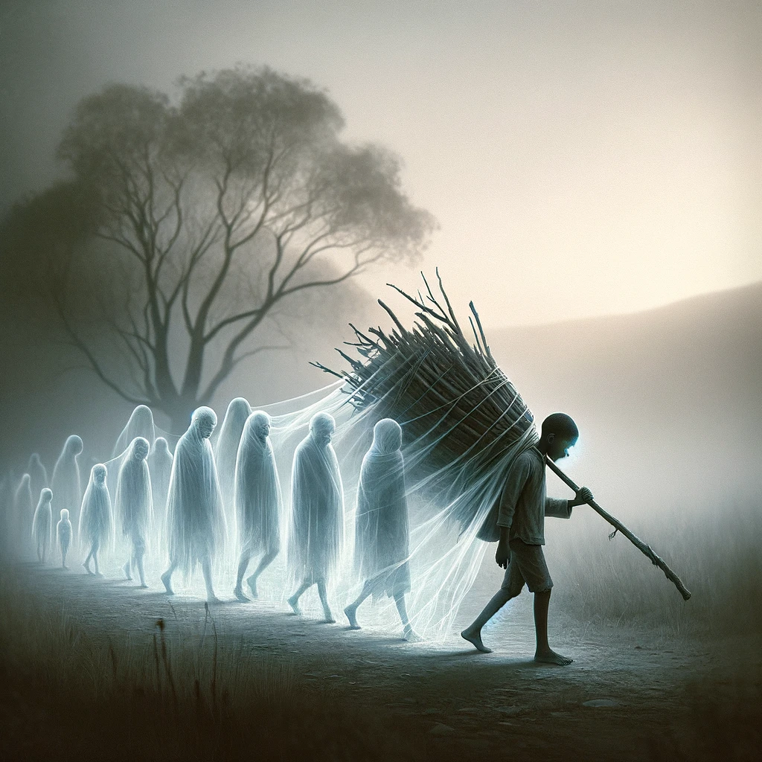
Lineage of carried trauma
Native American youth suicide, 10-19x higher than the national average
Holocaust survivors children and grandchildren; PTSD, nightmares, changes in cortisol baseline
Children born after 1994 in Rwanda exhibit symptoms of post-traumatic stress despite being too young to witness the killing of 800,000 people
Descendants of enslaved Africans in the United States having disproportionally higher rates of PTSD, anxiety, and susceptibility to chronic illness

Slide 13
Movement of generational trauma through cultures
“It was only in the late seventeenth century that white americans began in earnest to formalize a culture of white body supremacy in order to soothe the dissonance that existed between more powerful and less powerful white bodies; to blow centuries of white-on-white trauma through millions of Black and red bodies; and to attempt to colonize the minds of people of all colors. The concept of race was created to help white Americans deal with the hatred and brutality that they and their ancestors had themselves experienced for many generations at the hands of more powerful white bodies. The phantasm of race was conjured to help white people manage their fear and hatred of other white people.”
Victims to oppressors
Carried dehumanization of self translates to dehumanization of others
(Menakem, 2017)

Slide 14
Methods for working with intergenerational trauma
Family Constellations
Re-orient self in the system, increase awareness of greater forces moving in family lineage
EMDR
Can target the belief and somatic energy, doesn’t have to know full story
Parts work
Work with parts to unburden carried family emotional material
Somatic Experiencing
Doesn’t require knowledge of the story, focuses on the somatic experience of the moment
Mark Wolynn’s Core Language Model
Genogram using John Bradshaw material

Slide 15
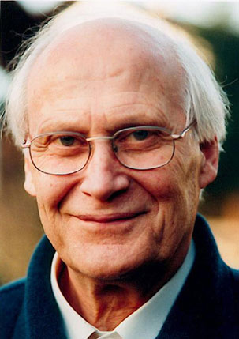
Family constellations
Bert Hellinger
Priest, therapist, philosopher
Heavily influenced by Eric Berne & Zulu Tribe in South Africa
Therapist’s dysfunctional helping position
‘Honor right order instead and helping is easier’
Bow to the great forces of love and harmony in family system

Slide 16
Family constellations principles
Everyone deserves to belong
Right Order and the Flow of Love
Equilibrium
Giving, Receiving, & Guilt/Innocence
Clients become the symptom bearer of a family entanglement
Role of Disease
Atonement and unpaid debts
Following those that are dead
No Victim Principle & Timing

Slide 17
Interventions for intergenerational trauma work
Family Constellations
Reconnect to the Flow of Love and Right Order**

Slide 18
Constellation examples in therapy
Client grew up with father constantly criticizing the mother for cheating. As a child the client is loyal to the father outwardly and secretly loyal to the mother. Client takes on rejected traits of their mother and perpetually acts out sexually in relationships as a means of loving their mother and drawing them closer
Have client surrender the carried traits to the responsible party
Have client stand in the place of their war veteran grandfather, feel his position in the family, feel his history, then stand in mother’s place and feel her terror
Gain acceptance of parents, move through resentment and blockage of access to strength from the lineage

Slide 19
Wolynn core language model
Book is a self-facilitated constellations guide to addressing ancestral issues through use of Core Language Model
Elicits non-declarative or implicit memory, some of which might be shared with ancestors
Focus on language/behavior that carries most emotional or somatic material attached to it, seems idiosyncratic or unusual, different kind of listening
4 Unconscious Themes
1. We have merged with a parent
2. We have rejected a parent
3. We have experienced an early break in the bond with our mother
4. We have identified with a member of the family system other than our parents
Ex: A child later in the lineup identifies with a previous child who has died. That child expresses what the family has repressed, takes on the lack of existence (depression, not being fully actualized) of their sibling to call attention back to them.

Slide 20
Releasing carried burdens
Method: Psychodrama, Gestalt, Pia Mellody’s Cathartic Release Protocol
Have client sit in chair or stand
Presence parents, grandparents or other identified people in the lineage
Facilitate release and surrender of carried emotional material to the family members
Use words, sounds, body movements, and symbols
Use clients as representatives in a group
Chairs
Visualization

Slide 21
The legacy of shame
John Bradshaw and “Carried Family Shame”
“We’re only as sick as our secrets” & Constellations: Everyone deserves to belong
Have clients create genogram highlighting
Addiction
Trauma
Murders, sexual assaults, acts of violence
Cross generational bonding & emotional incest
Identify people who aren’t spoken of
Died early in life, abortions
Sources of shame in the family

Slide 22
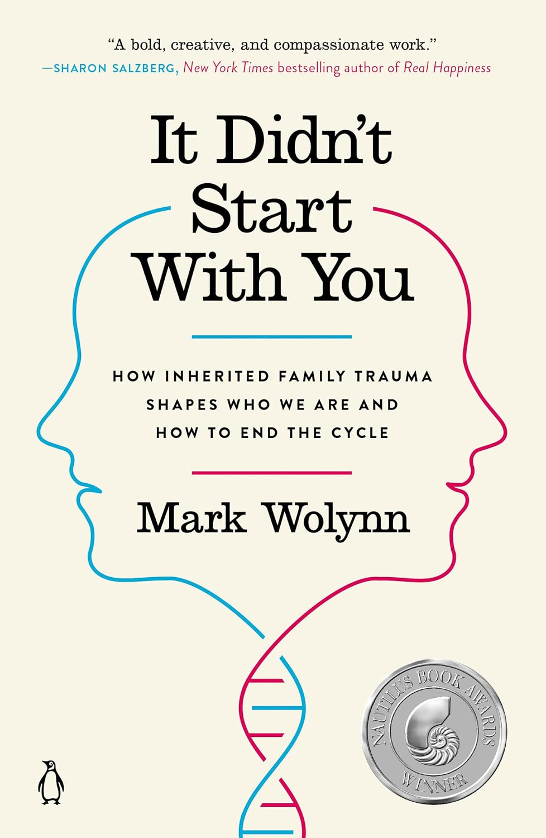
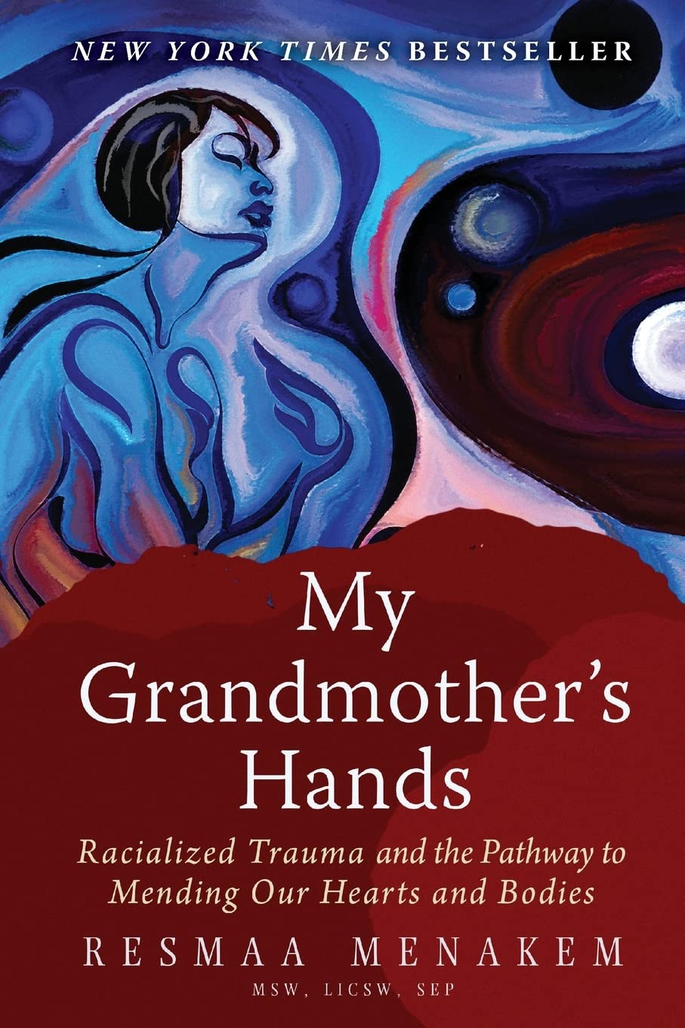
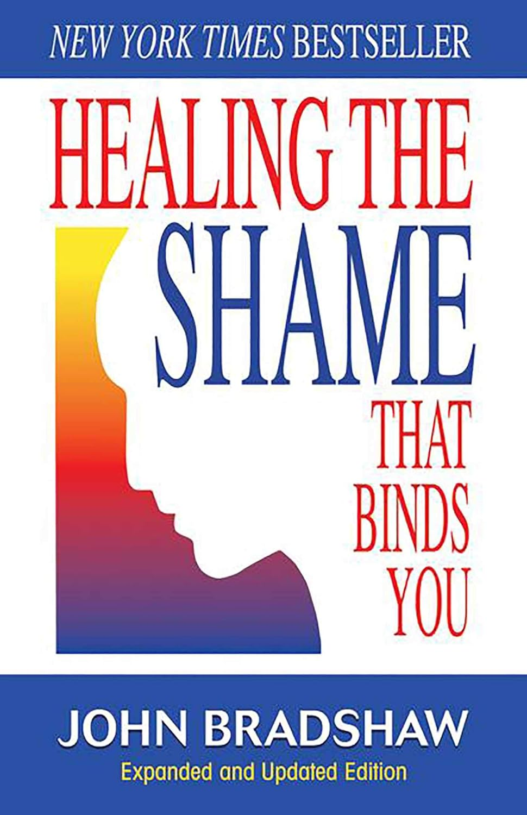
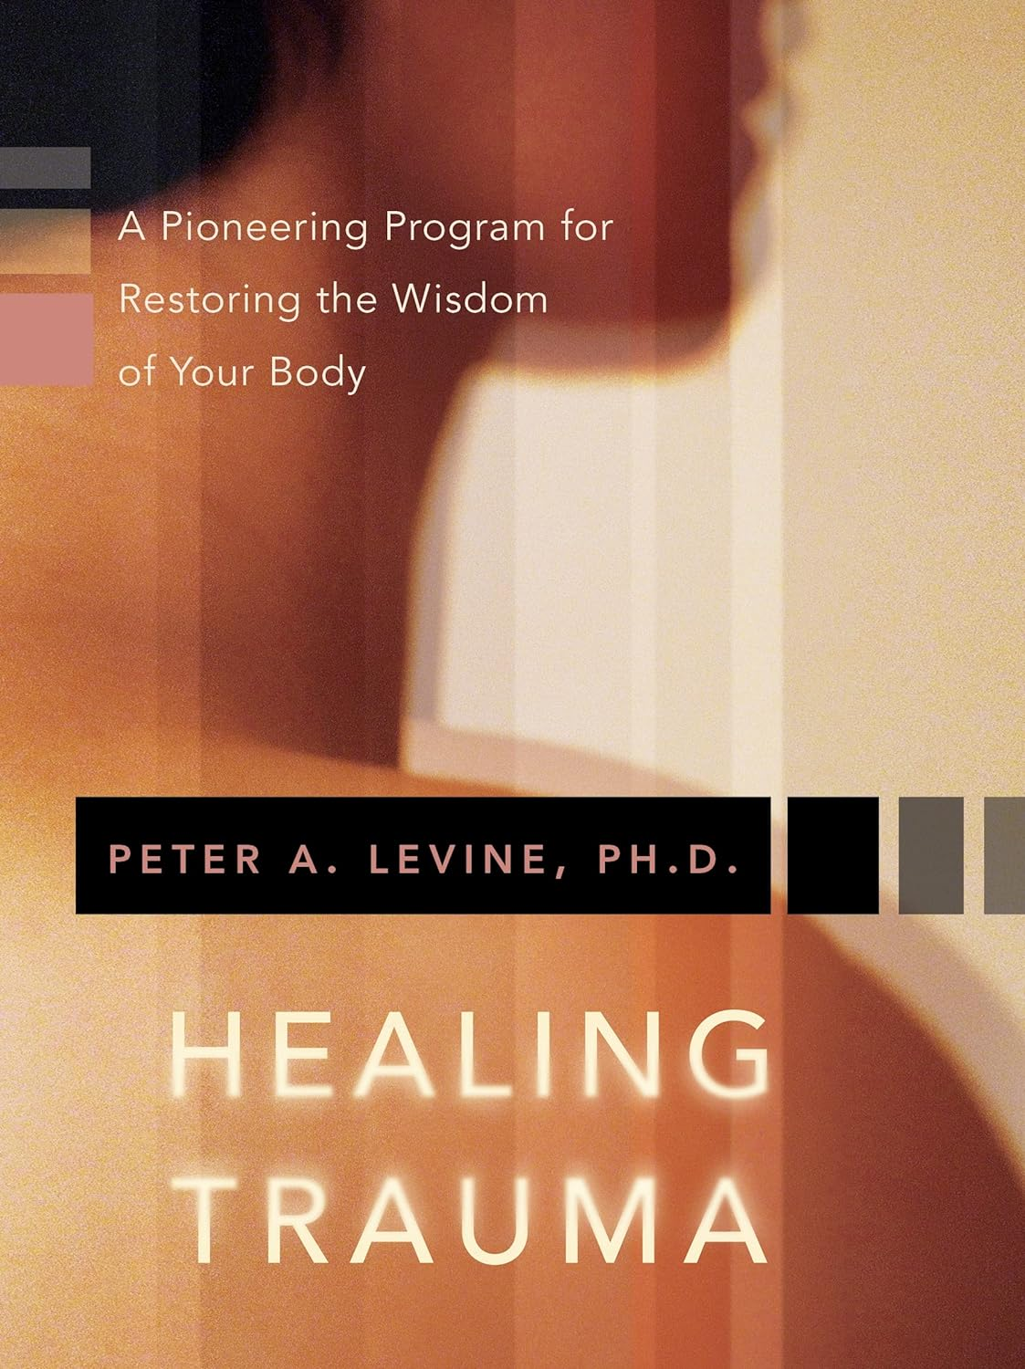
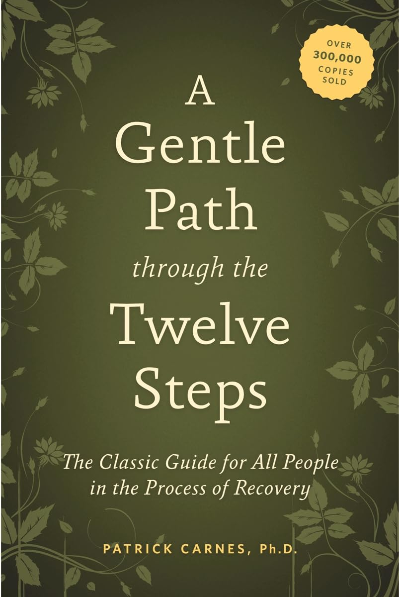
Reading recommendations

Slide 23
references
Bergman, K., Sarkar, P., O'Connor, T. G., Modi, N., & Glover, V. (2010). Maternal prenatal cortisol and infant cognitive development: moderation by infant-mother attachment. Biological Psychiatry, 67(11), 1026-1032. https://doi.org/10.1016/j.biopsych.2010.01.002
Hellinger, B. (2008). Rising in Love. Hellinger Publications.
Lipton, B. H. (2015, July 10). How is my research linked to epigenetics? Bruce H. Lipton, PhD. Retrieved from https://www.brucelipton.com/how-my-research-linked-epigenetics/
Nuwer, R. (2013, December 3). Baby Mice Can Inherit Fear of Certain Smells From Their Parents. Smithsonian Magazine. Retrieved from https://www.smithsonianmag.com/smart-news/baby-mice-can-inherit-fear-of-certain-smells-from-their-parents-180948096/
Wolynn, M. (2016). It didn't start with you: How inherited family trauma shapes who we are and how to end the cycle. Penguin Books.
Yehuda, R., Daskalakis, N. P., Bierer, L. M., Bader, H. N., Klengel, T., Holsboer, F., & Binder, E. B. (2015). Holocaust Exposure Induced Intergenerational Effects on FKBP5 Methylation. Biological Psychiatry, 80(5), 372-380. https://doi.org/10.1016/j.biopsych.2015.08.005

