Slide 1

Back to the Future
Scott Teitelbaum, MD, FAAP, DFASAM
Pottash Professor in Psychiatry and Neuroscience
University of Florida College of Medicine
Department of Psychiatry
Division Chief of Addiction Medicine
Medical Director, Florida Recovery Center

Slide 2
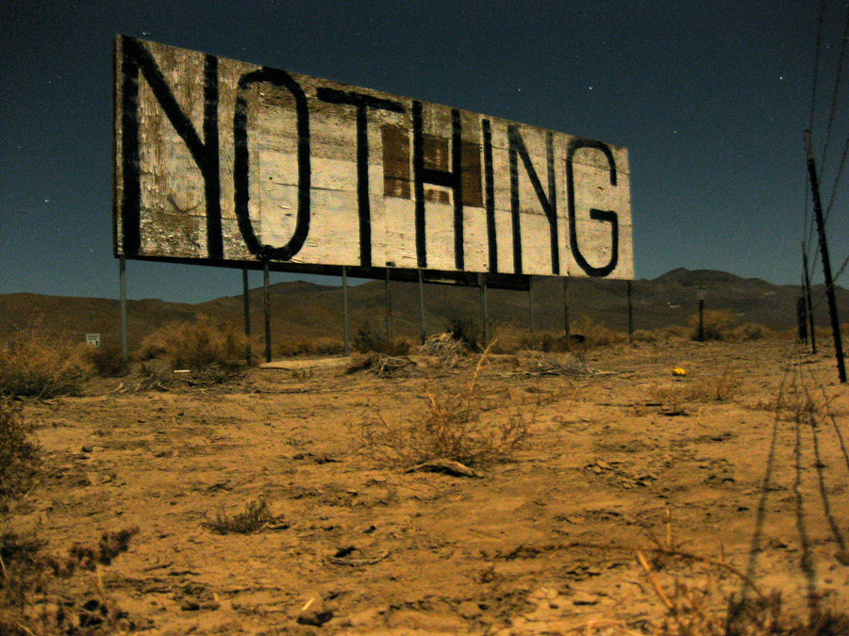
Disclosure

Slide 3
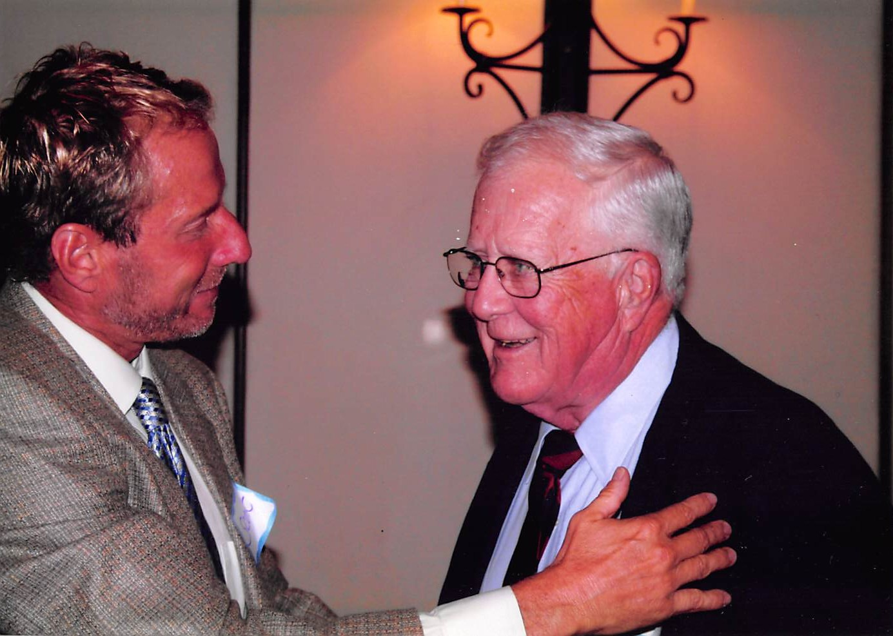

Slide 4
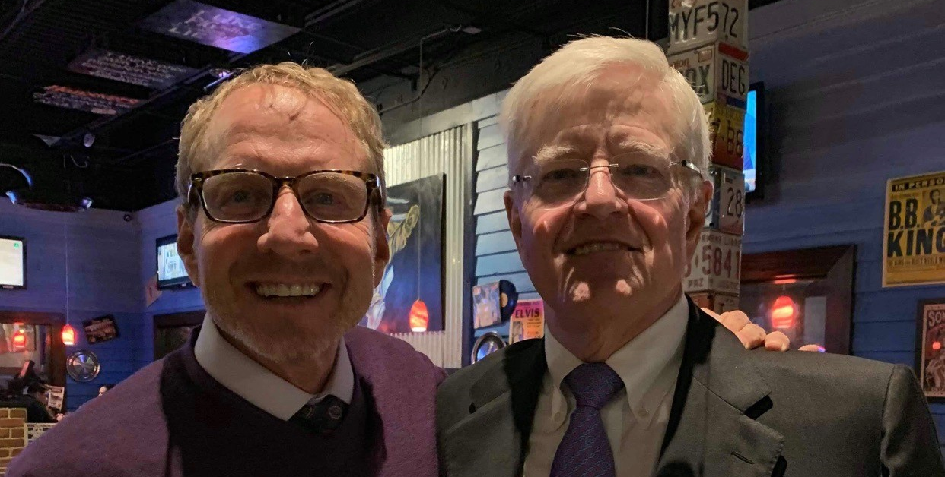

Slide 5
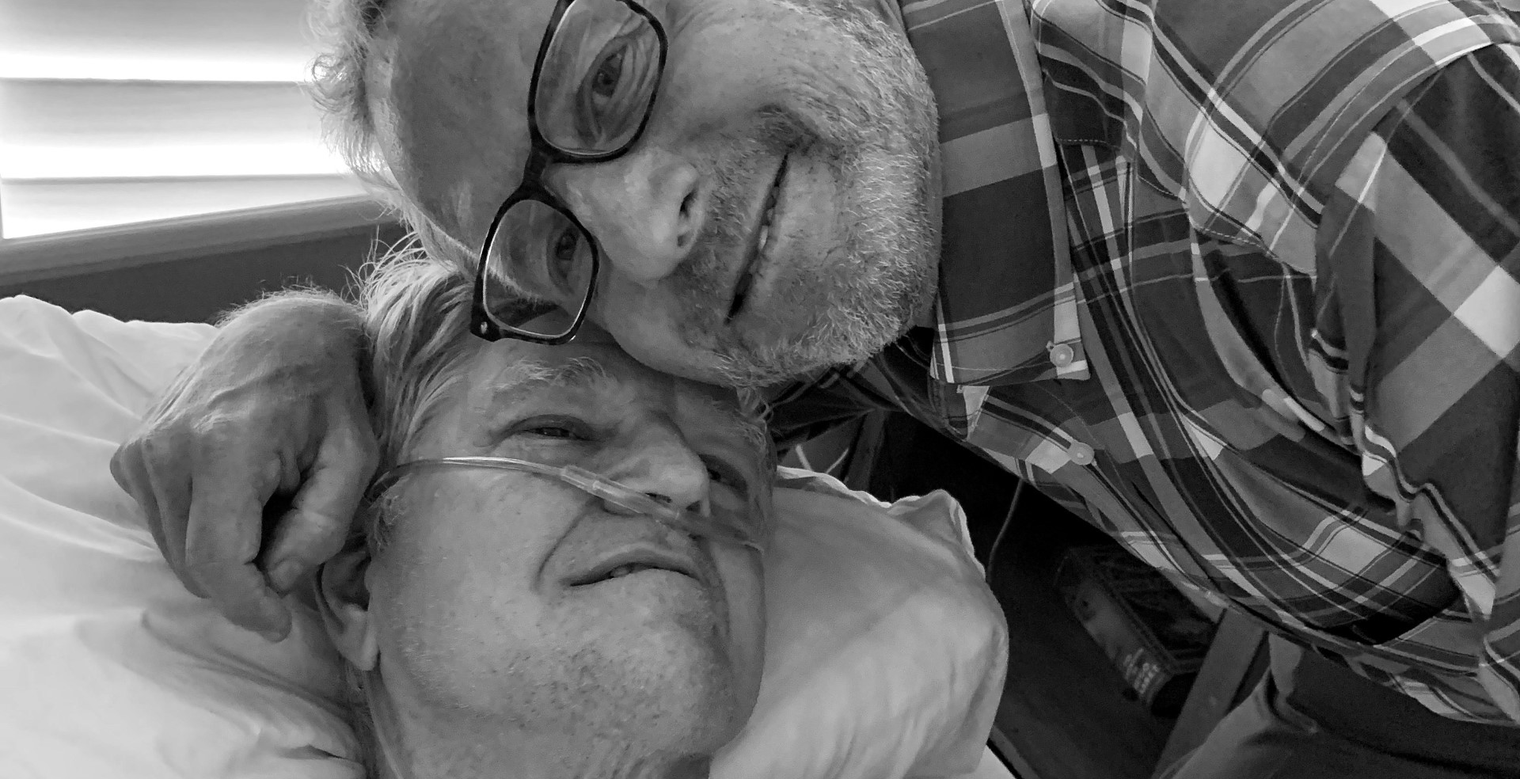

Slide 6
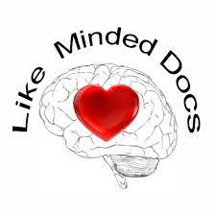
Like Minded Docs
(beginnings)
A growing number of addiction medicine doctors had become concerned about the direction ASAM seemed to be going.
We saw a strong emphasis on use of medications and development of new medications to treat addiction, with disregard for psychosocial and spiritual interventions as effective, evidence-based approaches to initiating and maintaining recovery from substance use disorders and other addictions.
In 2012, a small group of ASAM members, led by Ken Thompson, M.D., began organizing a collective of physicians with similar concerns, which became Like Minded Docs.

Slide 7
Objectives
To review and understand the history and evolution of addiction treatment and recovery in the United States
To review and understand the factors that led to the demise of the treatment field
To review and understand the history of the rebirth of Addiction Medicine and evolution of the field with a focus on the medicalization of psychoactive substances
To review and understand the lessons from history and where we are today

Slide 8
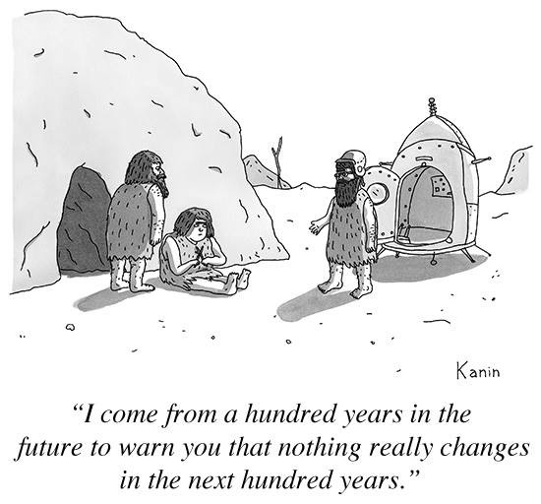

Slide 9
Seeds of Addiction Medicine
Problem of Language
1784 – Benjamin Rush, An Inquiry into the effects of Ardent Spirits
Intemperance, Dipsomania, Inebriety
Magnus Huss – coined Alcoholism 1849
Alcohol and Substance abuse and dependence
chemical dependency, addiction, substance use disorders etc .

Slide 10
Early Professionalization
(1730 – 1900)

Slide 11
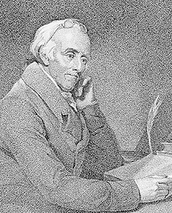
Rush, Benjamin; 1745-1813; physician, educator, humanitarian, patriot leader, writer; a physician in Philadelphia; Professor of Chemistry, College of Phila.; in 1774 helped organize society favoring abolition of slavery and its president, 1803; member Pa. Provincial Convention, 1776--a leader for Independence; member of Continental Congress, 1776, and a signer of Declaration of Independence; Surgeon General of part of army, 1777; lecturer at Pa. State College, 1778 and helped found Dickinson College, 1783--one of its trustees; member of Pa. Convention which ratified U.S. Constitution--a leader for ratification; in 1789 helped adopt improved State Constitution; a vigorous supporter of prison reform, better education, and other social progress.
Alcohol is addicting!
Rush is considered one of the greatest physicians of American history. He called for the restriction of alcohol and tobacco use, proposed the study of veterinary medicine, and wrote the first American textbook on psychiatry.

Slide 12
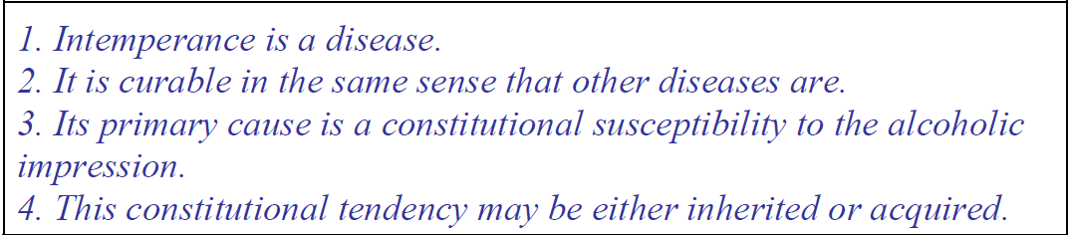
Bylaws of the American Association for the Study and Cure of Inebriety (1870)

Slide 13
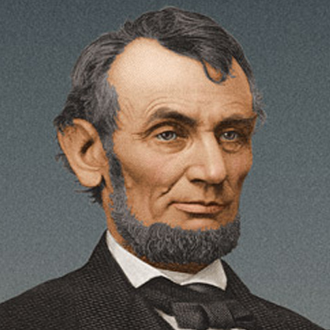
Abraham Lincoln on Alcoholism
… “In my judgment such of us as have never fallen victims have been spared more from the absence of appetite than from any mental or moral superiority…."
… “I believe if we take habitual drunkards as a class, their heads and their hearts will bear an advantageous comparison with those of any other class.
…“The victims of it were to be pitied and compassionated, just as are the heirs of consumption and other hereditary diseases.."
From Lincoln's address to the Washington Temperance Society, Springfield, Ill.
February 22 1842

Slide 14
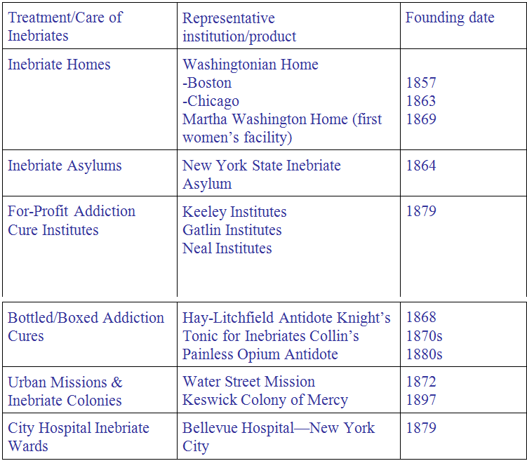
Professionalized Treatment of Addiction in the Nineteenth Century

Slide 15
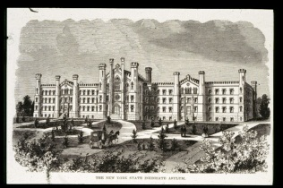
NY State Inebriate Asylum

Slide 16
Treatment Franchises
Kelley Institutes (1840-1966) – Dr. Leslie Keeley
Double Chloride of Gold Remedies
Believed Heredity and Childhood Exposure to Alcohol Critical
Treatment at Keeley Institutes
^ 4 weeks
4x/day injection of Keeley remedy
Focus on regular sleep, exercise, health recreation, abstinence and careful selection of friends
Keeley Legacy
Contents of remedy never revealed
Approach carried aura of scientific truth and lots of emotional intensity
Helped pioneer disease model
Hired recovered alcoholics
Social milieu of received shots greatest legacy

Slide 17
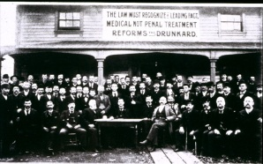
Keeley League No. 1 in Open Air Session, Dwight, Illinois

Slide 18
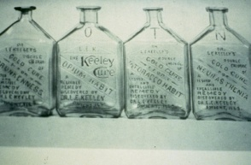
Keeley Home Cure Bottles

Slide 19
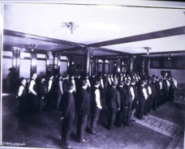
Keeley Patients in Line for Shots

Slide 20
Miracle Cures
Medicine still not “established”
Premise – secrecy, low cost, quick fix (no long term treatment)
Often contained cocaine, alcohol, morphine
Fraud as a theme in treatment of the addicted

Slide 21
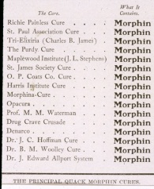
Collier’s List of Quack Cures

Slide 22
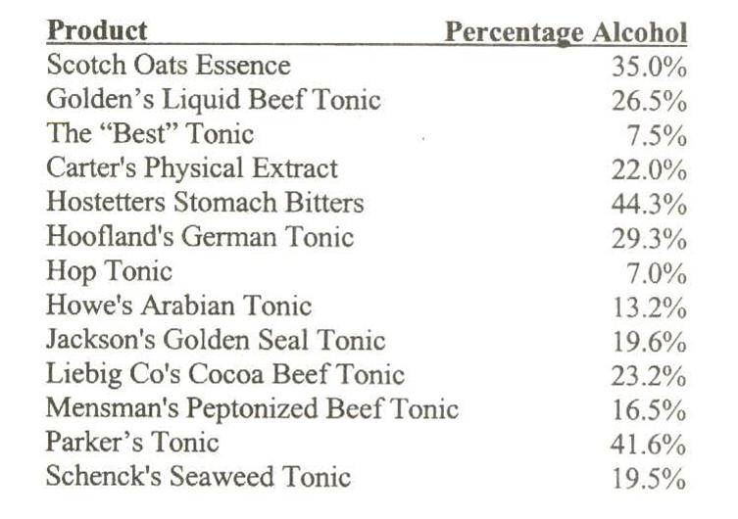

Slide 23
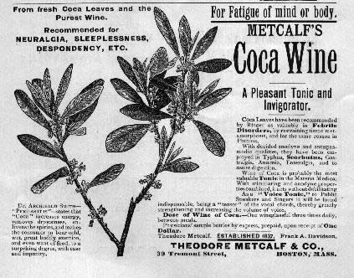

Slide 24
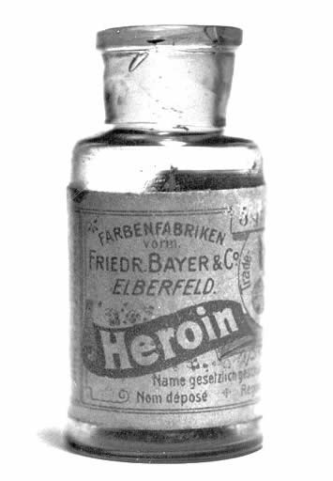
Might Not Meet Today’s FDA Standards

Slide 25
Religious Influences
“Skid Row” Alcoholic
Water Street Mission – Jerry McAuley
Salvation Army - William Booth 1878
Focus on Religious Conversion

Slide 26
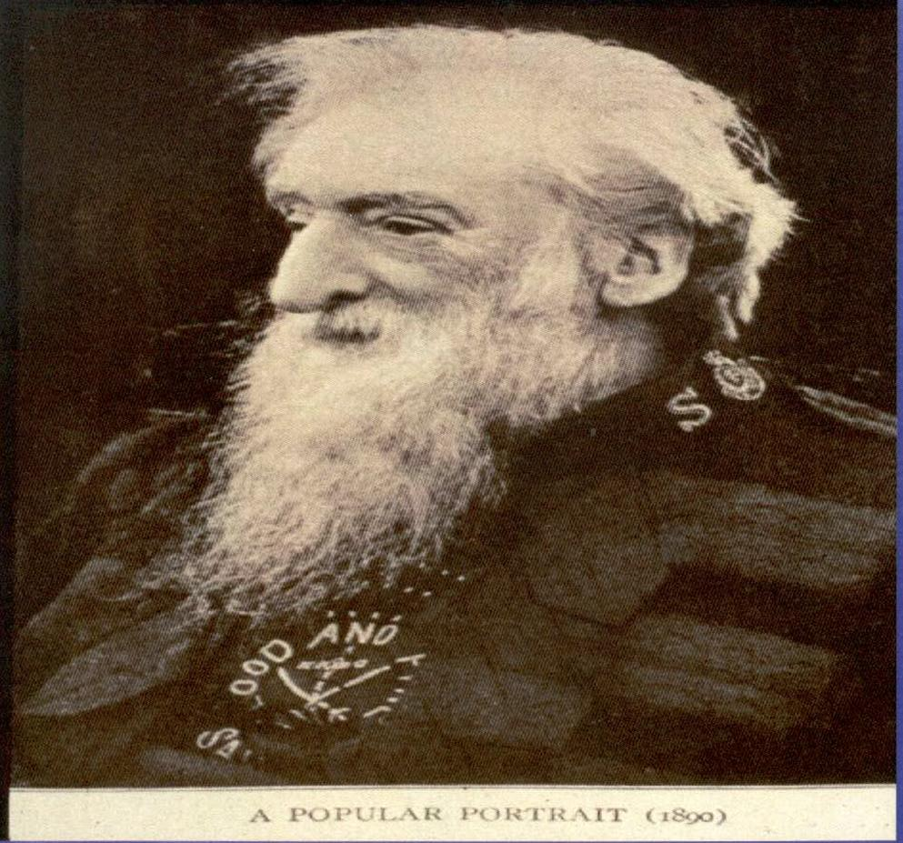
William Booth, Founder – Salvation Army

Slide 27
Early Seeds
Temperance Movement
  Process of moral reformation
  Moved from moderation to abstinence
  Initial focus on alcohol moved to other drugs after civil ware
  Moved from individual to shared recovery

Slide 28
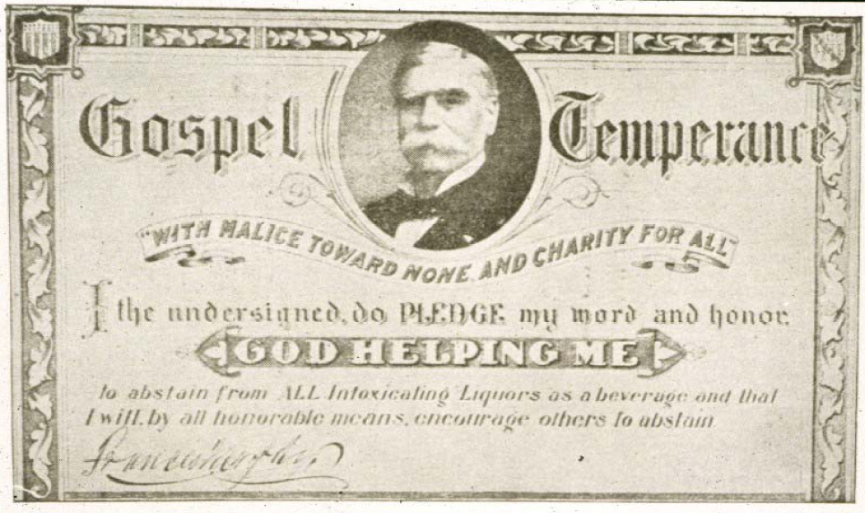
The Gospel Temperance Pledge
Murphy Pledge Card

Slide 29
Washingtonian Revival
Followed Struggling Temperance Movement
Leaders from Working Class, in Contrast to Temperance Elite
Ritual of Public Confessions by Charismatic Leaders

Slide 30
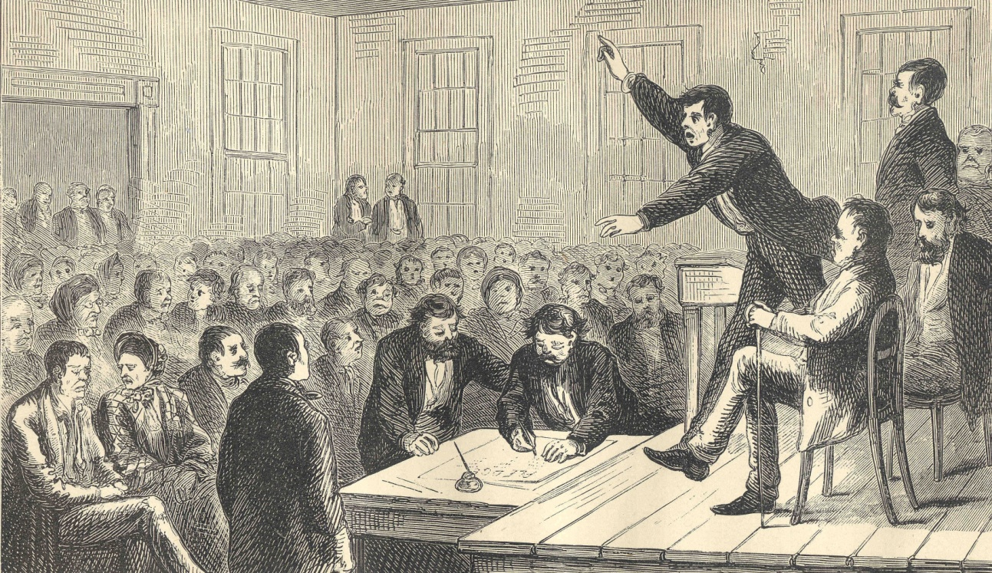
Washingtonian Meeting

Slide 31
Washingtonians Movement
1st Mutual Aid Society for Alcoholics
Laid foundation which included focus on:
Welfare and reformation of individual alcoholic
Abstinence
Fellowship
Sharing Recovery
Spiritual foundation
Demise – secondary to ideological issues and relapse of reformed drinkers

Slide 32
Fall of 19th Century Treatment
Inadequate Clinical Technology/Science
Fragmentation of Field
Ethical Abuses/ Public Exposure
Failure of Leadership Development
Social Policy Shifts--Criminalization
Economic Depressions

Slide 33
De-medicalization and Collapse of Addiction Treatment
(1900 – 1935)

Slide 34
A Shameful Regression
• Inebriate Penal Colonies
• Insane Asylums
• “Foul wards” and “cells” of urban hospitals
• Invasive Treatments, e.g., mandatory
sterilization, ECT, psychosurgeries

Slide 35
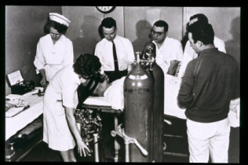
Electroshock Therapy

Slide 36
Treatment Setting 1900 - 1940
Inebriate Farm / Colony – T.D. Crothers
Local Hospital
Local Psychopathic Hospital
State Insane Asylums
Private Sanitarium
“Every time we’ve taken a drunk in this place, we’ve regretted it.” Dr. Quigley, 1930

Slide 37
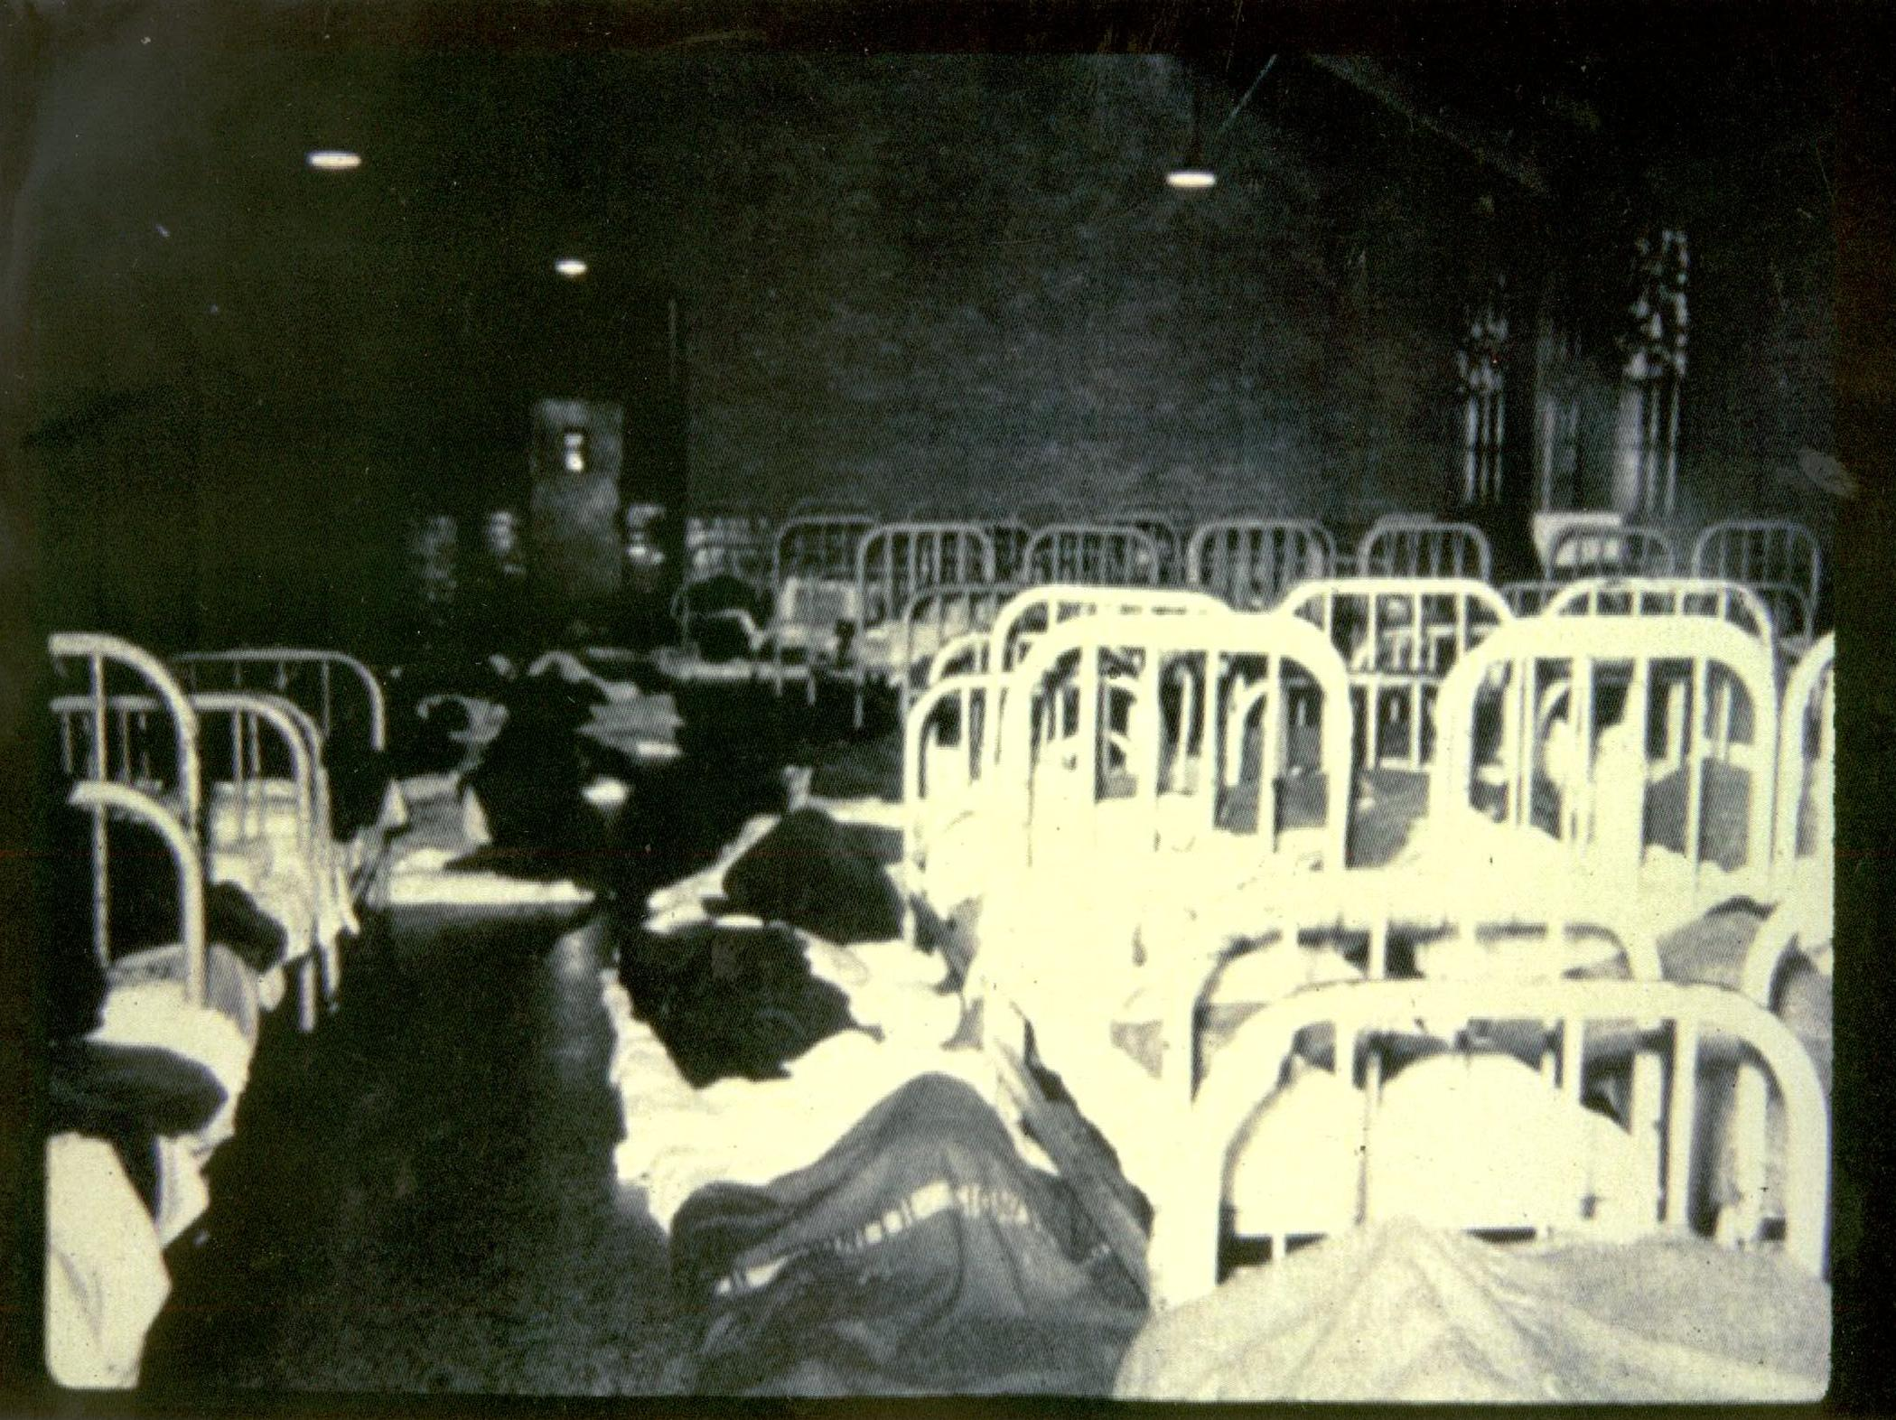
A Shameful Regression

Slide 38
Previous Medical Approaches to Alcoholism
Benjamin Rush used bleeding, blistering and treatment with mercury laden calomel
Water Cures
Drugs: Cocaine, Morphine, Bromide (20% fatality)
Drink wine in which eels suffocated
Aversion
ECT, Psycho-surgery
Mandatory sterilization

Slide 39
Psychiatry Influence
Karl Abraham 1908 essay “The Psychological Relations Between Sexuality and Alcoholism”
1920’s Dr. Lawrence Kolb – series of articles portraying substance use disorder as psychopathic in nature
First American standard nomenclature of disease 1933 – “Alcohol and Drug Addiction classified as personality disorders
Freud – fixation on oral stage of developement

Slide 40
Addiction to Narcotics and Other Drugs
1880 - 1925
Cocaine and Freud
Opiate Addiction – Hidden Disease
Treatment Mostly “cold turkey and tapers”
Drastic change after Harrison Act (1914)
Criminalization followed

Slide 41
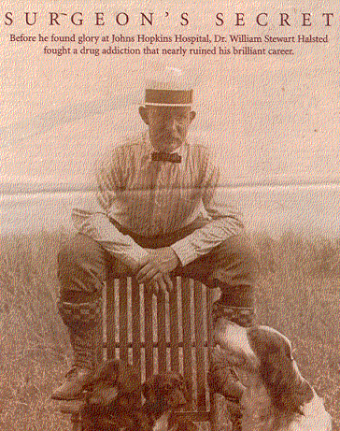
Only after his secret diary was opened in the 1960s did we discover that, after cocaine, Halstead had become addicted to morphine, and remained so for the remainder of his life.
Notes:
Only after his secret diary was opened in the 1960s did we discover that, after cocaine, Halstead had become addicted to morphine, and remained so for the remainder of his life. Halstead had a difficult time with morphine, but he was able to achieve a great deal. He could never have done so if he had remained on a stimulant.

Slide 42
The Rebirth of Addiction Medicine
(1935-1970)
Medical rather than penial treatment for opioid addiction
US Public Health Hospitals – Lexington, KY, Fort Worth, TX: “Narcotic Farms”
Many Doctors – Marie Nyswander, M.D., George Vaillant, M.D. got their start

Slide 43
Narcotics and Other Drugs
1925 - 1950
Hidden Drug Maintenance
Federal Narcotic Farms:
Lexington, KY and Fort Worth Texas
primary source of treatment, 1938 – 1950
Isolation of the Addict
Great Majority of Addicts Relapse

Slide 44
1920 – 1950 Opioid Hidden Maintenance
Doctor Shopping
“Pain” Complaints
Prescription Forgery

Slide 45
Narcotic Farms
Patients with Spectrum of Profiles
Long Treatment (Voluntary vs Involuntary)
Little (no) Involvement of Family
High Relapse Rate
Labor Focused

Slide 46
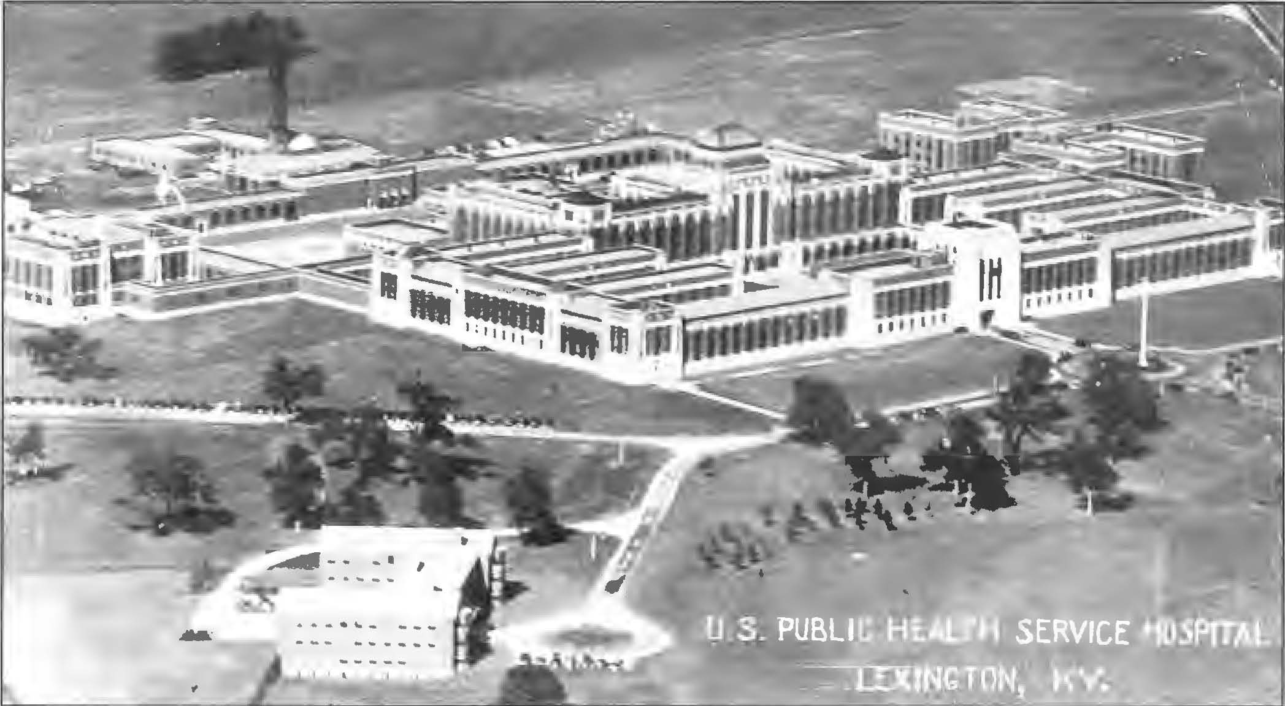
Federal “Narcotics Farm,” Lexington, Kentucky

Slide 47
1956:
American Medical Association
Alcoholism is a Disease
Report of the Board of Trustees. JAMA 162:750, 1956
June, 1987, AMA passed a resolution that all drug addictions are one disease
Notes:
American Medical Association
The American Medical Association is widely believed to have first accepted alcoholism as a disease in 1956. Dr. David Smith, however, has stated that the original resolution to do so was introduced in 1956, but was not officially ratified until 1966. In February, 1987, Dr. Smith introduced a motion that the AMA include all mood-altering drugs in the disease of chemical dependence, and the American Medical Society on Alcoholism and Other Drug Dependencies introduced the same motion in June, 1987. The AMA then passed a resolution that all drug addictions are one disease.

Slide 48
Modern Alcoholism Movement
  1930-1955 Radical Re-definition of Alcohol Problems
  Contextual Factors
    - Repeal of Prohibition
    - Great Depression
    - Rising Public Health Movement
  The Role of the Alcohol Industry
    - Wet vs. Dry (Alcoholism Safe Topic)
  Workplace, Church, State, Philanthropy
  Changing view of Alcoholism

Slide 49
The Modern Alcoholism Movement
Alcoholics Anonymous
Research Council on Problems of Alcohol
Yale Center for Alcohol Studies
National Committee for Education on Alcoholism

Slide 50
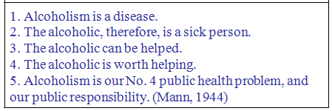
Anderson and Mann’s Five “Kinetic” Ideas

Slide 51
Birth of AA
Timing
Carl Jung, Rowland H. failed treatment
Oxford Groups
12 Steps - 1938
12 Traditions - 1946
12 & 12 - 1953

Slide 52
Key Influences on Alcoholics Anonymous Recovery Movement
Roland H.
Carl G. Jung
Ebby T.
Bill Wilson - William James
The Oxford Group
Dr. Silkworth
Bill Wilson
Dr. Bob Smith
Notes:
1930’s cast of characters…
Inspired by Spirit
Some say Divine Intervention
See what you think………

Slide 53
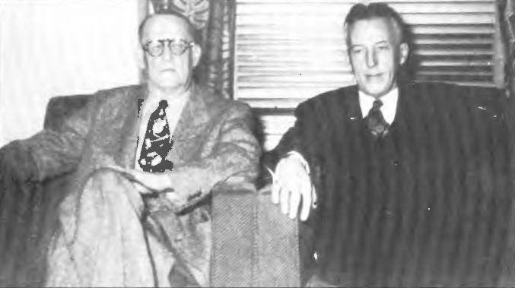
Dr. Robert Smith and Bill Wilson – A.A. Co-founders

Slide 54
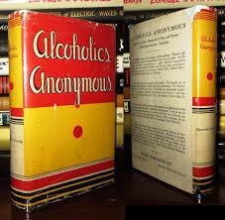
AA Big Book First Edition published in 1939, defined alcoholism as a three-fold disease that affects the individual physically, mentally and spiritually.
American Medical Association categorized Alcoholism as a Illness in 1956.
Notes:
However, in 1956 the American Medical Association (AMA) proclaimed alcoholism an "illness." Then, in 1966, the AMA proclaimed alcoholism a disease. - See more at: http://www.baldwinresearch.com/alcoholism.cfm#sthash.MUJnbvbB.dpuf

Slide 55
Circa 1938
An illness of this sort—and we have come to believe it an illness—involves those about us in a way no other human sickness can. If a person has cancer all are sorry for him and no one is angry or hurt. But not so with the alcoholic illness, for with it there goes anni­hilation of all the things worthwhile in life. It engulfs all whose lives touch the sufferer’s. It brings misun­derstanding, fierce resentment, financial insecurity, disgusted friends and employers, warped lives of blameless children, sad wives and parents—anyone can increase the list.
-Big Book of Alcoholics Anonymous, page 18

Slide 56
Three of AA’s Historical Innovations
Emancipated spirituality from its roots in religious institutions
Legitimized varieties of spiritual experiences in recovery
Separated antidotes for guilt from religion: self-inventory, confession, acts of restitution, acts of service

Slide 57
Program
Prescribed beliefs, values and behaviors of 12-Step Organizations. The 12-Steps.
Fellowship
Practice, activities and experience of a 12-Step organization: e.g. service, helping others, sharing, “working the Steps” etc.

Slide 58
“Alcoholics Anonymous has been called the most significant phenomenon in the history of ideas in the 20th Century”
Quote from Lasker Award Citation to AA, 1951.

Slide 59
Mid-Century Medical Treatment
1940’s to 1950 – Insulin Shock Therapy, ECT, Psychosurgery
Medically infecting alcoholics with Gonorrhea
Natural Therapies
Biggest Changes – Drug Interventions
Sedative, Tranquilizers, Amphetamines (including Meth), LSD, Hallucinogens, Hormones, Co₂,
1972 – Study 15,000 Docs ~ 65% prescribed benzo’s past detox!
Methadone – Opiate Maintenance

Slide 60
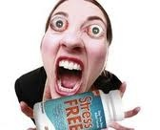

Slide 61
Mid Century Addiction Treatment
Increase in drug (heroin) use especially in juveniles
Eisenhower “new war on narcotic addiction”
Treatment for drug addiction lagged behind alcoholism treatment - Methadone just arriving
Methadone use for heroin addiction in mid 1960’s
Narcotics Anonymous

Slide 62
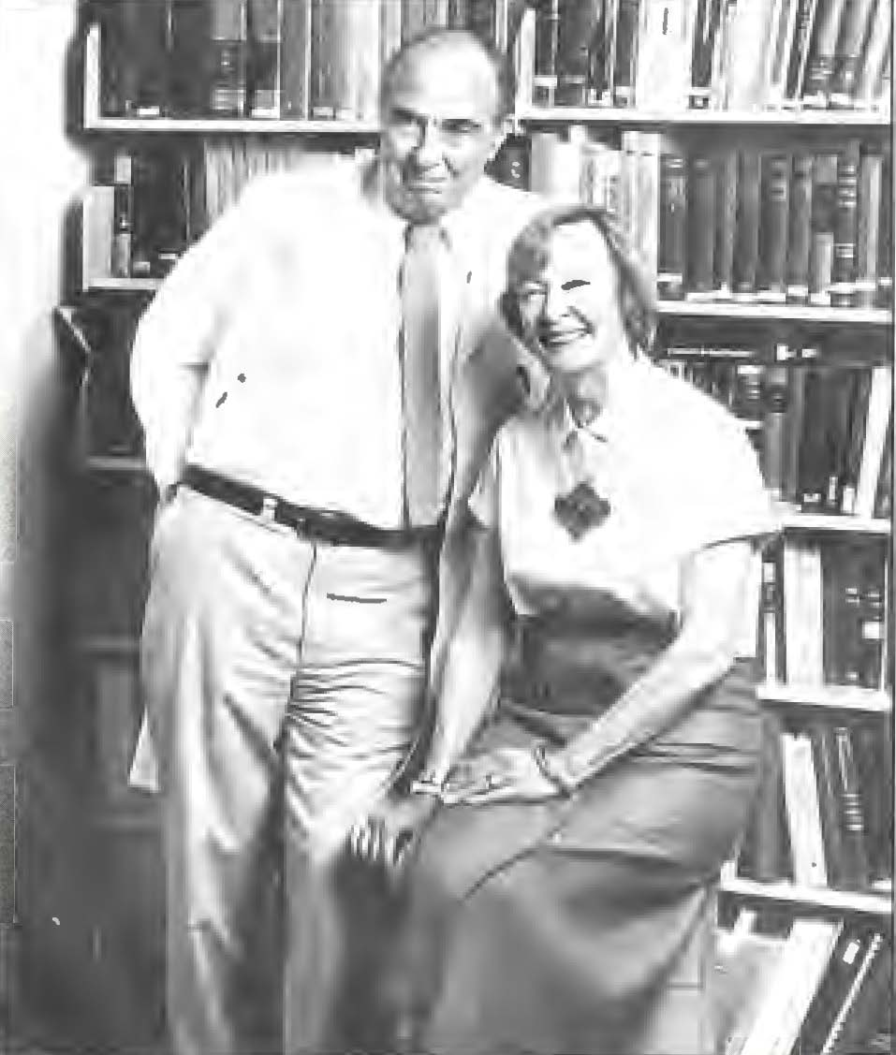
Dr. Vincent Dole and Dr. Marie Nyswander
Methadone Pioneers

Slide 63
They felt, without reading out reports carefully, that all they had to do was give methadone and then there was no more problem with the addicts. As best I could, at meetings and in publications, I urged that physicians should see that the problem was one of rehabilitating people with a very complicated mixture of social problems on top of a specific medical problem, and that they ought to tailor their programs to the kinds of problems they were dealing with.
-Vincent Dole

Slide 64
Integrating Spirituality and Professional Treatment
Pioneer House, Hazelden, Willmar, State Hospital
Minnesota Model
From Hazelden to Lutheran General/ Parkside & the world

Slide 65
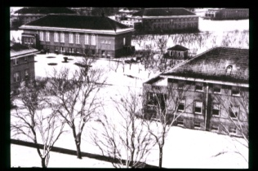
Willmar State Hospital, 1940’s

Slide 66
Elements of MN Model
Alcoholism is an involuntary, primary, chronic, progressive biopsychosocial (& spiritual) disease
Recovery is contingent upon, but is more than, abstinence from all non non-medical alcohol and other drug use. Early conceptualization of “chemical dependency”
Recovery best achieved through the Twelve Steps of AA and immersion in a community of shared experience, strength & hope.

Slide 67
Elements of MN Model cont..
Focus on direct treatment of the disease. Abandonment of psychoanalytic and moral views of addiction
Addiction best treated in a milieu of dignity and respect
Altered view of motivation
  Motivation or lack of it at intake is not a predictor of outcome
  Motivation is as much the responsibility of the milieu as of the patient

Slide 68
Achievements 1960-1980
Federal/State/Local Partnership
Alcoholism Education and Local Treatment
De-stigmatization
Decriminalization/Diversion
Medicalization
Betty Ford and the “Recovery Movement”

Slide 69
1980’s & 1990’s
• Commercialization and Profiteering
• An Ideological Backlash
  Addiction is a myth.
  Excessive AOD learned, not a disease.
  Treatment and mutual aid ineffective and harmful.
  Treatment experiment is a failure and should be de-funded.

Slide 70
1980’s & 1990’s cont.…
• Financial Backlash
  UR and QA
  Managed Care
  Closure/downsizing of Hospital Hospital-based and private programs
  Mergers and emergence of large “behavioral health systems”

Slide 71
Retreat Through the
1980’s and Early 1990’s
Cultural and policy shifts (Zero Tolerance)
Restigmatization
Demedicalization
Recriminalization

Slide 72
Disease ?
… drug addiction is not a mysterious disease … drug addiction is simply a degrading, debasing habit, and it is not necessary to consider this indulgence in any other light than an antisocial one.
Dr. Dana Hubbard
NYC Department of Public Health

Slide 73
Modern Evolution of Addiction Treatment
Deluge of Addiction Treatment Legislation
1970 – Hughes Act Comprehensive Alcoholism Treatment and Prevention Act
NIAAA / NIDA
Two Worlds: Alcoholism and Drug Addiction
Rebirth of Addiction Medicine
ASAM - 1983
Hidden Story: Exploitation and Relapse of Recovery Folks

Slide 74
Addiction Medicine Comes of Age
(1970 - Present)
NYSMS on Alcoholism – Dr. Ruth Fox
AMSA → ASAM in 1983
ASAM with numerous achievements
    Membership in AMA
    Advocacy for AMA to be designated as speciality (1990)
    Certification and research
    Annual scientific conference
    Text, journal, PPC (new ASAM criteria)
    Formation of ABAM in 2007

Slide 75
Where We Are Now
Coming of Age:
ASAM, ABAM, ABMS(ABPM) recognition (fellowships)
New Technology – MOUD, TMS, etc
Unintentional Consequences of Getting What we Want?
Have we learned from history?

Slide 76
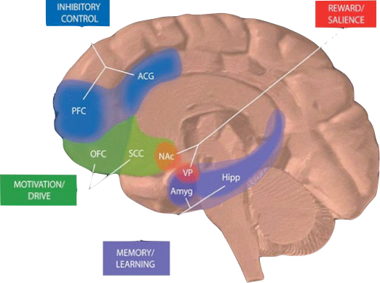
    A primary, chronic disease of brain reward,
    motivation,
    memory and
    related circuitry

Slide 77
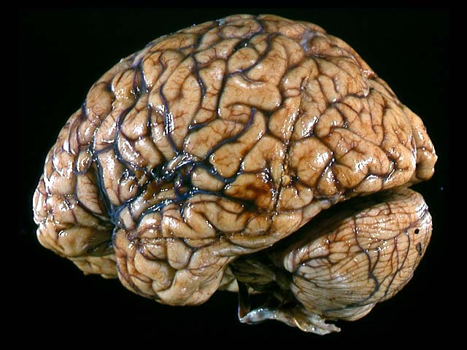
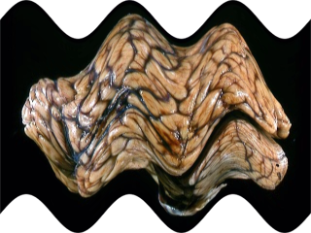
Brain of the addicted is fundamentally different:
Gene expression (Liu, Nickolendko 1994; Daunais & McGinty 1995)
Glucose metabolism (Volkow, Gillespie, 1996)
Responsiveness to environmental cues (O’Brien, Childress, 1993; Kilgus & Pumariega, 1994)

Slide 78
ASAM Definition of Addiction
Addiction is a primary, chronic disease of brain reward, motivation, memory and related circuitry. Dysfunction in these circuits leads to characteristic biological, psychological, social and spiritual manifestations. This is reflected in an individual pathologically pursuing reward and/or relief by substance use and other behaviors.
Addiction is characterized by inability to consistently abstain, impairment in behavioral control, craving, diminished recognition of significant problems with one’s behaviors and interpersonal relationships, and a dysfunctional emotional response. Like other chronic diseases, addiction often involves cycles of relapse and remission. Without treatment or engagement in recovery activities, addiction is progressive and can result in disability or premature death.

Slide 79
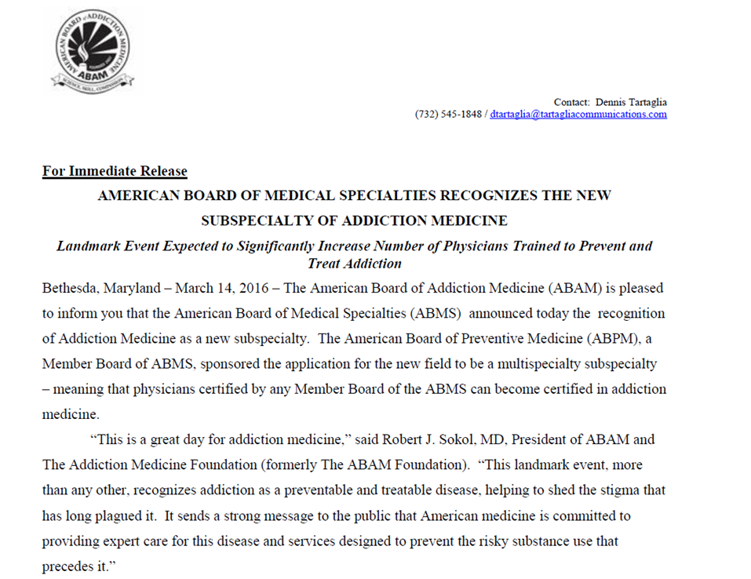

Slide 80
ASAM NEW
DEFINITION OF ADDICTION
Definition:
Addiction is a treatable, chronic medical disease involving complex interactions among brain circuits, genetics, the environment, and an individual’s life experiences. People with addiction use substances or engage in behaviors that become compulsive and often continue despite harmful consequences.
Prevention efforts and treatment approaches for addiction are generally as successful as those for other chronic diseases.

Slide 81

Designer Drugs:
What’s New & Ongoing
G
Speed
E
Ecstasy
BZP
Special K
Pot
Crystal
DMT

Slide 82
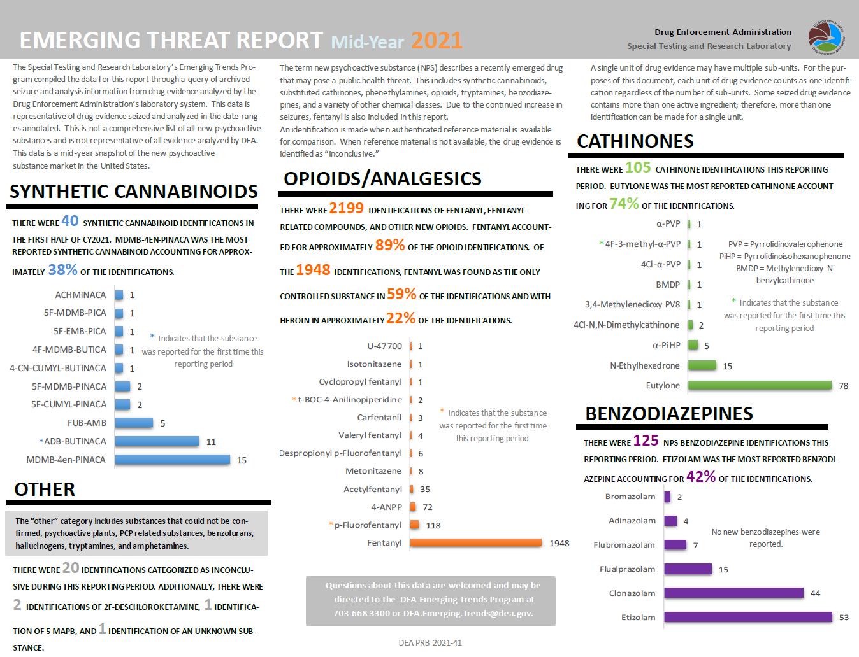
Notes:
As noted in the header of this table, this represents the most recent snapshot of NPS seized and analyzed by the DEA. The challenge here is that many, if not most, commercial labs do not have assays for these NPS. I recall that the opioid ISOTONITAZENE and the benzo ETIZOLAM are of interest to you?

Slide 83
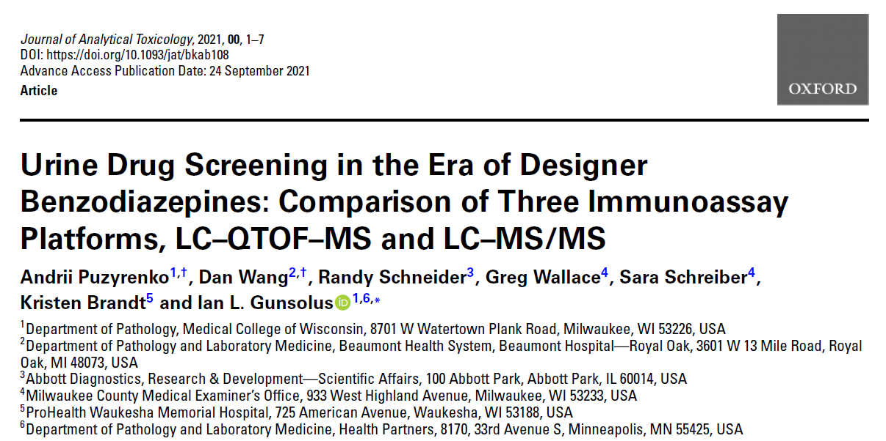

Slide 84
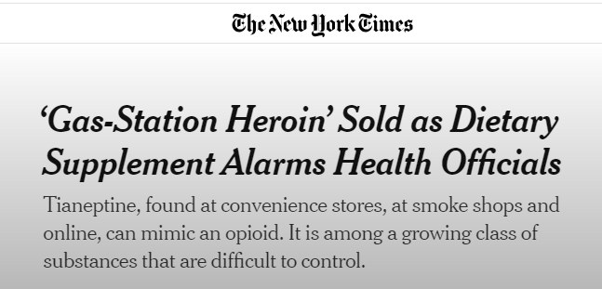
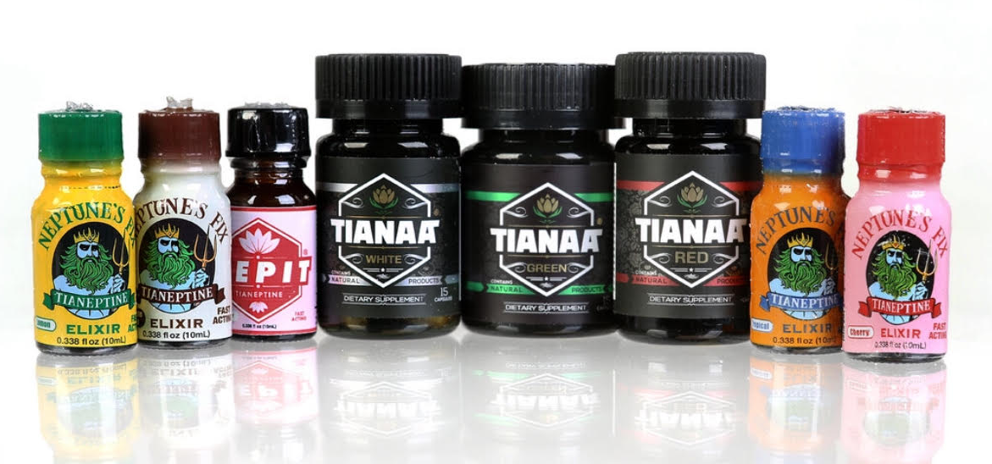

Slide 85
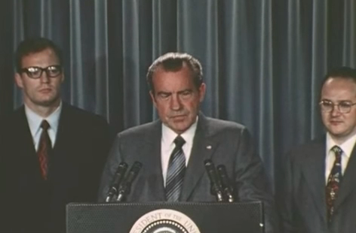
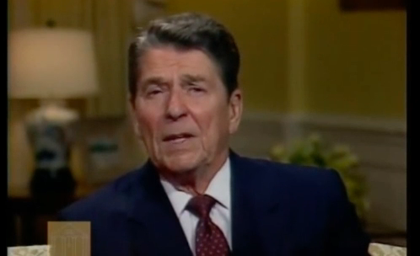
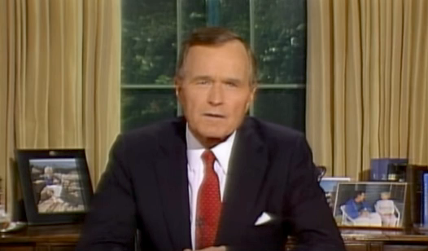
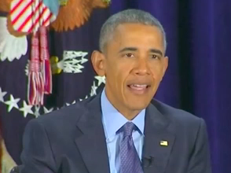
June 17, 1971
September 14, 1986
September 5, 1989
March 29, 2016

Slide 86
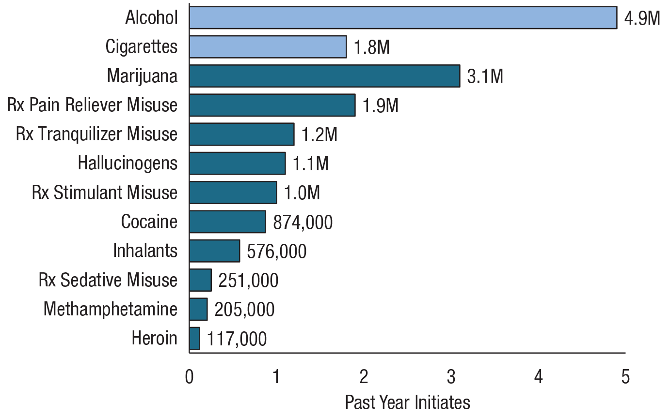
Past Year Initiates of Substances Among People Aged 12 or Older: 2018
FFR1.26
Rx = prescription.
Note: Estimates for prescription pain relievers, prescription tranquilizers, prescription stimulants, and prescription sedatives are for the initiation of misuse.

Slide 87
Drug overdoses now the leading cause of accidental
death
25
20
15
Motor vehicle accident
Deaths per 100,00
10
Drug induced overdoses
5
0
CDC 2015
1980
1982
1984
1986
1988
1990
1992
1994
1996
1998
2000
2002
2004
2006
2008
2010
2012

Slide 88
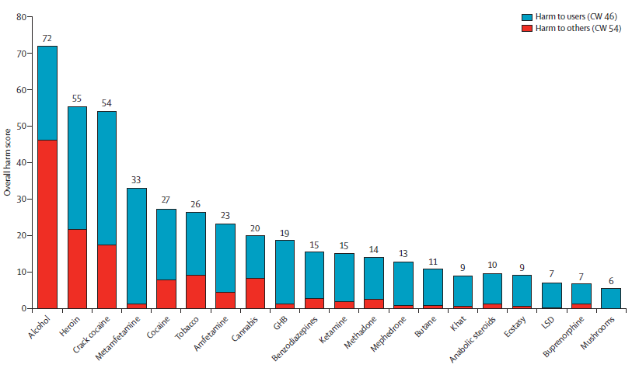
Nutt DJ. Lancet 2010;376:1558-1565
NEW

Slide 89
Relapse Rates Are Similar for Drug Dependence
And Other Chronic Illnesses
100
Addiction Treatment Does Work
90
80
70
60
Percent of Patients Who Relapse
50 to 70%
50 to 70%
50
40
40 to 60%
30
30 to 50%
20
10
0
Drug
Dependence
Type I
Diabetes
Hypertension
Asthma
Source: McLellan, A.T. et al., JAMA, Vol 284(13), October 4, 2000.

Slide 90
Treatment Today
Only 1 in 10 Americans who need treatment receive it
Of those that need it, approximately 95% don’t think they do
Of the 5% who believe they need it, 2/3 made no effort to obtain it
Less than 50% of those admitted to publically funded treatment successfully completed treatment

Slide 91
Harm Reduction
Different definitions and often misunderstood
In general, refers to policies, programs and projects that aim primarily to reduce health, social and economic harms associated with the use of psychoactive substances WITHOUT necessarily diminishing drug consumption.
It does not exclude abstinence as a goal.

Slide 92
Harm Reduction Coalition
Defined: “ A set of practical strategies and ideas aimed at reducing negative consequences associated with drug use. Harm Reduction is also a movement for social justice built on a belief in, and respect for, the rights of people who use drugs.”
www.harmreduction.org

Slide 93
There are Differences

Slide 94
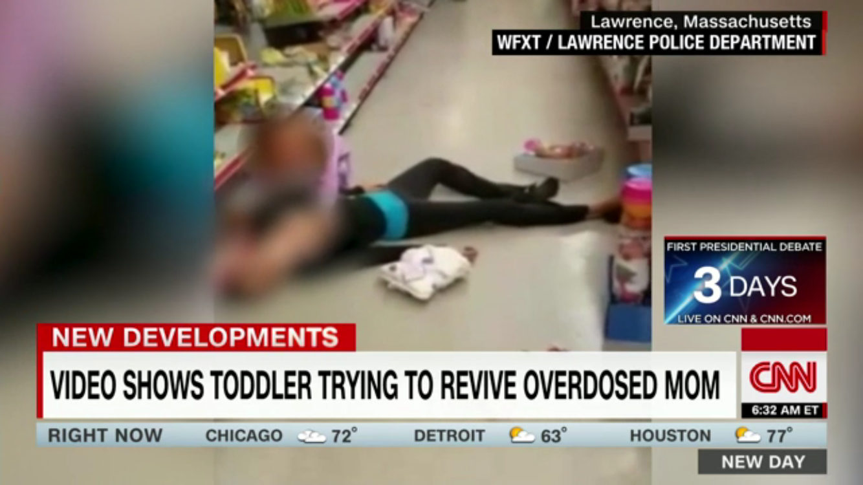
Reason #612*
* Why addiction will never be widely accepted to be a disease

Slide 95
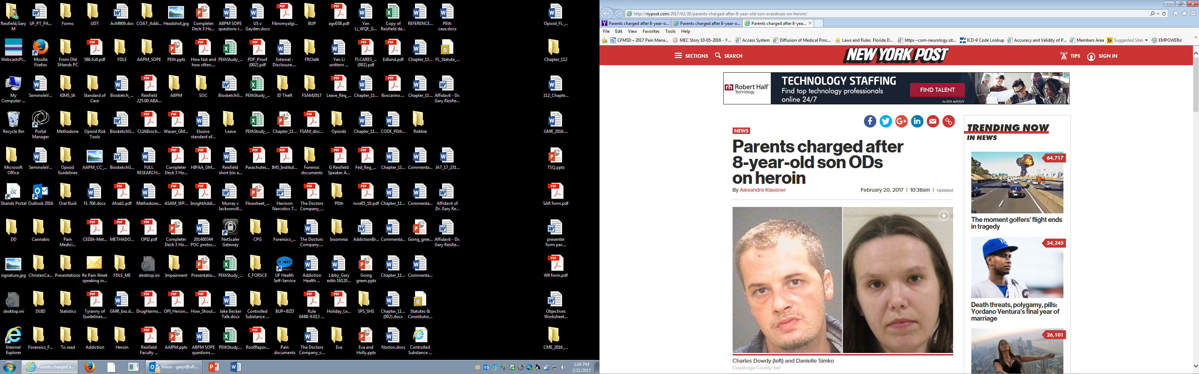
Reason #742*
* Why addiction will never be widely accepted to be a disease

Slide 96
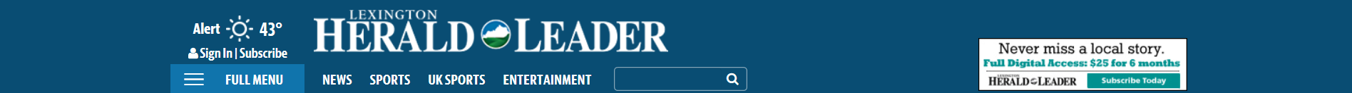
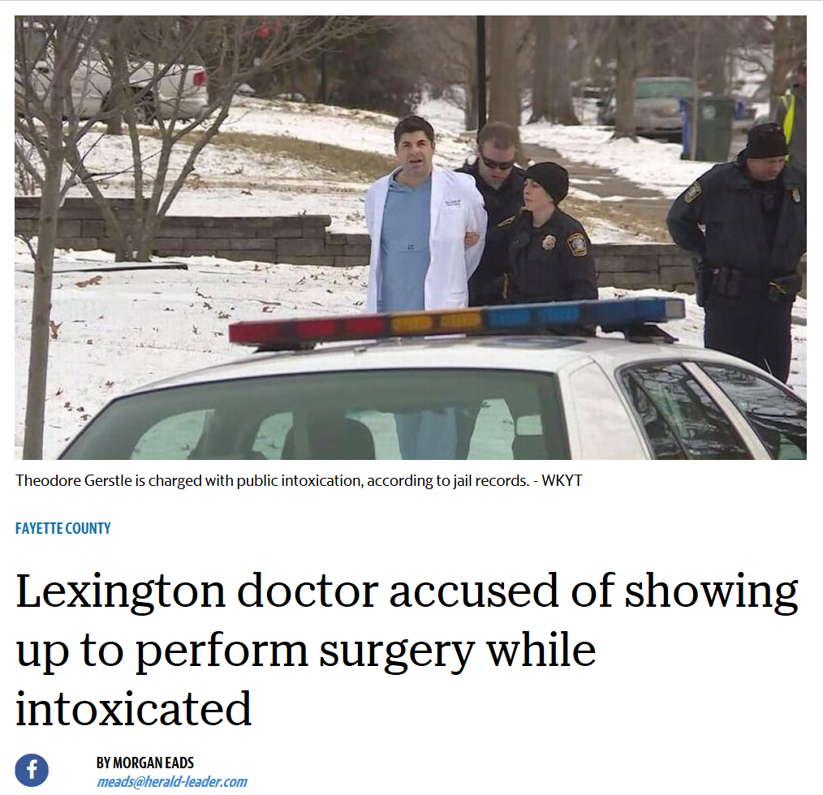
Reason #1306*
* Why addiction will never be widely viewed as a disease.

Slide 97
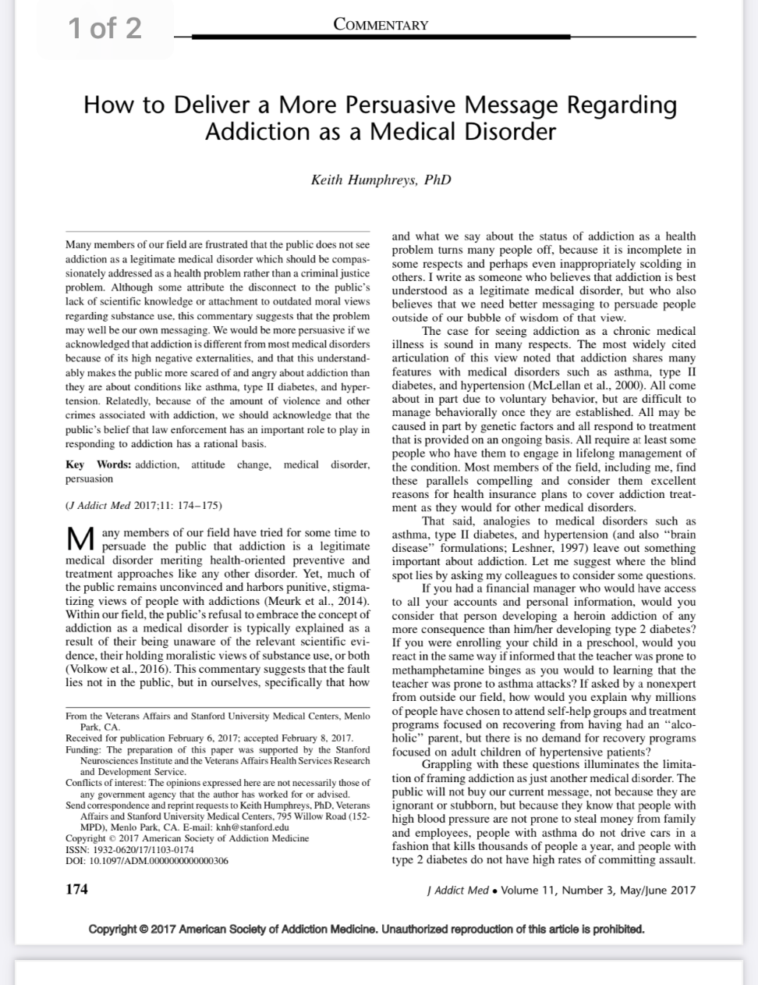
“high negative externalities”

Slide 98
Medicalization of Psychoactive Substances - Review
Opioids, Marijuana, Ketamine, Hallucinogens
How good is the science?
Unintended consequences
Policy & politics

Slide 99
Medicalization of Psychoactive Drugs – To be Considered:
Large public health burden
  Mental health issues including SUD/Addiction classified as “chronic Illnesses”
Question of inadequate treatment for SUD and MH Dx”s
  33 - 50% of people with MDD do not respond to antidepressants (TRD)
  Long time to response
  Significant side effects
Changes in drug policies
  All changes are being questioned

Slide 100
Eight Factors in Scheduling Drugs
Actual or relative potential for abuse
Known pharmacology
Current scientific knowledge of substance
History and current pattern of abuse
Scope, duration, and significance of abuse
Public health risk
Psychic or physiological dependence liability
If immediate precursor of controlled substance

Slide 101
Abuse Liability Defined
Use in amounts that create health or safety hazard
Non-medical use
Diversion
Substance actions are similar to other abused substance(s)
Evidence of actual abuse

Slide 102


Slide 103
Public Health Model of an Epidemic
Agent
Environment
↑: receptor affinity, purity,
faster routes
of administration
↓: blockade
↑: access, lower cost, prescribing
↓: culture change, neighborhood policing, PDMPs, sanctions
Host
↑: genetic, congenital & acquired vulnerability, comorbidity
↓: resilience, coping

Slide 104
When Evidence Goes Awry
1980 Letter to the Editor in NEJM
Single paragraph
No methods, definitions, or analysis
Broad conclusions
Cited 608 times
Porter J, Jick H. N Engl J Med 1980

Slide 105



Notes:
Melzack (now more than 80) at neurophysiologist specializing in the study of pain. He and Patrick Wall’s work led to the 1965 publication of their now-famous “gate-control” theory of pain. This revolutionized the ways of thinking about the nervous system and pain physiology. It rejected Decartes’ hard-wired system of a peripheral stimulus linked to the brain via fixed connections. They proposed that sensory information underwent dynamic integration and modulation at the leve of the SC and that the perception of pain could be modified by emotion and behavior.
Argues for the liberalization of morphine use in CNMP.
At the time of the article (1990) he notes that morphine is generally restricted to two groups of patients: 1) hospitalized patients with post-surgical pain, and 2) burn victims or those with incurable cancer.
Points to two studies of hospitalized patients that show “little evidence of addiction,” and also cites the recent study by Portenoy and Foley. He called their work “akin in aeronautics to breaking the sound barrier,” in that they represent a breakthrough to a reasoned, unbiased examination of the use of opioids in a population that has rarely been considered for such therapy.
He calls for well-controlled studies to provide data on the long-term effects of opioids on CNMP.

Slide 106

Florida Fun Facts
In 2010:
98/100 top oxycodone-dispensing physicians in U.S.
“practiced” in Florida
By far, more oxycodone was dispensed in Florida than in the remaining 49 states combined

Slide 107
Major opioid-caused deaths, Florida, 2007-2016
Medical Examiners Commission Annual Drug Reports, 2007-2015; Medical Examiners Commission Interim Drug Report 2016

Slide 108

iy[pa

Slide 109

Analogs Potency vs Morphine
Fentanyl is 100 times more potent
Sufentanil is 2,400 times more potent
3 Methyl Fentanyl is 6,000 times more potent
Carfentanil is 10,000 times more potent
Ohmefentanyl is 30,000 more potent

Slide 110


Slide 111

The Other Side of Buprenorphine
Scott Teitelbaum, M.D., FAAP, DFSAM
Pottash Professor in Psychiatry and Neuroscience
Vice Chair, Dept. of Psychiatry
Medical Director Florida Recovery Center
Division Chief, Addiction Medicine
University of Florida
Notes:
Objectives
Understand the neurochemistry behind the symptoms of addiction
Recognize how addiction mimics and/or is contributory to other medical issues
Develop basic skills to diagnose addiction
Understand how the primary care physician can help the addict

Slide 112


Slide 113

“’What we are seeing is a rise of dozens of rogue Suboxone clinics in our state that I believe are the second coming of our pill mills,’ Attorney General Andy Beshear said.”
Courier-Journal (Kentucky), June 8, 2017

Slide 114

Cannabis sativa
Annual plant in tropical and temperate zones
Generally flowering in the late summer months
Originally native to the Far East, now found wordwide
Hotter, dryer climates yield higher resin content

Slide 115
Public Opinion
Gallup Poll shows that in 1977, 28% thought “use of cannabis should be made legal”. In 2015, that number grew to 58%!
Quinnipiac 2016 poll showed 89% of respondents supported medical marijuana – no distinction made

Slide 116

Cannabis legal status
Source: https://mjbizdaily.com/map-of-us-marijuana-legalization-by-state/

Slide 117

The National Academies Press
Authors
Committee on the Health Effects of Marijuana: An Evidence Review and Research Agenda; Board on Population Health and Public Health Practice; Health and Medicine Division; National Academies of Sciences, Engineering, and Medicine
PDF Available at: http://www.nap.edu/24625

Slide 118

The Power of
Collective Delusion

Slide 119


Slide 120

 | 2021 | 2016 | 2011
Past-year | 43% | 34% | 29%
Past-month | 29% | 21% | 17%
Daily | 11% | 8% | 6%
Source: 2021 Monitoring the Future study of substance use behaviors and related attitudes among teens in the United States

Slide 121
Cannabis use disorders, 2018-2022
Ages 12+
Source: NSDUH, 2018-2022
Notes:
Scott, I made this slide by going back to the primary data from your 12/13/23 SAM email, which cited the 329% increase.
The corresponding numbers are: 4.42 million (2018) to 18.98 million (2022) – a 329% increase over the most recent four year period for which data is available.
This data includes mild-, moderate-, and severe CUD
Kinda looks like things took off with the pandemic.

Slide 122
Cannabis use disorders, 2018-2022
Ages 12+
Source: NSDUH, 2018-2022
Notes:
Scott, I made this slide by going back to the primary data from your 12/13/23 SAM email, which cited the 329% increase.
The corresponding numbers are: 4.42 million (2018) to 18.98 million (2022) – a 329% increase over the most recent four year period for which data is available.
This data includes mild-, moderate-, and severe CUD
Kinda looks like things took off with the pandemic.

Slide 123
Marijuana Medicalization
More product options
Illicit Production
  Unregulated potency/THC content
More analogs
New routes of delivery (dabbing, vaping)
Advertising
  Dispensaries
More use
Daily use by teens
Pregnant women
Boomers and elderly
More Issues
Medical (cardiac)
Traffic accidents
Child poisonings
Addiction

Slide 124

Marijuana Perceived Risk vs. Use

Slide 125


Slide 126
Is Marijuana a Worrisome Precedent?
Will psychedelic drugs follow marijuana strategy?
Will psychedelics get ahead of efficacy and safety evidence?
Ballot initiative?
“Compassionate access” without FDA approval

Slide 127

Gateway Drug

Slide 128


Slide 129


Slide 130
Chemical Mechanism of Psychedelics
Increased psychological flexibility
Sense of increased insight
Emotional acceptance
Mystical-type state

Slide 131


Slide 132
But wait…
Benedryl is an ineffective blind
Self-reports about drinking were confirmed by urinary EtG (but were collected for only 53.8% of participants)
Subjects reported lower drinking intensity than those in most AUD trials
The study was not adequately powered to evaluate effects in subgroups
The study did not go beyond 32 weeks

Slide 133
10 hallucinogen clinical trial limitations
Limited power
Lack of placebo control or comparisons with approved antidepressants
Open-label or crossover design
Short-term monitoring
Efficacy conclusions compromised by intensive concurrent psychological support and expectancy bias
Awareness of group assignment by both participant and observer
Overrepresentation of participants who are white, college educated, have previous drug experience, and are interested in spirituality
Exclusion of depressed persons at risk of suicide
Inadequate screening of persons at risk for transitioning to psychotic disorders
Protocols cannot be readily scaled
Madras BK, NEJM 2022
Notes:
Madras also notes the social implications of “medicalizing” hallucinogens, for which there is a movement (180 registered clinical trials for hallucinogens in the treatment of depression; other neuropsychiatric disorders; SUDs; “demoralization”; and “enhancement of spirituality.”
She also observes that the momentum to legalize hallucinogens recapitulates elements used in the movements to increase legal access to cannabis and Rx opioids, including:
Minimize potential adverse consequences and dismiss evidence-based safety concerns for general use
Recruit mainstream media to endorse the use of a class of drugs
Industry-led campaigns to increase demand
Advocate legalization as a source of tax revenue

Slide 134
How solid is the science?
Considerations:
  Recruitment
  Allocation of subjects
  Protocols, subsequent care
  Assessment of end-points
  Handling of withdrawals
  Exclusion of data from analysis

Slide 135
Long-Term Adverse Effects
Hallucinogens
Change/distort perception of surroundings
Sensations/images seem real but are not
Change/distort sensory reality; synesthesia, visual hallucinations
Persistent psychosis
  Visual Disturbances
  Disorganized thinking
  Paranoia
  Mood changes
Hallucinogen Persisting Perception Disorder (HPPD)
  Can occur with without warning
  Can occur days or years after use
  More common in the presence of mental health history
  Can happen to anyone

Slide 136
Hallucinogen Emergencies
Suicidality secondary to distorted perception and thoughts
Changes in mood
Medical emergencies more common with use of dissociatives (ketamine)
  Overdose, seizures, coma, death

Slide 137



Notes:
Scott: Interestingly, MTF never defines the members of the hallucinogen group, except for explicit mentions of LSD, MDMA, and (apparently) ketamine (p 142).
8.0% of young adults reported hallucinogen use in 2022 – a statistically significant change across the previous 5- and 10-year periods.
4.1% of middle-age adults reported hallucinogen use in 2022 – a statistically significant change across the previous 1-, 5-, and 10-year periods.

Slide 138


Slide 139


Slide 140

“
The Journal reported last year that Musk microdoses ketamine for depression and takes full doses at parties. In response to that article, Musk posted on social media that ketamine is a better way to deal with depression than antidepressants. He later said he had a prescription for ketamine.
Notes:
This case is an example of the potential for psychedelics – ketamine in this case – to recapitulate the opioid epidemic, in which people (both patients and non-patients) thought that prescription opioids were safe (and effective) because they were, well, FDA-approved prescription drugs.
Here we see the erasure of the line between quote unquote medical use (microdosing for depression) and nonmedical use (full doses at parties).

Slide 141

Notes:
I wonder how various combinations of LSD, cocaine, ecstasy, mushrooms, and ketamine impact his depression. Sounds, too, like he is impaired in the workplace.

Slide 142
Ketamine for Treatment-Resistant Depression (TRD)
Initial studies promising for TRD
Quick improvement, need frequent treatment
FDA required drug-makers to develop Risk Evaluation and Mitigation Strategies (REMS); however
  “Rogue” ketamine clinics are popping up
  There is no standard
  Only 35% require training and only 12% require physician
  Contraindications are not clear
  Minimal, if any, guidance on age, pregnancy, or individuals in safety-sensitive professions

Slide 143

Notes:
Background: There are three medications approved by the U.S. Food and Drug Administration (FDA) for the treatment of AUD: acamprosate, disulfiram, and naltrexone. Although naltrexone and acamprosate are first-line agents recommended to treat AUD, studies have shown significant heterogeneity in treatment response to these medications, leading to variable efficacy rates across patients. Therefore, it is imperative that research and development of more effective options for AUD remain a high priority to advance the field of addiction medicine. One emerging topic in psychiatric research involves the use of psychotomimetic agents for debilitating medical conditions.
Ketamine is an N-methyl-D-aspartate (NMDA) antagonist that was first approved by the FDA in 1970 as an anesthetic agent. Since then, ketamine has long established its role in the operating room, and researchers have continued to investigate its potential benefits in patients with depression, pain syndromes, status epilepticus, and substance use disorders. In 2019, the FDA approved the S-enantiomer of ketamine (esketamine) for patients with treatment-resistant depression (TRD). Following the success of these studies on TRD with low-dose ketamine infusions, investigators were intrigued by the results and began to evaluate their impact on patients with alcohol use disorder.
This systematic review:
A total of 11 studies with 854 adult patients in three different countries (the USA, the UK, and Russia) were analyzed.
Sample sizes ranged from 5 to 211 people.
Seven studies included patients with alcohol use disorder, one study focused on heavy drinkers at moderate-high risk for development of AUD, and three studies elaborated extensively on alcohol withdrawal.
The overall proportion of patients achieving abstinence and reduced consumption was most favorable in people receiving combination ketamine and psychotherapy treatment.
The results were mixed with respect to relapse, craving, and withdrawal.
Ketamine may be an effective therapeutic modality for people with alcohol use disorders who fail to respond to FDA-approved first-line agents. More robust clinical trials are necessary to provide a more accurate assessment of efficacy, safety profile, and dosing strategies for ketamine utilization in alcohol use disorder.
Limitations:
Most of the studies encompassed small sample sizes (N < 100 in nine studies), with the inclusion of two case series.
Effective blinding may have been compromised in the trials due to the dissociative and psychogenic properties of ketamine.
The authors were unable to conduct a meta-analysis due to heterogeneity among the study design, inclusion criteria, dosing regimen, use of concomitant medications, outcome variables, treatment duration, and follow-up period.
Several of the studies were associated with a moderate to high risk of bias due to methodological limitations, primarily concerning measurements of the outcome and the selection of reported results.
Given the strict eligibility criteria of the included studies, the efficacy of ketamine for participants in these studies may not be representative of individuals diagnosed with alcohol use disorder.

Slide 144

Notes:
The authors identified 204 research studies in a database search.
Of these, 10 articles demonstrated the use of ketamine in AUD or AWS in humans. Seven studies investigated the use of ketamine in AUD and three studies described its use in AWS.
Ketamine used in AUD was beneficial in reducing cravings, alcohol consumption and longer abstinence rates when compared to treatment as usual. In AWS, ketamine was used as an adjunct to standard benzodiazepine therapy during severe refractory AWS and at signs of delirium tremens. Adjunctive use of ketamine demonstrated earlier resolution of delirium tremens and AWS, reduced ICU stay, and lowered likelihood of intubation. Oversedation, headache, hypertension, and euphoria were the documented adverse effects after ketamine administration for AUD and AWS.
Conclusion: The use of sub-dissociative doses of ketamine for the treatment of AUD and AWS is promising but more definitive evidence of its efficacy and safety is required before recommending it for broader clinical use.
Limitations:
Overall, the sample sizes remain small
In all reported trials, and all studies for AWS were retrospective in nature with high probability of bias.
Persistent among many trials of powerfully psychoactive substances is the challenge to maintain blinding. While the Dakwar trial used an active placebo (midazolam), they did not evaluate the integrity of blinding. In the Grabski trial, virtually all participants who received ketamine and the majority of those in the placebo group correctly identified the treatment allocation, suggesting that blinding was particularly ineffective. In drug trials, the failure of blinding makes it difficult to separate the expectancy and placebo effects from the actual treatment effects, and future trials using ketamine will need to address this fundamental challenge inherent to studies that utilize ketamine.
Many of the trial participants had mild to moderate AUD, limiting generalizability to those with more severe drinking.
Other substance use and psychiatric disorders were often exclusions as well as, limiting the ability to generalize to those with psychiatric co-morbidities.
Finally, the subjective effects of ketamine may be playing a role in contributing to the outcomes, as is suspected when psychedelics are used to treat psychiatric and substance use disorders

Slide 145

Notes:
These authors suggest that ketamine be “repurposed” for the treatment of CUD. (I think that Bertha Madras warned against this sort of thing.)
Ketamine was chosen based on “AI-based prediction” coupled with “expert knowledge.”
The ketamine for cocaine research suffers from several of Madras’ complaints, including small, homogenous sample sizes; retrospective design; inadequate control medications (benzos); short follow-up

Slide 146

Notes:
A pandemic-related loosening of telehealth laws allowed for the prescribing of CS remotely.
This has led, amongst other things, to an increase in the availability of ketamine.
Before relaxed telehealth rules, patients needed first to be evaluated in-person by a doctor, and treatment was limited chiefly to clinics.
Now, patients can receive the drug by mail, with many taking it more frequently and for longer periods of time – sometimes daily, and sometimes for months or years – despite scant research.
Individuals in this article discussed abusing their prescriptions and concealing their abuse – and resultant health issues – from their clinicians.

Slide 147

Trends in self-reported past-year ketamine use
Ages 12-34, United States, 2006-2019
Notes:
In March 2019, the FDA approved esketamine nasal spray for use in treatment-resistant depression. This approval led to extensive media coverage of the drug, with subsequent references to ketamine as a “club drug” and use of its street name, “Special K.” Indeed, between 2016 and 2019, its reported use in NYC clubs increased from 5.9% to 15.3%.
Data from the above graph was derived from 2006-2019 NSDUH. It shows:
Low overall use (<1%), but increasing use
A nearly linear increase in ketamine use from 2006-2014.
A cubic increase in use from 2015-2019.
Limitation:
These numbers are probably underestimates because they were based solely on self-report.
These are all pre-pandemic numbers

Slide 148


Slide 149

Notes:
https://www.wsj.com/articles/ftc-launches-probe-of-cerebrals-business-practices-11655241983?mod=article_inline

Slide 150

Notes:
https://www.wsj.com/articles/cerebral-adderall-adhd-prescribe-11654705250?mod=article_inline

Slide 151


Slide 152


Slide 153
Bill’s Writing on Medications
“Some of us, perfectly sober for months or years, contract the habit of using sedatives to cure insomnia or slight nervous irritability. I have the impression that some of us get away with it, year after year, just as we did when we first began to drink alcohol. Yet experience shows, all too often, than even the “controlled” pill taker may get out of control. The same crazy rationalizations that once characterized his drinking begin to blight his existence. He thinks that if pills can cure insomnia so may they cure his worry.”
Language of the Heart 1945

Slide 154
“In addicts, doses of drugs that are too low to produce any conscious recognition that they received drugs are still capable of inducing changes in the brain and influencing behavior…”
Mark S. Gold, MD
Dept of Psychiatry
University of Florida

Slide 155
Conclusions
Pharmacotherapy for SUD/addiction is not a new phenomenon and can have a role, but is not a Panacea
MOUD (including naltrexone) has shown efficacy in the treatment of OUD but is not a Panacea
The use of MDMA, psilocybin, ketamine, and/or LSD may show promise in highly selected populations if administered in closely supervised settings with intensive support
Careful not to repeat the same mistakes that were made with cannabis

Slide 156
What Have We Learned????
Money drives legislation
~25 states considering multiple bills/initiatives regarding medical hallucinogens
Bills signed into law
  Tend to sidestep/contradict 1970 CSD
  Propose decriminalization
  Do not specify medical oversight/training/licensure

Slide 157
Lessons From History
Stay Clinically and Ethically Centered
Practice within Boundaries of Care
Addiction Technology
Monitor Political and Economic Environment
Pay Attention and be Active
Don’t lose sight of Singleness of Purpose
To increase access to and improve the quality of addiction treatment

Slide 158
The Great Challenge
For Addiction Medicine in 21st Century
To Integrate:
Into the house of medicine
Addiction Medicine, Psychiatry, Therapy and Spirituality in the Treatment of Substance Use Disorders.

Slide 159


Slide 160


