Slide 1
Adderall, Suboxone, and Benzodiazepines: The Current State of Play
Geoff Wilson, LCSW, LCADC, CCS

Slide 2
Agenda
Will increase knowledge regarding prescribing patterns for specific medications.
Will increase knowledge pertaining to patients with co-occurring disorders & the negative effects of various prescribed medications on these disorders.

Slide 3
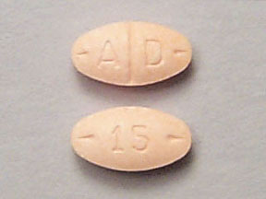
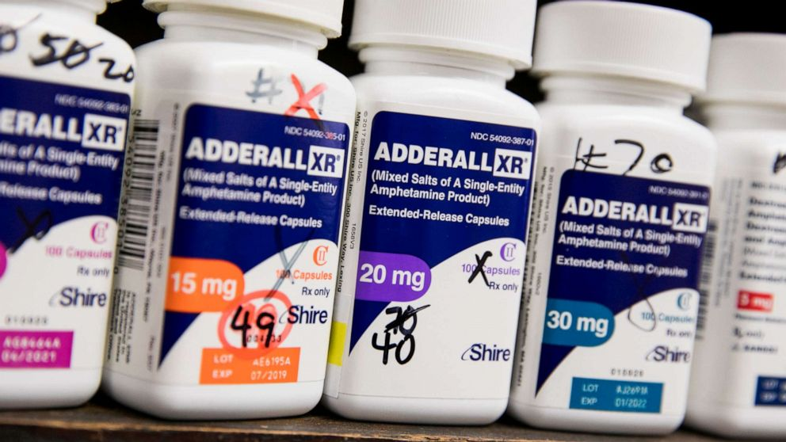
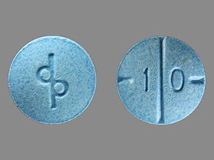
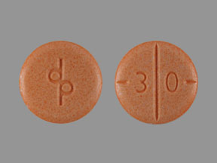
FDA Confirms Adderall Shortage in the US

Slide 4
Adderall Shortage
There are many reasons for constrained supply, including tight regulation due to its classification as a schedule II drug which the DEA defines as "drugs with a high potential for abuse, with use potentially leading to severe psychological or physical dependence."
In addition, labor shortages, supply chain issues and an increase in the number of people who have been prescribed the drug in recent years may have an effect on supply.

Slide 5
Increase in Adderall Prescriptions
Prescriptions for ADHD medications jumped by more than 14% in a two-year period after the start of the pandemic in March 2020, according to a study published Wednesday in JAMA Psychiatry.
There were nearly 6 million new prescriptions for stimulants in the first two years of the pandemic, around 700,000 more than in the two years prior, according to the study, which was led by researchers at the U.S. Food and Drug Administration.

Slide 6
Stimulant Prescriptions
The CDC estimates that around 6 million children between the ages of 3 and 17 -- approximately 10% -- have been diagnosed with ADHD, and these numbers may have increased since 2019.
However, the surge in prescriptions was fueled most notably by an increase in ADHD prescriptions among young adults and women, data shows.
The study noted that prescriptions for stimulant and nonstimulant ADHD treatments during the pandemic were much higher than before the pandemic, potentially due to the number of adults working from home. Overall, stimulant prescriptions for those 20 to 39 jumped 30 percent, while nonstimulant ADHD prescriptions for that age group increased 81 percent.

Slide 7
Ease of Access
The Drug Enforcement Administration (DEA) also started allowing medical providers to prescribe treatment for ADHD via telemedicine, making it more accessible to more people. Those telemedicine flexibilities will last until the end of 2024.
For children, the highest stimulant rate was in Delaware at 5.1%, followed by Kentucky, South Carolina, Rhode Island, and North Carolina. The lowest rate was in Alaska at 0.4% with California, Hawaii, Colorado and Nevada rounding out the lowest five.

Slide 8
Access to Services: Good and Bad!
While some of these services legitimately helped increase access to necessary drugs when supply chain issues marred the healthcare system, there were also notorious bad actors.
The most obvious example of such bad actors was the telehealth startup Cerebral, which the United States Department of Justice investigated due to its alleged prescribing practices around controlled substances like Adderall and Xanax.
The company also famously utilized social media platforms like TikTok and Instagram to advertise its services, some of which were later pulled for being deceptive.

Slide 9
Ease of Receiving a Prescription
The companies often promise online access to clinicians who can prescribe prescription medication for disorders such as anxiety, depression and ADHD in exchange for a monthly fee ranging from $79 to $325.

Slide 10
Trends in Incident Prescriptions for Behavioral Health Medications in the US, 2018-2022 (JAMA Psychiatry, Jan 10, 2024)
This study included the use of comprehensive, national-level outpatient incident prescription dispensing data across all payment types (commercial insurance, Medicare/ Medicaid, and cash) across 5 drug classes: Anti-depressants, Benzodiazepines, C-II Stimulants, Non-Stimulant ADHD, and Buprenorphine.

Slide 12
What About Suboxone??

Slide 13
Buprenorphine Prescribing
For buprenorphine MOUD, there was an initial drop in incident prescriptions in March 2020. However, trends did not change, consistent with a prior study. One potential explanation for the lack of change in trends is that telemedicine prescribing flexibilities may have allowed clinicians to continue to diagnose and start treatment for OUD.
Although we did not directly study the impact of telemedicine in our analyses, other studies have found that telemedicine flexibilities and other interventions to expand access to MOUD during the COVID-19 pandemic were used by Medicare recipients and commercially insured patients to initiate OUD-related care and were associated with improved retention in care, reductions in overdose-related outcomes, and improved patient engagement.

Slide 14
Whose Prescribing…..
Nurse practitioners had the largest increases in prescribing incident prescriptions across the 5 drug classes. This is consistent with a study that found that behavioral health visits among Medicare beneficiaries conducted by psychiatric behavioral health nurse practitioners increased by 162%, whereas those by psychiatrists decreased by 6% from 2011 to 2019. Trends in Incident Prescriptions for Behavioral Health Medications in the US, 2018-2022 Grace Chai, PharmD, MPH; Jing Xu, PhD, MA; Sonal Goyal, PharmD, MPH; Corinne Woods, RPh, MPH; Amy Ho, PharmD, BCPS; Jaejoon Song, PhD; Gerald Dal Pan, MD, MHS

Slide 15
Findings……
Incident prescriptions dispensed for the 5 drug classes changed from 51,500,321 before the COVID-19 pandemic to 54,000,169 during the pandemic.
The largest unadjusted percentage increase in incident prescriptions by prescriber specialty was among nurse practitioners across all drug classes ranging from 7% (from 1,811,376 to 1,944,852;benzodiazepines) to 78% (from 157,578 to 280,925; buprenorphine MOUD).
For patient age and sex, the largest increases were within C-II stimulants and nonstimulant ADHD drugs among patients aged 20 to 39 years (30% from 1,887, 017 to 2,455,706] and 81% [from 255,053 to 461,017], respectively) and female patients (25% from 2,352,095 to 2,942,604] and 59% [from 395,678 to 630,678], respectively).

Slide 17
Buprenorphine Prescribing
The federal government has taken steps to increase the number of clinicians who prescribe buprenorphine, but many patients struggle to get those prescriptions filled. A recent study found that 1 in 5 U.S. pharmacies do not provide buprenorphine.

Slide 18
Another Issue with Prescribing…
Research in North Carolina and Kentucky has found that many pharmacists worry that ordering more buprenorphine will trigger a DEA investigation.
The DEA does not specify thresholds for controlled substances, but it requires wholesalers to flag suspicious orders. In turn, wholesalers limit how much a pharmacy can buy or create algorithms to detect orders that exceed projected need. (DEA takes aggressive stance toward pharmacies trying to dispense addiction medicine; NOVEMBER 8, 2021).

Slide 19
Another Issue with Prescribing…
That creates a "prescribing cliff," said Bayla Ostrach, lead author of a paper studying this issue in North Carolina. Doctors may prescribe buprenorphine to more patients, but pharmacies order enough for only a certain number of customers. Since many people stay on buprenorphine for years, once the pharmacy hits its self-established quota, it may rarely have openings for new patients.

Slide 20
One Story……
James, 34, had been filling his Subutex prescription at the supermarket chain Publix for seven years. In that time, he held steady jobs and cared for his wife and children. Then, last year, James said, he went to get his prescription refilled and was told Publix no longer stocks Subutex. A decade ago, when James began the medication, he chose Subutex because it was cheaper than Suboxone. James was not eager to change to a potentially pricier medication. And he worried a different drug might disrupt his recovery. Luckily, James found an independent pharmacy that provides Subutex. It's more expensive, since the new place doesn't accept his insurance, he said. He pays about $40 a week, compared with $40 a month previously.
But James said it's worth it.
"I've been in 10 rehabs and a million detoxes, and the only thing that has worked for me was one sublingual tablet," James said. Along with therapy, "this saved my life."

Slide 21
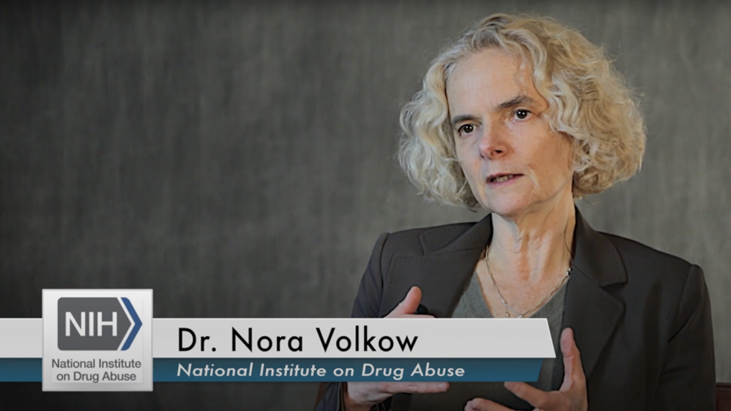
If a person wants to get treatment and abstain from drug use, “that’s great” as a “theoretical ideal,” the official said. “But to basically impose that as a reality for everyone—who have very different backgrounds and opportunities—I think it’s sort of like a magical thought and not practical.”
The “inflexibility” of abstinence-only “costs a lot of lives,” Volkow said. (NIDA Director Calls Abstinence-Only Approach “Catastrophic” for OD Crisis BY KYLE JAEGER NOVEMBER 21, 2023).

Slide 22
Trends in and Characteristics of Buprenorphine Misuse Among Adults in the US
Misuse was defined as use “in any way that a doctor [physician] did not direct you to use them, including (1) use without a prescription of your own; (2) use in greater amounts, more often, or longer than you were told to take them; or (3) use in any other way a doctor did not direct you to use them.
These findings suggest that among adults with OUD, prevalence of buprenorphine misuse trended downward from 2015 to 2019. In 2019, nearly three-fourths of US adults reporting past-year buprenorphine use did not misuse their prescribed buprenorphine, and most who misused reported using prescription opioids without having their own prescriptions. (Trends in and Characteristics of Buprenorphine Misuse Among Adults in the US: Beth Han, MD, PhD, MPH; Christopher M. Jones, PharmD, DrPH, MPH; Emily B. Einstein, PhD; Wilson M. Compton, MD, MP

Slide 25
Top 5 Kentucky Counties for Opiate Prescriptions
1) Perry County: 316.5 per 100 people, 364% higher than the state average, 631% higher than national average
2) McCracken County: 244.4 per 100 people, 258% higher than state average and 464% higher than national average.
3) Owsley County: 192 per 100 people, 181% higher than the sate average and 344% higher than national average.
4) Clark County: 188 per 100 people, 175% higher than state average and 334% higher than national average
5) Bell County: 140 per 100 people, 105% higher than state average, and 223% higher than national average. (Hazard Herald, September 22, 2023)

Slide 26
What about Benzodiazepines??

Slide 27
What About Benzodiazepines??
A third of the recorded benzodiazepine prescriptions issued in the US were given alongside a prescription for an opioid painkiller.
“Benzodiazepine deaths have gone up substantially over the past two decades in the US, increasing from just over 1000 annual deaths in 1999 to over 11,000 deaths in 2017,” says McDonald. “Almost all cases also involved opioids.”

Slide 28
Benzodiazepines
Benzodiazepine-related overdose mortality has risen dramatically, from 0.6 per 100,000 adults in 1999 to 4.4 per 100,000 in 2016.
Using nationally representative data, we surveyed the landscape of outpatient benzodiazepine use and found that the rate for benzodiazepine visits doubled from 2003 to 2015. Use among psychiatrists was stable, but increased among all other types of physicians, including PCPs, medical specialists, and surgeons.

Slide 29
Benzodiazepine Prescribing
By indication, use was stable for visits related to insomnia and increased by only about one-quarter for visits related to anxiety or neurologic conditions; in contrast, it more than doubled for back and chronic pain as well for other conditions for which we could not identify a specific indication. In addition, benzodiazepines are increasingly prescribed with other sedating medications. (Patterns in Outpatient Benzodiazepine Prescribing in the United States Sumit D. Agarwal, MD; Bruce E. Landon, MD, MBA, MS).

Slide 30
Benzodiazepines
The percentage of outpatient medical visits that led to a benzodiazepine prescription doubled from 2003 to 2015, according to a recent study. And about half those prescriptions came from primary care physicians.
While benzodiazepines are mostly prescribed for anxiety, insomnia and seizures, the study found that the biggest rise in prescriptions during this time period was for back pain and other types of chronic pain. The findings appear online in JAMA Network Open.

Slide 33
Fast forward…….
Benzodiazepine-involved overdose deaths decreased during 2017–2019; however, since 2019, the illicit benzodiazepine supply increased.
From 2019 to 2020, benzodiazepine overdose visits per 100,000 emergency department visits increased (23.7%), both with (34.4%) and without (21.0%) opioid co-involvement.
From April–June 2019 to April–June 2020, prescription and illicit benzodiazepine-involved overdose deaths increased 21.8% and 519.6%, respectively.
Trends in Nonfatal and Fatal Overdoses Involving Benzodiazepines — 38 States and the District of Columbia, 2019–2020 Weekly / August 27, 2021 Morbidity and Mortality Weekly Report

Slide 34
Benzodiazepines
Benzodiazepines were involved in 6,982 (16.8%) of 41,496 overdose deaths during January 2019–June 2020 reported by 23 states, with opioids involved in 6,384 (91.4%) benzodiazepine deaths.

Slide 36
Anna Lembke, an associate professor of psychiatry and medical director of addiction medicine at Stanford University School of Medicine.
"I think the big message here is that primary care doctors are really left with burden of dealing, not only with chronic pain and opioid prescription, but also benzodiazepine prescriptions," she says.
The trends, she adds, reflect "the incredible burden of care on primary care physicians, who are given little time, or resources" to handle a high volume of pain patients with complex conditions.

Slide 37
Dr. Joanna Starrels, as associate professor at the department of medicine at the Albert Einstein College of Medicine.
"Primary care doctors," she says, "are the frontline providers. "And in many settings, particularly in rural areas, we may be the only providers. So, we end up needing to treat conditions where specialists may be better trained — like chronic pain, addiction and anxiety.“
Co-prescribing these two kinds of medications can be dangerous. "They both slow down the central nervous system in complementary ways [that] increase the risk of overdose deaths," says Starrels. "It is dangerous — and generally advised not to prescribe together."

Slide 38
What Do We Think????
The alarming increase in overdose deaths underscores the need for more accessible treatment services, and studies have shown that medication-based treatment promotes long-term recovery from opioid use disorder. (SAMHSA; HHS Releases New Buprenorphine Practice Guidelines, Expanding Access to Treatment for Opioid Use Disorder Main page content Tuesday, April 27, 2021).

Slide 40
References
Trends in Incident Prescriptions for Behavioral Health Medications in the US, 2018-2022; Grace Chai, PharmD, MPH1; Jing Xu, PhD, MA1; Sonal Goyal, PharmD, MPH1; et al
JAMA Psychiatry
Trends in Incident Prescriptions for Behavioral Health Medications in the US, 2018-2022 (JAMA Psychiatry, Jan 10, 2024
(Trends in and Characteristics of Buprenorphine Misuse Among Adults in the US: Beth Han, MD, PhD, MPH; Christopher M. Jones, PharmD, DrPH, MPH; Emily B. Einstein, PhD; Wilson M. Compton, MD, MP
NPR: DEA takes aggressive stance toward pharmacies trying to dispense addiction medicine NOVEMBER 8, 2021
Center for Disease Control: State Buprenorphine Prescribing Rates
Center for Disease Control: State Opioid Dispensing Rates
Patterns in Outpatient Benzodiazepine Prescribing in the United States Sumit D. Agarwal, MD; Bruce E. Landon, MD, MBA, MS.
JAMA Network OPEN, 2019 2:1
Trends in Nonfatal and Fatal Overdoses Involving Benzodiazepines — 38 States and the District of Columbia, 2019–2020 Weekly / August 27, 2021 Morbidity and Mortality Weekly Report
SAMHSA; HHS Releases New Buprenorphine Practice Guidelines, Expanding Access to Treatment for Opioid Use Disorder Main page content Tuesday, April 27, 2021.
Hazard Herald, September 22, 2023.

Slide 41
Thank You!!
Geoff Wilson, LCSW, LCADC, CCS
The Offices of Paul Dalton/Lexington
Counseling & Psychiatry
501 Darby Creek Rd., Suite 11
Lexington, KY 40509
859-229-5722
geoffwilson914@gmail.com

