Slide 1
Attachment & pornography, gaming and internet addictions
Mike Eiden LCSW, LCADC, CSAT phD Candidate
Eiden.integrative@gmail.com
502-219-6304

Slide 2
Objectives
Discuss diagnosis and common client presentations related to screen addiction
1
Illustrate common client presentations related to screen addiction
2
Provide overview of treatment methods through an addiction model with an attachment focus
3

Slide 3
Current data related to screen use in the United States
Children and adolescents spend a lot of time watching screens, including smartphones, tablets, gaming consoles, TVs, and computers. On average, children ages 8-12 in the United States spend 4-6 hours a day watching or using screens, and teens spend up to 9 hours. While screens can entertain, teach, and keep children occupied, too much use may lead to problems (American Academy of Child and Adolescent Psychiatry, 2020)
According to the Kaiser Family Foundation on the CDC’s main page, kids ages 8-18 now spend, on average, a whopping 7.5 hours in front of a screen for entertainment each day, 4.5 of which are spent watching TV. Over a year, that adds up to 114 full days watching a screen for fun. That’s just the time they spend in front of a screen for entertainment. It doesn’t include the time they spend on the computer at school for educational purposes or at home for homework.
According to a 2016 CNN report, the average American adult spends 10 hours and 39 minutes a day on screens.

Slide 4
Interactive vs. Passive Screen Use
Passive
Watching TV or movies from across the room
While on singular device
Interactive
Regular interfacing with device—able to manipulate level of stimulation/arousal
Gaming, watching TV/movies on handheld device, Youtube, social media, taking videos on phone, pornography and masturbation
Causes hyperarousal, activates addictive process, more likely to negatively impact sleep and memory
Prolonged exposure puts body into chronic stress state

Slide 5
Case Example: Kevin
Kevin’s parents called a therapist after learning that their son had failed out of his first year of college and been kicked out of his housing due to destroying parts of his dorm during bouts of rage. Kevin is 19 and now living back at home with his parents and their relationship is very contentious. Kevin is suicidally depressed, experiences extreme social anxiety, and has gone through various medication regimens to treat his ADHD diagnosis he received at 12 years old. During the intake session, the therapist learns that Kevin is an only child and witnessed a lot of verbal arguing between his parents throughout childhood. Kevin reports being closer to his Mom and sees his Dad as the disciplinarian. The therapist learns that Kevin began using a tablet around 5 years old to play games and watch Youtube. He was initially only allowed 1 hr of solo time screen time per day but that time grew larger and he was allowed to earn more time if he kept his room clean. Kevin’s parents both worked full time and liked that Kevin was able to entertain himself. Kevin developed more of an interest in online gaming and was given a laptop to game with when he was 10 years old. Kevin would game for several hours during the weekend and began to ask persistently to game during the week nights. His parents eventually relented and allowed him to game during the week as well. Kevin’s gaming quickly escalated to several hours at night during the week and bingeing for 4-6 hours on weekends. Kevin was given a personal cell phone at 12 years old and spent time texting his friends, using snapchat, and messaging on Discord. Kevin’s parents noticed that he gradually spent less time outside of the house and became very agitated when asked to stop gaming and do chores, eat meals, or go to sleep. Kevin’s school performance began to decline despite having high test scores and an above average IQ. Kevin discovered internet pornography for the first time through a friend on one of his Discord groups. Soon after, Kevin’s ritual became going to school, coming home at 3pm and going into his room to game, message his friends, and watch Youtube reels until the early morning hours when he would need to watch pornography and masturbate to get to sleep. All through high school Kevin and his parents argued constantly about his screen use and Kevin’s parents made multiple attempts to limit his use via app blockers and filters. Kevin developed a pattern of stealing his parents and family members phones during a period of punishment without his devices. Kevin managed to graduate high school and began college living on campus. Kevin quickly lost control of his schedule and sleep routine which resulted in missing classes and not turning in assignments. Kevin was aware he needed to study and sleep but found himself unable to stop messaging on Discord and watching pornography late at night. He became increasingly ashamed at his lack of control and inability to complete tasks. Kevin regularly experienced bouts of rage when having to interact with his professors admonishing his poor performance and once he received his failing end of semester grades began to destroy his dorm and punched holes in the walls.

Slide 6
Diagnosis related to screen addictions
In 2018 the World Health Organization included in the ICD-11 both Compulsive Sexual Behavior Disorder and Internet Gaming Disorder
The DSM-V included Internet Gaming Disorder in the section: conditions requiring more research.

Slide 7
DSM-V
The DSM-5 proposes nine symptoms for internet gaming disorder. A person must demonstrate at least five of these within one year for a positive diagnosis.
• Preoccupation with games (i.e., always thinking about internet games). • Withdrawal symptoms when gaming is taken away (i.e., feelings of discomfort such as irritability, anxiety, depression). • Tolerance (i.e., needing to play for increasing amounts of time). • Difficulty/inability to reduce playing. • Loss of interest in previous hobbies and giving up other activities. • Continuing to play despite problems. • Problems with relationships (conflict and dishonesty about gaming behavior). • Playing to feel better. • Negative impact on community, social, school, and work environments
Notes:
Hopefully DSM will eventually include a broader diagnosis for interactive screen use disorder using already established addiction criteria clinicians are familiar with.

Slide 8
ICD-11 Compulsive Sexual Behavior Disorder
“Compulsive sexual behavior disorder is characterized by a persistent pattern of failure to control intense, repetitive sexual impulses or urges resulting in repetitive sexual behavior. Symptoms may include repetitive sexual activities becoming a central focus of the person’s life to the point of neglecting health and personal care or other interests, activities and responsibilities; numerous unsuccessful efforts to significantly reduce repetitive sexual behavior; and continued repetitive sexual behavior despite adverse consequences or deriving little or no satisfaction from it. The pattern of failure to control intense, sexual impulses or urges and resulting repetitive sexual behavior is manifested over an extended period of time (e.g., 6 months or more), and causes marked distress or significant impairment in personal, family, social, educational, occupational, or other important areas of functioning. Distress that is entirely related to moral judgments and disapproval about sexual impulses, urges, or behaviors is not sufficient to meet this requirement.”

Slide 9
Kevin
Kevin’s parents called a therapist after learning that their son had failed out of his first year of college and been kicked out of his housing due to destroying parts of his dorm during bouts of rage. Kevin is 19 and now living back at home with his parents and their relationship is very contentious. Kevin is suicidally depressed, experiences extreme social anxiety, and has gone through various medication regimens to treat his ADHD diagnosis he received at 12 years old. During the intake session, the therapist learns that Kevin is an only child and witnessed a lot of verbal arguing between his parents throughout childhood. Kevin reports being closer to his Mom and sees his Dad as the disciplinarian. The therapist learns that Kevin began using a tablet around 5 years old to play games and watch Youtube. He was initially only allowed 1 hr of solo time screen time per day but that time grew larger and he was allowed to earn more time if he kept his room clean. Kevin’s parents both worked full time and liked that Kevin was able to entertain himself. Kevin developed more of an interest in online gaming and was given a laptop to game with when he was 10 years old. Kevin would game for several hours during the weekend and began to ask persistently to game during the week nights. His parents eventually relented and allowed him to game during the week as well. Kevin’s gaming quickly escalated to several hours at night during the week and bingeing for 4-6 hours on weekends. Kevin was given a personal cell phone at 12 years old and spent time texting his friends, using snapchat, and messaging on Discord. Kevin’s parents noticed that he gradually spent less time outside of the house and became very agitated when asked to stop gaming and do chores, eat meals, or go to sleep. Kevin’s school performance began to decline despite having high test scores and an above average IQ. Kevin discovered internet pornography for the first time through a friend on one of his Discord groups. Soon after, Kevin’s ritual became going to school, coming home at 3pm and going into his room to game, message his friends, and watch Youtube reels until the early morning hours when he would need to watch pornography and masturbate to get to sleep. All through high school Kevin and his parents argued constantly about his screen use and Kevin’s parents made multiple attempts to limit his use via app blockers and filters. Kevin developed a pattern of stealing his parents and family members phones during a period of punishment without his devices. Kevin managed to graduate high school and began college living on campus. Kevin quickly lost control of his schedule and sleep routine which resulted in missing classes and not turning in assignments. Kevin was aware he needed to study and sleep but found himself unable to stop messaging on Discord and watching pornography late at night. He became increasingly ashamed at his lack of control and inability to complete tasks. Kevin regularly experienced bouts of rage when having to interact with his professors admonishing his poor performance and once he received his failing end of semester grades began to destroy his dorm and punched holes in the walls. Since being at home Kevin has not had any screen access and has experienced a profound level of depression and anhedonia.

Slide 10
Screen addiction interaction
Why pornography, gaming, and internet addiction together?

Slide 11
Dopamine
Pornography, gaming, discussion forums (sexting), social media, Youtube—super stimulus
Abnormal super stimulus has the brain register false evolutionary benefit
Games including sexualized avatars & embedded gambling (loot boxes)
Rhythmic novelty seeking

Slide 12
Fantasy
Porn, gaming, and social media use can all tap into compelling and even archetypal elements of fantasy
Who I get to be in the virtual world and the intensely pleasurable experiences I have there can quickly escalate into compulsivity
Able to curate a specific persona and minimize emotional risk involved in connection

Slide 13
One device to rule them all
Handheld devices are capable of housing all the same entertainment content
Devices are all used for the same purpose as opposed to distinct separation based on tasks
Education system becoming more screen dependent at earlier stages of development

Slide 14
All revved up and nowhere to go
Our nervous systems have evolved to keep track of quick changes, bright colors, loud noises, and changing landscapes by raising the arousal in our bodies to stay vigilant and defend against threat
Interactive screen use including: gaming on any device, Youtube, pornography, and social media scrolling activate the limbic system and require nervous system to engage fight or flight to keep up with stimulation, induces chronic stress state (Dunckley, 2015)
Task switching, long exposures to interactive screen use, and blue light toned light (suppresses melatonin production) negatively impacts restorative sleep

Slide 15
Task switching
‘Multi-tasking’ is a myth
Task switching gradually decreases cognitive control on task of focus
Chronic task switching causes abundance of neural activity not associated with task to light up, increasing likelihood for distraction-impairs ability to omit irrelevant information

Slide 16
Co-regulation & Attunement
Our nervous systems are designed to co-regulate by borrowing the stability of larger, more stable nervous systems in times of distress (Porges, 2011; Siegel & Hartzell, 2014)
This co-regulation fosters attachment and allows us to know we have a safe and secure base to return to when life becomes challenging or scary
Functional attunement
Caregiver attunes to child’s nonverbal cues
Impacts language development, social skills, emotional regulation, trauma resilience
French—”Virtual Autism”

Slide 17
Early onset of self-regulation vs. co-regulation
Interactive screen use can become a powerful way to self-regulate and tone the nervous system
Kids who start interactive screen use early are more likely to develop a hardwired pattern of self-regulation & compensate with this behavior, missing key developmental milestones
Issue becomes compounded as gaps in development impair ability to co-regulate and tendency to lean towards self-regulation becomes preferable (early trauma-attachment disruption increases vulnerability)
Empathy
Attunement
Verbal and emotional expression
Reading body language
Developing internal regulation methods
Notes:
***If this happens too early kids may bypass neurological instinct to bond with caregivers and turn towards screens instead.***

Slide 18
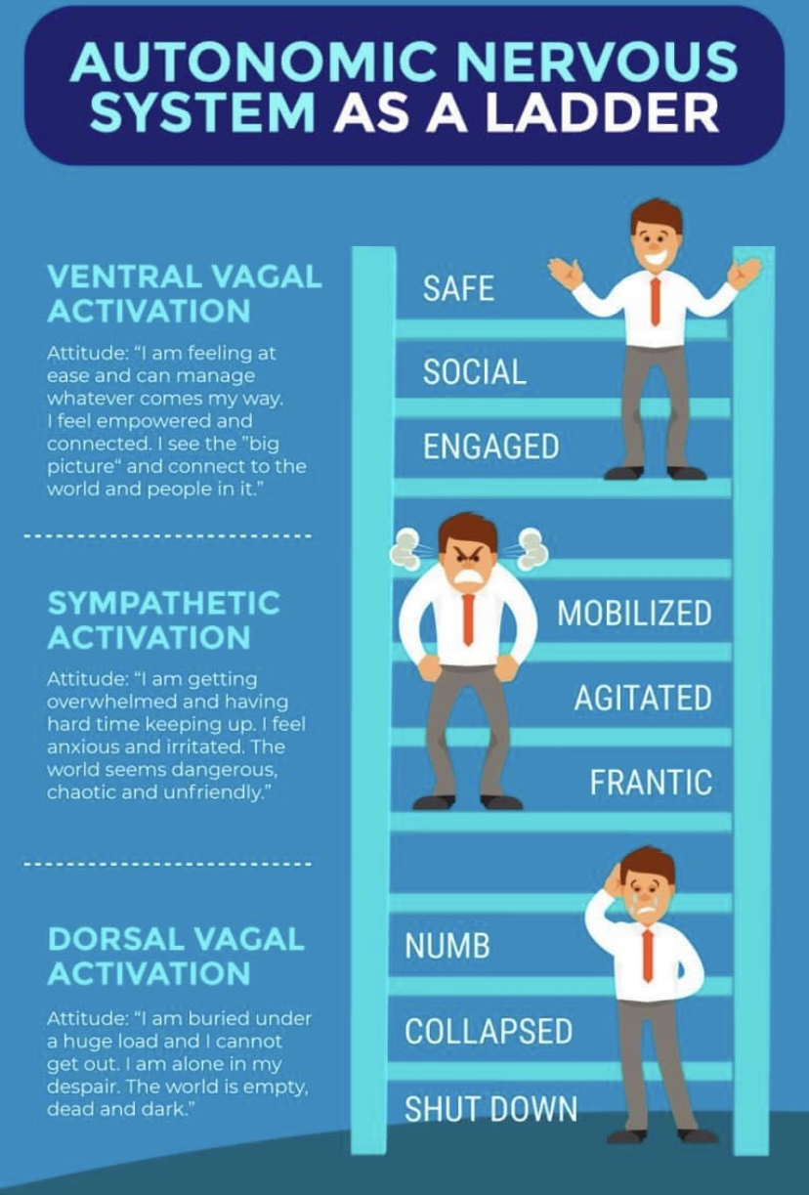
Autonomic Ladder

Slide 19
Risk Factors for Developing Screen Addiction
Early exposure to interactive screen use & poor screen use modeling
Parental encouragement to use screens when distressed/absence of necessary boundaries
ACE’s
Addiction in family history
Limited access to well-regulated caregiver
High conflict/violence between caregivers, rigid and disengaged family system
Poverty and reduced access to resources
Lack of united front in parent-driven screen use boundaries

Slide 20
Common symptoms and collateral indicators of screen addiction
Prolonged sleep disturbance or insomnia
Lack of interest in non-screen related activities
Difficulty concentrating, impairment in executive functioning
Extreme anger and/or rage when screen limits are set
Decreased academic performance/work performance
Low distress tolerance
Demonstrated need to use screens when upset

Slide 21
Continued…
Age-inappropriate tantrums
Extreme methods of deceit, lying, or manipulation to gain screen access
Significant weight fluctuations
Decreased interest in social connections and/or partnered sex
Social isolation, “being awkward around others” “being a poor sport”
Affect presentation is listless and irritable when not engaging in screen use
Exacerbates or mirrors common ADHD and/or Autism Spectrum symptomology
Consequences related to sexting

Slide 22
Current socio-cultural factors
Technology and interactive screen use applications are advancing rapidly (Swann, Moeller & Lijffijt, 2016)
Endless novelty
Virtual reality, TikTok, Youtube shorts, reels
COVID-19 pandemic has forced many to rely more heavily on the use of technology for education, socializing, and entertainment
Having to use same device for work and entertainment
Parents and kids sharing space at home with school and work; ‘Digital Babysitter’
Norms related to social connection have changed dramatically where kids who are completely off the grid of social media/texting/forums may feel socially isolated

Slide 23
Attachment disruption & developmental gaps

Slide 24
Examples of attachment ruptures & screen use
“Mom and Dad are arguing for several hours, no one comes to talk to me about how I’m feeling, I get so anxious I become nauseous and watch 3 hours of Tiktok reels with the TV on in the background so I can fall asleep”
“I had a bad day at school and when I tried to talk to Mom/Dad about it they seemed really busy. I know they both work a lot. I tried doing homework but was so distracted by how sad I was I couldn’t stop scrolling Instagram and lost track of time. My homework got turned in late and then my parents were upset with me.”
“When Dad gets angry it makes me nervous. It’s hard to tell him how anxious I get when he’s upset so I try to stay calm about it. At night I get restless and that’s usually when I’ll scroll social media, watch pornography and masturbate to calm down.”

Slide 25
Impact of screen addiction on language development
Observed negative brain alterations in Broca’s area and the occipital lobe
Theory of mind abilities, visual system, and cognitive control functions were all found to be altered in internet-related addictions (Dong, Zhou, & Zhao, 2011; Kuss & Lopez-Fernandez, 2016)
“emphasize that beside the brain’s reward and inhibitory control systems, the language system is the next candidate to be involved in the pathogenesis of IUD.”
Darnai, Perlaki, Orsi, Arató, Szente, Horváth, et al. (2022) Language processing in Internet use disorder: Task-based fMRI study.
Notes:
Theory of mind – The ability to understand and take into account another individual’s mental state or motivations.

Slide 26
Shame & Restoration of the Self
Divert attention to area I have control and mastery (gaming, social media, pornography)
Shake off feelings of shame, sense of self restored, and pattern reinforced by dopamine hit
Becomes rigid and compulsive if my only outlet for competence/belonging/relief exists virtually
Experience shame in school setting (belonging, academic performance, extra-curricular)

Slide 27
Sexting
Sexting is the action or practice of using a computer or mobile device to perform the following activities (not an exhaustive list):
Sending sexually suggestive written messages
Sending or receiving erotic pictures of sexually suggestive content or nude pictures
Sharing pornographic literature, pictures, or video pornography
Using a mobile device as a visual or auditory aid for mutual masturbation

Slide 28
Continued…
Sexting is normative behavior for adolescents and adults
Follows stages of courtship: noticing, observing, flirting, demonstration, etc
Problematic when it’s a part of a compulsive pattern
Endless novelty can be achieved through dating apps, Discord chat, Reddit forums, Snapchat
The pursuit of endless novelty found in gaming and pornography can be mirrored with task switching between social media & dating apps where erotic messaging can occur
People might not respond like pornography does and compulsion can lead to aggression

Slide 29
KY Laws related to teens and child pornography
Under KRS 531.20 & KRS 531.40 there is no distinction between adults and children distributing child pornography
A teen who sends a picture of herself/himself to another teen would face the same charges as an adult who exploits a child and publishes it online
If the minor is under 18 years old, producing child pornography is a Class C felony; under 16 years old is a Class B felony
There is currently no exception given for nude photos being exchanged between two consenting minors
Any minor convicted of a sexting offense will be placed on the sex offender registry for life

Slide 30
Ethical considerations
Mandatory reporting
Sexting amongst minors
Viewing, possessing, and/or distributing child pornography
As the laws stand currently there is not a safe way for folks to disclose information that could prevent future offenses or perpetuation of sex trafficking/production of child pornography
Informed Consent
Consider including in limitations of confidentiality reporting related to child pornography
Referral and Collaboration
Team approach works best in cases with comorbid sex addiction and sex offending (CSAT, SOTP, sex therapist, etc)
Assessment of Risk
Do not provide any documentation or judgement related to risk of future of offense unless you have received specialized training

Slide 31
Screen addiction and the LGBTQIA+ community
Impact of repression and shame
Arousal and desire are repressed and access to community limited
Seek refuge for arousal mirroring, community, and relief from shame online
*Specific considerations for safety planning when beginning treatment related to abstinence plans
Impact of being treated by a dominant culture practitioner

Slide 32
Screen Addiction with Neurodiverse Clients
Screen addiction can mirror certain traits of ADHD or Autism Spectrum Disorder and/or exacerbate symptoms
Overwhelmed stress state leading into cycle behaviors that include stimming (visual and tactile) and includes a dopamine hit at the end
Elements of screen addiction may have their roots in attempts to stim that have become rigid/extreme
Task switching, bold graphics, rapidly changing videos—visual stimming
Tapping, texting, and masturbating—tactile stimming

Slide 33
Treatment Overview
Abstinence period or Reset
Integrate group therapy, 12-step, individual therapy, family therapy and psycho-education as needed
Re-integrate screen use

Slide 34
Abstinence Period
Dr. Dunckley recommends at least 3 weeks
Dr. Hilarie Cash uses at least 90 day model
Total screen abstinence, best to approach as a family experiment
Can be done at home; based on needs and current risk or severity may need to happen in residential setting
Safety plan
Sweep the house
Install improved life balancing behaviors with focus on exercise, socializing, and nutrition
Maintain strict sleep schedule

Slide 35
Therapeutic treatment planning
Family systems treatment model works best
Depending on the age of the client and onset of compulsivity, treatment needs can be comprehensive or minimal
Individual therapy
Group therapy
Peer support & 12-step
Psycho-education

Slide 36
Screen re-integration plan
Follows a period of abstinence and is trial/error based
Focus on connecting socially & task completion
Solo Entertainment based screen use is lowest priority & included last
Example:
Client gets 30 minutes of phone time to connect with friends using a ‘dumb’ phone 2x per week for 2 weeks
Client can use PC to complete hw in 30 minute intervals while supervised

Slide 37
Interventions
Recovery
Bonding with others in 12-step community or peer led groups
Online Gamers Anonymous, Sex Addicts Anonymous, Internet and Technology Addiction Anonymous (small but growing communities)
Psycho-education
Neuroscience related to addiction, hyperarousal, and interactive screen use
Intent is to reduce shame & confusion related to screen/gaming/porn use and provide accurate explanation
Individual Therapy
Focus on developing new regulation strategies that are pro-social
EMDR
Navigating missed developmental milestones to improve functioning
Create needed boundaries for tech use with addiction potential in mind
Family therapy
Addressing how relationship with screen use began and spun out of control
Address emotional injuries, attachment disruptions during screen addiction
Provide support for abstinence period accountability
IFS
3 circles for sex addiction, gaming disorder, and/or screen addiction
Arousal management skills
Family addresses modeling of appropriate screen use
Psyhco-ed for parents related to emotional boundaries, support towards autonomy
Notes:
**Avoid common clinical mistake of “address the social isolation and gaming/porn will cease or address ADHD and screen use will drop.”

Slide 38
12-step Support
CGAA (Computer Gaming Addicts Anonymous) OLGA (On-Line Gamers Anonymous) OLG-Anon (On-Line Gamers Anon for Family) ITAA (Internet and Technology Addicts Anonymous) DA (Debtors Anonymous) UA (Underearners Anonymous)

Slide 39
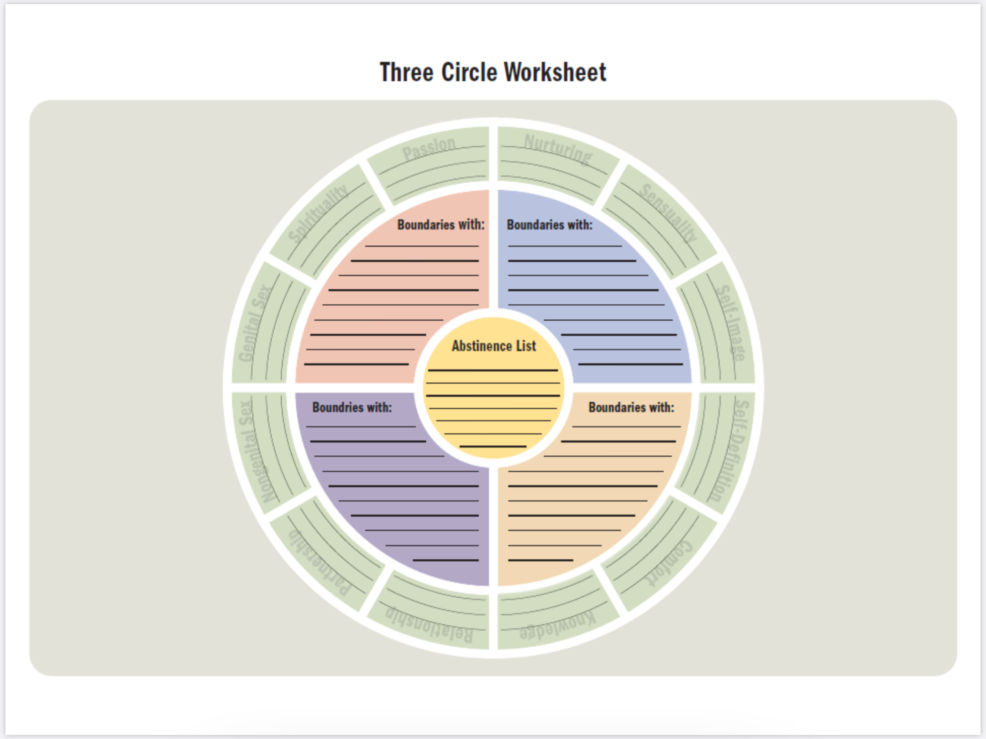

Slide 40
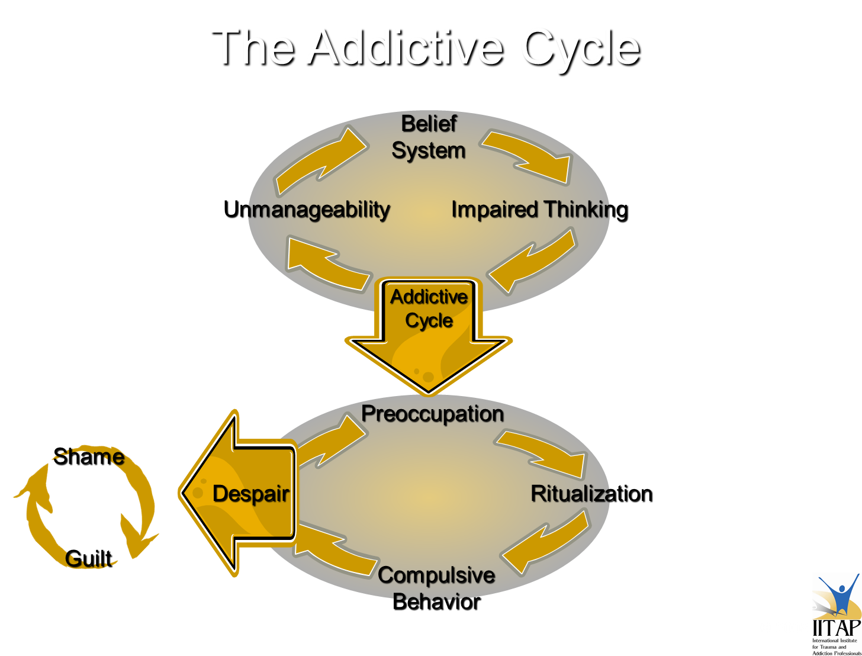

Slide 41
Managing physiological arousal
Coach clients on how to track signs of heightened arousal
Use brief structured respiration practices vs mindfulness with ‘organic’ breathing
Reduces physiological arousal and enhances mood
Focus on cyclic sighing
Box breathing
Wimhof
Cyclic hyperventilation
Balban et al. (2023). Brief structured respiration practices enhance mood and reduce physiological arousal.

Slide 42
Autonomic Ladder

Slide 43
Examples of mindful technology use
Doing homework in common area of house, where my use can be monitored, on a PC with content blockers for social media, gaming, pornography & Youtube
Only using 1 screen at a time with intentional time limits
Maintain balance through structured daily activities & set screen time (not 'earned' time)
Using a Gabb phone or “dumb” phone
Identify internal mechanisms of elevated arousal & use cool down periods
Bookending screen time with sensory deprivation & mindfulness meditation (sitting or walking)

Slide 44
Using fantasy in therapy
People go to video games, pornography, and social media for what they get to DO, and stay for who they get to BE
Social media and my persona
Pornography content as a mirror of arousal template and/or trauma
Explore themes in kinds of pornography consumed
Look for compelling or dominant themes in video games
What role or character do I like to be?
What story is appealing to me?

Slide 45
Understanding Fantasy
Dr. Michael Bader theorizes that sexual fantasy serves the role of resolving pathogenic beliefs that would otherwise inhibit the safety and pleasure necessary to experience arousal.

Slide 46
Understanding Arousal according to Dr. Bader
“The function of sexual fantasy is to undo the beliefs and feelings interfering with sexual excitement, to ensure both our safety and pleasure. Our fantasies convince us that we aren’t going to harm or betray anyone, and that if we get fully aroused, no one will suffer.”
“When it comes to sexual arousal, psychology makes use of biology, not the other way around.”

Slide 47
Fantasy Exploration Interventions
Have client write a desired sexual fantasy
Have client write a story depicting themselves as the main character in an epic story where they can have special powers, superhero qualities, etc
Ask client to bring gaming console into session or explore contents of their social media pages together
Identify core themes and story lines present in fantasy
Work with client to integrate these experiences in more intentional, conscious way
Use compelling themes as potential targets for trauma work, EMDR, experiential therapies

Slide 48
Practical Recovery Examples
Have historical thought distortions and excuses posted in plain sight near devices
“I’m only going to re-download Snapchat to check people’s stories and then I’ll get off.” “I need to research this topic and Reddit is the only place that has this information.” “I can just look at a couple people’s profiles that I know are more sexually explicit but that’s different than watching porn.” “I’m just going to check the future’s predictions one more time to make sure I don’t want to change my position.”
Transparent consultation on ongoing basis of screen activities
Therapist, parent, sponsor, etc
Maintain consistent boundaries with non-screen mood regulation strategies
Exercise, yoga, meditation, sensory deprivation practices, talking with a friend
If wanting to engage in isolated self-stimulating behavior (gaming on mobile or console, watching Netflix alone, etc) make 2 phone calls or connect with 2 people to have a check-in related to your current feelings, mood, and/or sources of stress
If after completing 2 honest connection opportunities & the desire to stimulate is still present, move towards the behavior with a planned time allotment and utilize accountability support.

Slide 49
Imaginative Attachment Visualization

Slide 50
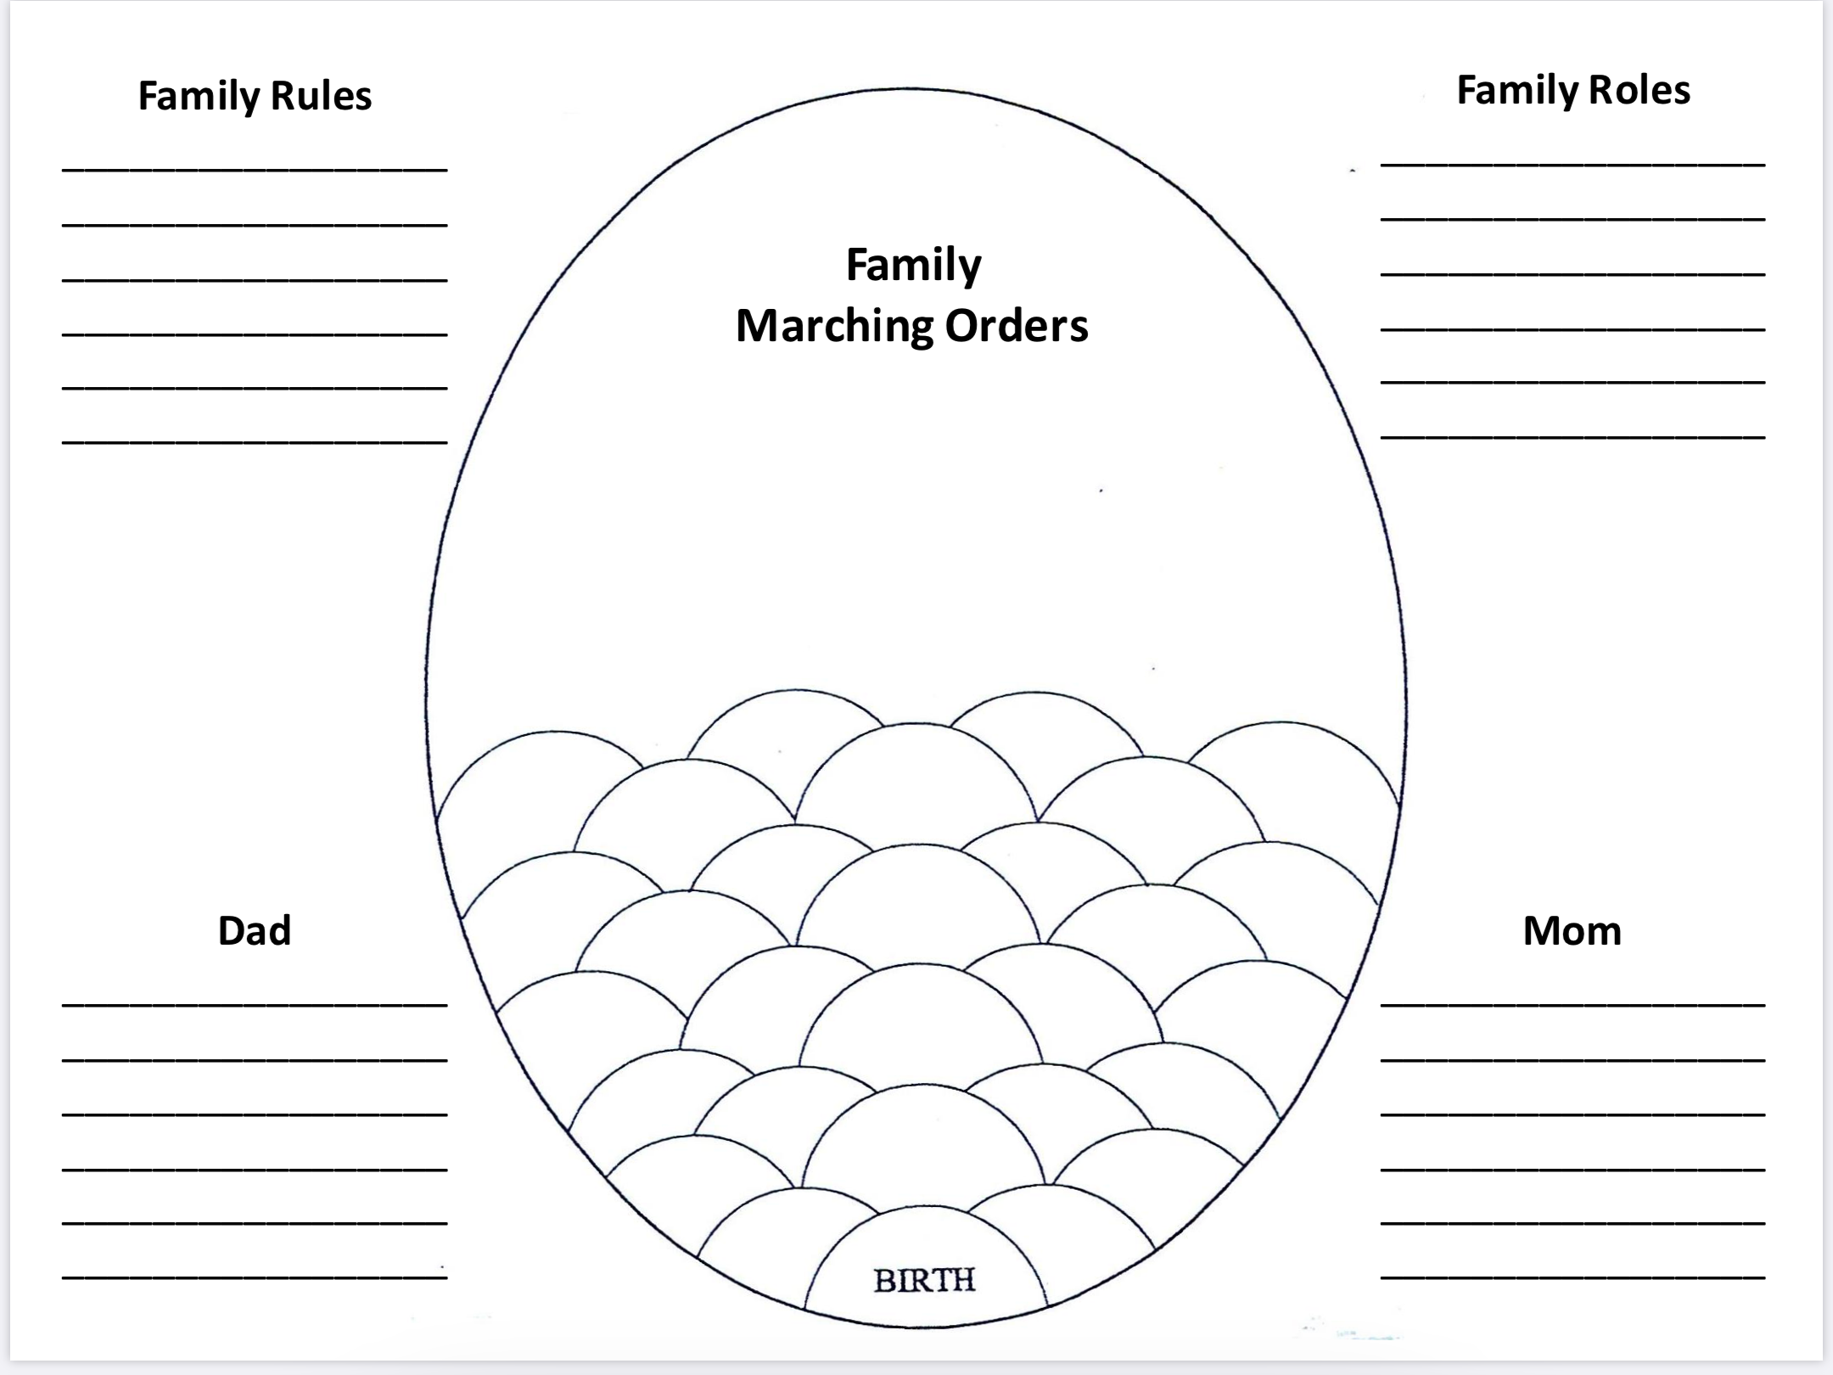

Slide 51
Recommendations for Screen Use
Birth – 3 years old: no screen use if possible. Limit to only Facetime with a parent or educational material with a parent.
3 – 6 years old: 90 minutes of passive screen time per day, abstain from interactive screen use
6 – 12 years old: 90 minutes of passive screen use per day, prolong solo interactive screen use as long as possible, no more than 60 minutes per day
12 – 18 years old:
Start with 2 hours of interactive screen use per day, move towards greater autonomy as person gets closer to 18
Maintain boundaries that screen use occurs after responsibilities and socializing is completed
Use blockers and filters
Allow autonomy and privacy as child gets older
Parents make the screen boundaries and do not use ‘earned time’ concept
American Academy of Child and Adolescent Psychiatry (2020). Screen time and children.
American Academy of Pediatrics (2022). Down time from screen time.

Slide 52
Prevention continued…
Keep phones out of bedroom at night, no TV in bedroom
Turn off notifications on all apps except call and text
When using laptop or tablet for work/school keep phone in separate room
Don’t keep phone on physical person while in your living space
Keep stimulating interactive screen use to 30 minute windows with sensory deprivation, exercise, or structured breathing breaks in between
Screen use breaks can be useful even if not meeting full addiction criteria

Slide 53
Types of Parental Intervention
In a meta-analysis conducted in 2019, Chen and Shi identified the following categories of parental intervention with screen use:
Active Mediation
Dialogue and active discussion about types of media usage
Dialogue respects and places emphasis on child’s perspective, autonomy, and self-determination
Restrictive Mediation
Rule making
Concrete limit setting
Use of filtering, blocking, tracking apps
Co-using
Using the media along with the child whether TV, web surfing, gaming
Does not involve discussion

Slide 54
Parental Intervention Effectiveness
Active Mediation
Suggests a reduction in total screen time and reduction in risky social media use, privacy disclosure, and cyberbullying
Cultivates critical stance toward media
Changes attitude towards pornography and TV violence
Restrictive Mediation
Associated with decrease in sexual solicitations, time spent on screens, and exposure to cyberbullying
Can have ‘boomerang’ effect of increasing positive attitudes towards pornography, violence in gaming and TV, and risky social media behavior if not paired with active mediation
Co-using
Currently producing mixed results
May improve level of learning associated with media use but may also increase screen time and media induced escalation of aggression
(Chen & Shi, 2019)

Slide 55
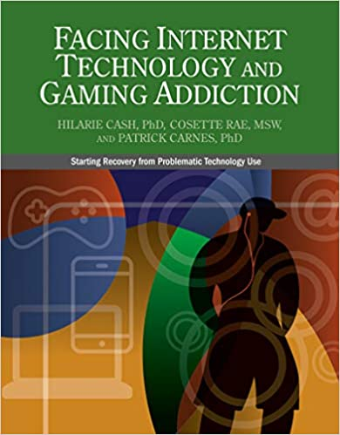
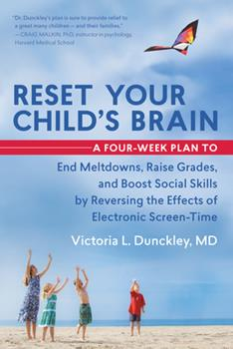
Recommended Reading

Slide 56
Additional Resources
RestartLife
https://www.restartlife.com
Access screens/assessments related to gaming and problematic screen use
https://www.albertahealthservices.ca/info/Page17566.aspx
Reset Your Child’s Brain
https://drdunckley.com/reset-your-childs-brain/

Slide 57
References
AACAP. (2020). Screen time and children. Retrieved October 17, 2022, from https://www.aacap.org/AACAP/Families_and_Youth/Facts_for_Families/FFF-Guide/Children-And-Watching-TV-054.aspx
Balban, M. Y., Neri, E., Kogon, M. M., Weed, L., Nouriani, B., Jo, B., Holl, G., Zeitzer, J. M., Spiegel, D., & Huberman, A. D. (2023). Brief structured respiration practices enhance mood and reduce physiological arousal. Cell Reports Medicine, 0(0). https://doi.org/10.1016/j.xcrm.2022.100895
Chen, L., & Shi, J. (2018). Reducing harm from media: A meta-analysis of parental mediation. Journalism & Mass Communication Quarterly, 96 (1), 173–193. https://doi.org/10.1177/1077699018754908
Dunckley V. L. (2015). Reset your child's brain : a four-week plan to end meltdowns raise grades and boost social skills by reversing the effects of electronic screen-time. New World Library.
Porges, S. W. (2011). The polyvagal theory: Neurophysiological foundations of emotions, attachment, communication, and self-regulation. W W Norton & Co.
Siegel, D. J., & Hartzell, M. (2005). Parenting from the inside out. Jeremy P Tarcher.

