Slide 1
Gender Differences in Addiction
Ellen A. Ovson, M.D., F.A.S.A.M
Medical Director, Lakeview Health

Slide 3
Learning Objectives
Participants will be able to:
Define sex and gender differences that affect women’s experience with substance use, SUD services, and recovery
Identify common reasons that women initiate substance use, along with risk factors and protective factors for women and girls
Identify three common barriers women have in seeking and accessing treatment
Notes:
By the end of this module, you will achieve the following three learning objectives.

Slide 4
Women are . . .
Notes:
Trainer Notes: Women Are” Icebreaker, Full Group Discussion
Have everyone go around the room and respond with one strengths-based word to complete the sentence: “Women are . . . “ (or can use “Women who come to our program are . . . “ or “Women I see in my practice are . . . “).
Tell participants that if the word they thought of has already been said by someone else, they should pick another word. Write the words on a flip chart page and post them for everyone to see.
This exercise will capture the diversity and strengths of women, and the perspectives of participants.

Slide 5
Sex and Gender Differences
“Sex” and “gender” do not mean the same thing.
Sex differences are related to biology.
Gender is part of a person’s self-representation. It relates to culturally defined characteristics of masculinity and femininity.
There are both sex and gender differences that relate to SUDs and SUD treatment for men and women.
Notes:
The terms sex and gender are often used interchangeably in today’s world, but their root meanings are not the same.
Sex differences relate to biology.
Differences between males and females include reproductive organs, hormones, body size, metabolism, and bone mass.
Sex differences are not absolutes, and many are on a spectrum. For example, men as a whole have more physical strength than women. Yet there are women who are physically stronger than most men, and men who are physically weaker than many women.
Another example is hormones. Though testosterone (an androgen) is thought of as a “male” hormone, and estrogen is thought of as a “female” hormone, both hormones are present in both males and females. The levels of these hormones in the body differs by person.
Gender differences refer to the characteristics, roles, and expectations constructed by culture and social norms related to what it means to be masculine or feminine, or to be a man or woman.
Gender differences will be discussed in a moment.
Note to Trainer: No matter what sex a person was assigned at birth, that person may identify as a woman, man, transgender man or woman, gender non-conforming, or another gender identity. The terms “woman/girl” are used in this presentation to refer to anyone who identifies as female. If a client identifies as a girl or woman, she should be considered as such by center staff.
DISCUSSION QUESTION:
What are some of the ways that women and men are the same?
What are some ways women and men are different?
RESOURCES
For more information about sex differences, see:
TIP 51: Chapter 3, “Physiological Effects of Alcohol, Drugs, and Tobacco on Women” (pp. 37-56) and “Biological and Psychological” (pp. 7-9) (SAMHSA, 2009)
National Institutes of Health’s Office of Research on Women’s Health website “A to Z Guide: Sex and Gender Influences on Health” at http://orwh.od.nih.gov/resources/sexgenderhealth/index.asp

Slide 6
Telescoping and Other Sex-related Differences
Telescoping, in this use of the term, refers to an effect whereby women “progress faster than men from initial use to alcohol- and drug-related problems, even when using a similar or lesser amount of substances.”
(Substance Abuse and Mental Health Services Administration [SAMHSA], 2009, p. 27; Piazza et al., 1989)
Notes:
Telescoping, in this instance, is related to sex differences. Far more studies exist about the effects of alcohol on women, versus men, than about illicit drugs. However, there is evidence suggesting women are more vulnerable than men to the negative health effects of illicit drugs (SAMHSA, 2009).
Examples of sex-related differences related to alcohol use include:
In general, women develop alcohol-related physical health problems at lower levels of consumption over shorter periods of time than men (Antai-Otong, 2006; Van Thiel, 1989; SAMHSA, 2009, p. 41). They also have increased severity, greater numbers of, and faster development of alcohol-related health complications (SAMHSA, 2009, p. 40; Blum et al. 1998; Greenfield, 1996)
Women become more cognitively impaired than men by alcohol consumption (SAMHSA, 2009).
When women and men of the same weight have the same amount of alcohol, the women end up with higher concentrations of blood alcohol (SAMHSA, 2009). This is because women have proportionately more body fat and a lower volume of body water to dilute alcohol (Romach and Sellers, 1998).
At a rate of drinking two to three standard drinks each day, women have a higher mortality rate than men who drink the same amount (Holman et al., 1996).
Women develop other alcohol-related diseases at lower total lifetime exposures than men, such as liver disease, cardiac damage, and breast cancer (Van Thiel et al., 1989).
Telescoping also applies to nicotine. Smoking alters dopamine in the brain at different rates and in different locations in men and women; women have the response in the brain region associated with habit formation (NIH, 2016). Women metabolize nicotine faster than men, so nicotine replacement therapies can be less effective in women (NIH, 2016).
RESOURCES
SAMHSA’s TIP 51 (2009), lists various journal articles, studies, and information related to telescoping and substance use on pages 27, and 40-48.

Slide 7
Lessons from the “Big Book”
“”To be gravely affected, one does not necessarily have to drink a long time nor take the quantities some of us have. This is particularly true of women. Potential female alcoholics often turn into the real thing and are gone beyond recall in a few years.” page 33, Alcoholics Anonymous, 1939

Slide 8
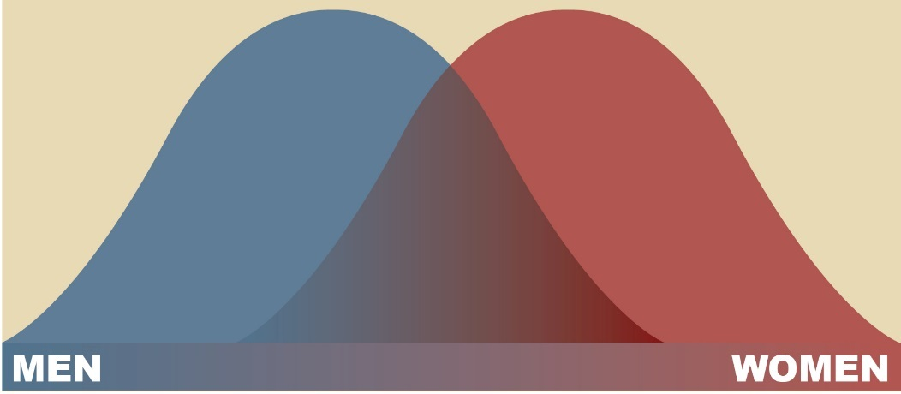
Gender Differences
Factors such as culture, age, socioeconomic status, religion, disability, race/ethnicity, and sexual orientation all influence gender roles and expectations.
Some gender traits are common, but none are absolute.
Notes:
One’s sense of masculinity or femininity is part of one’s identity. People measure their femaleness and maleness against certain accepted norms and what it means to be a “man” or a “woman” in one’s culture, religion, race, and so on. What is “acceptable” for men and women in one culture may be thought of as unacceptable, inappropriate, or shameful in another. But not everyone follows, or is comfortable, with those norms.
Certain characteristics are common among women and girls and ought to be taken into consideration, but don’t assume a woman or girl fits common gender characteristics or traits simply because she is female or because of her culture, race, religion, sexual orientation, and so on. Many women have traits that are associated with being masculine, and many men have feminine traits, no matter their culture, gender identity, or sexual orientation.
Gender differences tend to occur on two bell curves, like those shown on this slide. Traits linked to men and masculinity are on the left of the spectrum, and traits linked to women and femininity are on the right. Men and women overlap quite a bit. For example, men as a whole have more physical strength than women, but there are women who are physically stronger than most men, and men who are physically weaker than many women.
If you are serving women, you need to adapt services so they meet women’s needs. To do this, it helps to have an understanding of the women’s “bell curve” and to know that differences among women lie along the curve.
DISCUSSION QUESTION:
What are some examples of the red curve/blue curve?
How has the red curve/blue curve shifted with time? (e.g., there are more women who have careers in math, science and engineering now than there used to be; there are more men with responsibilities for children.)
RESOURCES
For more information about gender differences, see:
Addressing the Needs of Women and Girls: Developing Core Competencies for Mental Health and Substance Abuse Service Professionals (SAMHSA, 2011, pp. 2, 10-15, 24)
Introduction to Women and SUDs online course, Module One (SAMHSA, n.d.)
SAMHSA’s Guidance Document: Supporting Women in Co-ed Settings (SAMHSA, 2016a)

Slide 9
Why Gender Matters
Though women and men have much in common, sex and gender differences influence their lives and experiences.
Common differences between men and women affect the treatment and recovery needs of women with SUDs.
Notes:
Both sex and gender differences have an impact on the development of SUDs and on the treatment and recovery service needs of women with SUDs.
Differences between men and women include biological, as well as social and environmental factors. These will all discussed in this section.
RESOURCES
For more details about the importance of this topic and the need for core competencies when working with women and girls see:
Addressing the Needs of Women and Girls: Developing Core Competencies for Mental Health and Substance Abuse Service Professionals (SAMHSA, 2011, pp. 2-9)
Guidance to States: Treatment Standards for Women with Substance Use Disorders, “Introduction and Background” (Mandell & Werner, 2008, pp. 6-8)
TIP 51: Substance Abuse Treatment: Addressing the Specific Needs of Women, “Executive Summary” (SAMHSA, 2009, pp. xvii-xxiii)

Slide 10
Activity – Sex vs. Gender
Is it a sex or gender difference?
Notes:
Trainer Notes: Sex vs. Gender, Full Group Exercise
Call out some characteristics and ask people to raise their right hand if they think it is relates more commonly to sex and raise their left hand if they think it relates more commonly to gender.
Ask people to raise both hands if they think that something can be related to both sex and gender, and allow for discussion about how it can be related to both.
If people disagree, allow them to present their reasons for determining something is related to a sex or a gender difference. This can present some valuable learning opportunities and discussion about different ways people may view sex and gender. It is also a good time to stress the bell curve of gender and sex traits.
Possible characteristics (trainers can use their own ideas)
Question: “Is this trait more commonly related to sex (right hand), or gender (left hand)?”
Nurturing (gender)
Physically strong (sex)
Emotional (gender)
Compassionate (gender)
Collaborative (gender)
Body shape (sex)
Assertive (gender)
Independent (gender)
Dominant (gender)
High sex drive (sex)
Height (sex)
Logical (gender)
Physical strength (sex)
Empathetic (gender)
Kind (gender)

Slide 11
Sex and Gender Differences Related to SUDs
Women often differ from men in their:
Pathways to substance use
Risk factors for use
Consequences of use
Barriers to treatment/recovery
Recovery support needs
Notes:
Sex and gender differences means that women have different experiences than men.
In regards to substance use, women typically have different pathways to substance use, risk factors for use, consequences for use, barriers to treatment, and recovery support needs.
Each of these topics will be discussed in this module.

Slide 12
Women and Men
Notes:
Trainer Notes: Women and Men, Small-Group Discussion (write questions on flipchart)
Break participants into small groups, and ask them to discuss these questions.
In general, in what ways do you feel the needs of women with SUDs differ from men with SUDs? How are they the same?
What about in relation to recovery? How do you feel women’s recovery experiences compare to men’s—what is the same, what is different?
Ask that each group share one or two of their answers.
After participants have shared ideas, note that the rest of this section will talk about these differing needs in relation to SUD treatment and recovery.

Slide 13
Culture and SUDs
“The complex interplay of culture and health— as well as the influence of differing attitudes toward, definitions of, and beliefs about health and substance use among cultural groups—affects the psychosocial development of women and their alcohol, drug, and tobacco use and abuse.”
(SAMHSA, 2009, pp. xxi–xxii)
Notes:
The risks for substance use and SUDs are best understood by looking at the cultural context of a woman’s life.
Understanding cultural differences among women is vital to designing and implementing effective SUD services.
A woman may identify with many cultural groups and consider belonging to them part of her identity. Those groups can include nationality, race/ethnicity, religion, social class, generation, sexual orientation, gender identity, locality, or any kind of social group that has its own distinct culture.
Training in cultural competence helps staff recognize individual and group strengths and resiliency factors that can help women from diverse cultural groups during treatment and recovery.
Culturally responsive care improves short- and long-term outcomes.
RESOURCES
For more information about substance abuse among specific cultural groups, see TIP 51 (SAMHSA, 2009, p.. 103-122).

Slide 14
Lesbian and Bisexual Women and SUDs
Research suggests that, compared with heterosexual women, lesbian and bisexual women:
Are more likely to consume alcohol and in greater amounts. (Case et al., 2004; Cochran et al., 2001, 2004; Hughes & Wilsnack, 1997)
Use alcohol, marijuana, prescription drugs, and tobacco more than heterosexual women and are likely to consume alcohol more frequently and in greater amounts. (Case et al., 2004; Cochran et al., 2004)
Have higher rates of substance use and dependence compared with heterosexual women. (Bickelhaupt, 1995; Cochran et al., 2000; Diamant et al., 2000)
Notes:
These findings suggest that prevention and treatment programs should specifically address substance use among lesbian and bisexual women.
Adolescent females and women who are struggling around their sexual orientation or experiencing prejudice have a greater risk of initiating and maintaining substance use (McKirnan & Peterson, 1992).
Only 6% of substance abuse treatment services offer special programs or group therapy for lesbian women. (SAMHSA, 2009)
One reason for the higher rates of substance use among lesbians may be that adverse, punitive, and traumatic reactions from parents or caregivers in response to their children’s sexual orientation has been linked with poor mental health and an increase in substance use (Ryan, et al., 2009; Hughes et al., 2007). Also, adolescent females and women who are struggling around their sexual orientation or experiencing prejudice have a greater risk of initiating and maintaining substance use (McKirnan & Peterson, 1992).
SAMHSA’s TIP 51 recommends that SUD staff “explore coping style and enhance coping skills needed to manage stress associated with self-disclosure and the habitual ‘coming out’ process, to deal with attitudes from others regarding sexual orientation, and to address feelings of alienation from family members who are rejecting of sexual orientation” (p. 125).
RESOURCES
For more information about ways to best serve lesbian and bisexual women in behavioral health settings, see:
Top Health Issues for LGBT Populations Information & Resource Kit (SAMHSA, 2012d)
TIP 51 (SAMHSA, 2009, pp. 22, 124-125

Slide 15
Women and the Military
Women make up approximately 15 percent of the armed forces. (Office of the Deputy Assistant Secretary of Defense, 2013)
Women who are in the military are at risk of additional trauma, including military sexual trauma (MST). Many also experience trauma prior to joining the military.
Substance use among women veterans is high.
Women with military experience often have higher than average work experience and education levels.
Notes:
Military sexual trauma is commonly reported by women veterans. Department of Veterans Affairs (VA) data show that 1 out of every 4 to 5 women veterans experiences military sexual trauma, which is associated with both substance use and mental conditions, including PTSD, depression, and other anxiety disorders (SAMHSA, 2012c; U.S. Department of Veterans Affairs, 2015a).
On average, more than 7% of veterans report a substance use disorder. Younger veterans are more likely to have a history of substance abuse, and one-fifth Iraq and Afghanistan veterans are diagnosed with an SUD (U.S. Department of Veterans Affairs, 2015b).
Though more men than women veterans are treated for substance abuse, the number of women veterans admitted to treatment programs has been on the rise. More than half of women veterans in these programs are treated for alcohol abuse and more than one-fifth for cocaine use, followed by opiates, marijuana, and other drugs (U.S. Department of Veterans Affairs, 2015b).
As a benefit during recovery, all female veterans have work experience through their military service, and many have specialized advanced training, as all service personnel receive advanced training in their fields. Advanced training and cross-referenced training can be in the computerized, financial, medical, engineering, administrative, personnel, technical, mechanical, and security fields. Many women veterans also received leadership training and experience during their service. This experience can be helpful in finding these women employment after SUD treatment/recovery services end.
In addition, according the U.S. Department of Veterans Affairs (2011):
Higher percentages of both male and female veterans had completed some college education (i.e., an Associate’s degree or less) compared with non-veterans.
Female veterans were also more likely than male veterans to have completed some college education and to have completed a bachelor’s degree.
Female veterans were more likely to have a bachelor’s degree than their non-veteran counterparts.
Since 2004, the percentage of female veterans with an advanced degree has been significantly higher than female non-veterans.
RESOURCES
For more information about women veterans and behavioral health issues, see Behavioral Health Issues among Afghanistan and Iraq U.S. War Veterans (SAMHSA, 2012).
For information about effects of trauma, violence, and abuse on women in the military, see Action Steps for Improving Women’s Mental Health (Office On Women’s Health, 2009, pp. 9-10).

Slide 16
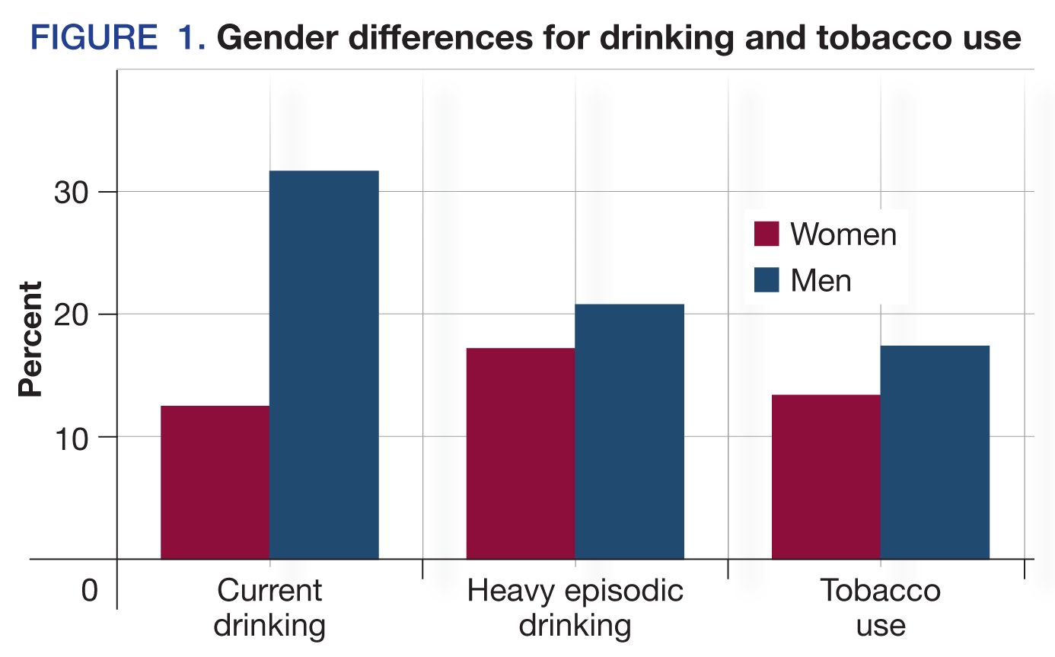

Slide 17
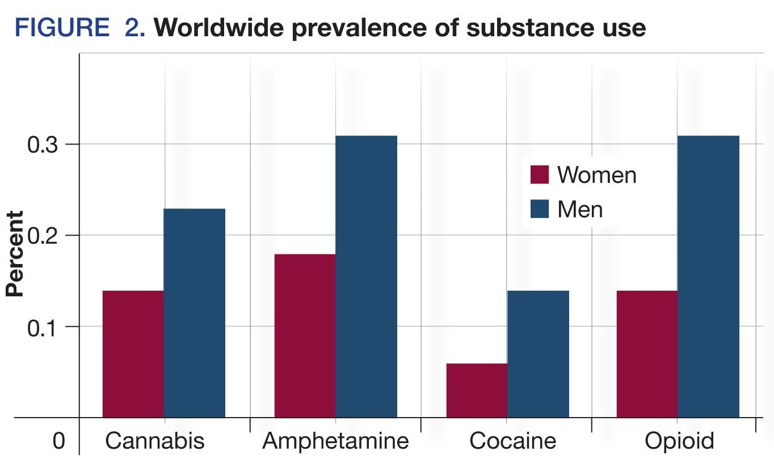

Slide 18
Lessons from the “Big Book”
“More than 15% of us are women.” page xx, Forward to the 2nd edition, 1955.
“Women now make up more than one-fourth of the membership; among newer members, the proportion in nearly one third.” page xxii, Forward to the 3rd edition, 1976.

Slide 19
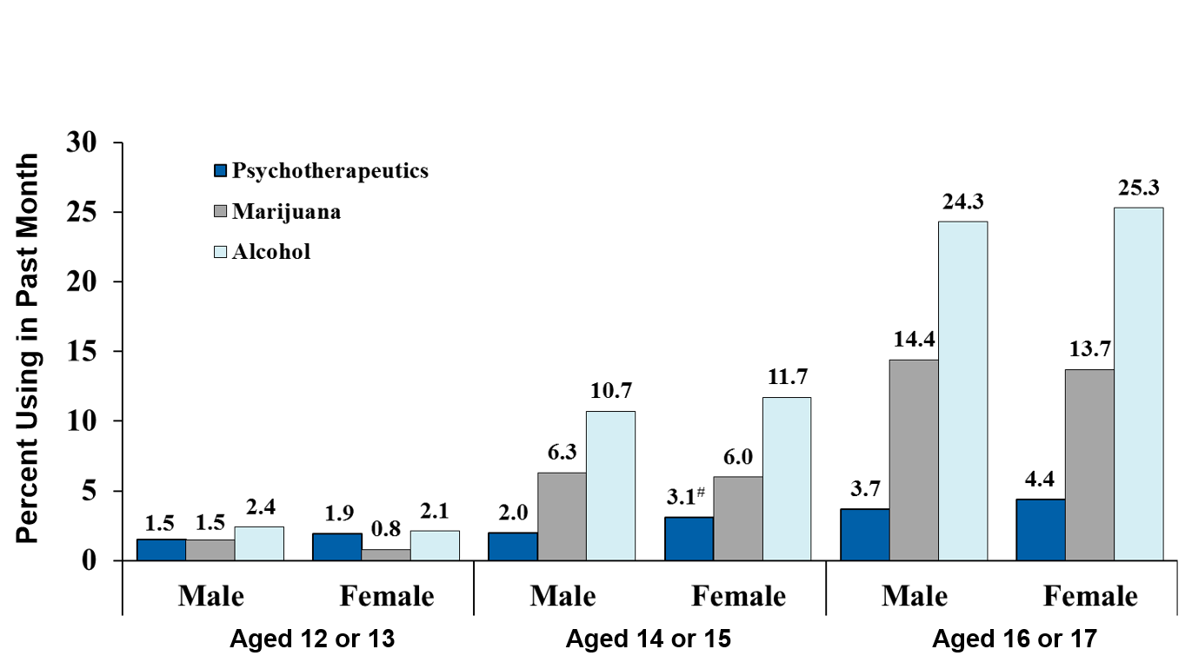
Substance Use: Adolescents
Past Month Use of Selected Illicit Drugs and Alcohol among Youths Aged 12 to 17, by Gender and Age Group: 2012
# Difference between this estimate and the male estimate is statistically significant at the .05 level.
Source: SAMHSA. (2013c). Results from the 2012 National Survey on Drug Use and Health: Mental health findings, NSDUH Series H-47.
Notes:
In this graph, you can see that among adolescent girls and boys ages 12-17, girls are using alcohol and most illicit substances at the same or slightly higher rates than boys.
Boys in all age groups are more likely to use marijuana but girls in each age group are more likely to engage in nonmedical use of psychotherapeutic drugs such as pain relievers, tranquilizers, stimulants and sedatives, as well as alcohol.
RESOURCE
Statistics adapted from Results from the 2012 National Survey on Drug Use and Health: Mental health findings, NSDUH Series H-47 (SAMHSA, 2013c).

Slide 20
Stages of Addiction
Initiation/acquisition
Escalation
Maintenance
Abstinence and/or withdrawal
Relapse or reinstatement

Slide 21
Sex Differences in Stages of Addiction
 | Acquisition | Escalation | Maintenance | Withdrawal | Relapse
Women | Initial exposure to drug, food or activity. May experience more pleasurable responses to drugs than men (cocaine, amphetamine). More likely to self- medicate than men. | Increase in amount and frequency of drug taking. For those at risk for addiction, escalation is more rapid than for men (gambling, alcohol, drugs). | The addictive behavior is established and stabilizes. Females stabilize at higher doses of drug than do males. Side effects of drug use are greater for women. | Female smokers report increased negative affect during withdrawal and experience a greater stress response than men do. | Women are more likely to relapse than men and do so more sporadically.
Men | Initial exposure to drug, food or activity. Take drugs and engage in risky behaviors to be part of the group more than women do. | Slower escalation than for women (gambling, alcohol, drugs). | The addictive behavior is established and stabilizes. Males stabilize at lower doses of drug than do females. | Men exhibit greater symptoms of withdrawal from alcohol than women. | Men have longer periods of abstinence than women.

Slide 22
Women tend to progress more rapidly from initial experience to addiction
Women experience greater unpleasant symptoms than men in withdrawal – greater effects on mood and anxiety as well as an exaggerated stress response.
However, men exhibit greater withdrawal symptoms from alcohol.

Slide 23
The greater propensity of women to relapse is associated with negative affect and greater withdrawal severity to some drugs.
Alternatively, women may experience greater sensitivity to stress or “the cues” associated with the drug.
Greater cue-induced reinstatement of drug taking has been replicated in animal models.

Slide 24
Issues related to social support for maintaining abstinence, with men tending to be more supported at home and on the job, while women tend to be more isolated
Women may experience greater stigma

Slide 25
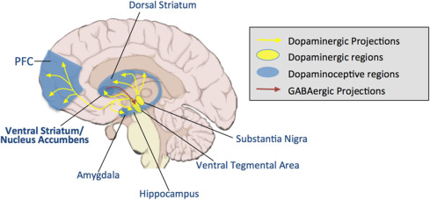
Anatomy of Addictive Disease Men vs. Women

Slide 26
The Possible Biological Reasons That Women are Different

Slide 27
Harvard Study

Slide 28
Study at Harvard-affiliated Massachusetts General Hospital has shown different effects in the reward systems in men’s and women’s brains.
Reward system consists of several structures including the amygdala and hippocampus.

Slide 29
Researchers compared MRIs of 30 women and 30 men with chronic alcoholism who had been abstinent for at least four weeks and 31 women and 29 men who were not known to abuse alcohol.

Slide 30
The reward systems of the alcoholic women were, on average, 4.4% larger than those of nonalcoholic women.
Reverse was true in men – alcoholic men had reward systems 4.1% smaller than nonalcoholic men.

Slide 31
Earlier studies have shown that excessive drinking is often linked with anxiety disorders in women and antisocial personality behavior in men.
Suggests men and women may need different types of treatment!
May reflect an underlying gender difference in psychological factors that motivate men and women to drink.

Slide 32
More Recent Research

Slide 33
The Neurobiology of Sex Differences in Addiction
Nucleus accumbens is important for engaging in behaviors that are initially rewarding.
Dorsal striatum is involved in escalated drug-taking and compulsive behaviors.
Dorsal striatum is important for well-learned patterns of behavior without the intentional control of the prefrontal cortex. (Driving a stick shift)

Slide 34
The Neurobiology of Sex Differences in Addiction
Female rats and humans shift from voluntary control to compulsive drug intake more rapidly than males.
Due to reduction in nucleus accumbens dopamine release that allows the dorsal striatum to assume control.
Female smokers exhibit lower response in the ventral striatum than the dorsal striatum to nicotine stimulation.

Slide 35
The Neurobiology of Sex Differences in Addiction
Female rats exhibit enhance drug-, cue- and stress-induced reinstatement in alcohol, cocaine, and morphine-seeking compared to males.
Phases of the menstrual and estrous cycles affect drug-taking and quitting behaviors of females, with higher estrogen levels enhancing the effects of drugs, especially stimulants.

Slide 36
Types of sex differences
Type | Qualitative sex differences | Quantitative sex differences | Convergent sex differences | Population sex differences
How males and females differ | Females exhibit one behavior and males exhibit a different behavior on a given test. The traits cannot be measured on the same scale. | One sex exhibits a greater response than the other in the same conditions. The event can be measured on the same scale. | Males and females exhibit the same behavior, but the underlying processes that mediate the trait are different. | The proportion of males and females with a trait differs.

Slide 37
The Neurobiology of Sex Differences in Addiction
Qualitative: Women have estradiol.
Quantitative: Neural mechanism the same, but female psychomotor response to amphetamine greater initially.

Slide 38
The Neurobiology of Sex Differences in Addiction
Convergent: Both males and females progress to compulsive drug use, but estradiol in females enhances dopamine in the dorsal striatum.
Population: Difference in rate of escalation to drug taking influenced by prenatal stress – causes male rats to resemble females!

Slide 39
The Neurobiology of Sex Differences in Addiction
Childhood abuse and trauma: Abused girls more likely than boys to abuse illegal drugs as adults.

Slide 40
The Neurobiology of Sex Differences in Addiction
Sexual differentiation of the bipotential brain is not bimodal – either all male or all female – affected by events during embryonic and postnatal life, with events prior to puberty having a greater effect.
Maternal stress makes male and female fetuses less masculinized.

Slide 41
Males will be less aggressive and more prone to addiction and have learning deficits as adults.
Females will exhibit greater anxiety and depression.
The Neurobiology of Sex Differences in Addiction

Slide 42
Protective Factors for Girls/Young Women
Feeling connected to family, cared about, and supported; high parental warmth
Parent disapproval of substance use
Religious/spiritual practices
Coping skills
Notes:
Initiation of substance use for girls/young women can be different than boys/young men. It is important to note there are also protective factors for girls and young women.
Several protective factors can help prevent substance use and SUDS. This slide lists some of the top factors (Agrawal et al. 2005; (Mrazek and Haggerty 1994; SAMHSA, 2009; Van Gundy 2006). Other factors include family togetherness during meal time and feeling part of one’s school (SAMHSA, n.d.).
RESOURCES
For more about protective factors see:
Introduction to Women and SUDs online course, Module One
TIP 51 (SAMHA, 2009, pp. 2-23, 27, 103-135)

Slide 43
Common Reasons/Risks Factors for Initiation of Substance Use
Influence of relationships
Co-occurring disorders
Trauma history
Prescription medications
Notes:
There are many reasons and risk factors that lead to substance use for women, and these four are among the most common (SAMHSA, 2009):
Relationships:
Women are strongly influenced by familial substance abuse/friends/partners who use substances.
Initiation of substance use typically begins after introduction of substance through a significant relationship, such as intimate partner.
Women more likely than men to define selves in terms of their relationships and obligations.
CODs:
CODs are more likely for women with SUDS than men with SUDs, particularly mood disorders, anxiety disorders, and eating disorders.
Women may use substances to improve mood/mood disorders: to relax, reduce stress, focus attention, and increase confidence.
Women may use substances in relation to eating disorders/body image concerns, to obtain positive effects such as weight loss and increased energy.
Trauma:
Past trauma is more likely for women, including rape, sexual assault, intimate partner violence.
Women may use substances to cope with emotional effects of trauma.
Women who experience child abuse, sexual assault, or intimate partner violence are significantly more likely to develop SUDs than other women.
Prescription Drugs:
Women are much more likely than men to be prescribed addictive drugs by their doctors and to become dependent on them.
Women are 48% more likely than men to use a prescription drug that can be abused, and 55% of new people who used these drugs were female (SAMHSA, 2009).
RESOURCES
For more information about pathways and risks, see TIP 51, “Risks Factors Associated with Initiation of Substance Use and the Development of Substance Use Disorders Among Women” (2009, pp. 18-26).

Slide 44
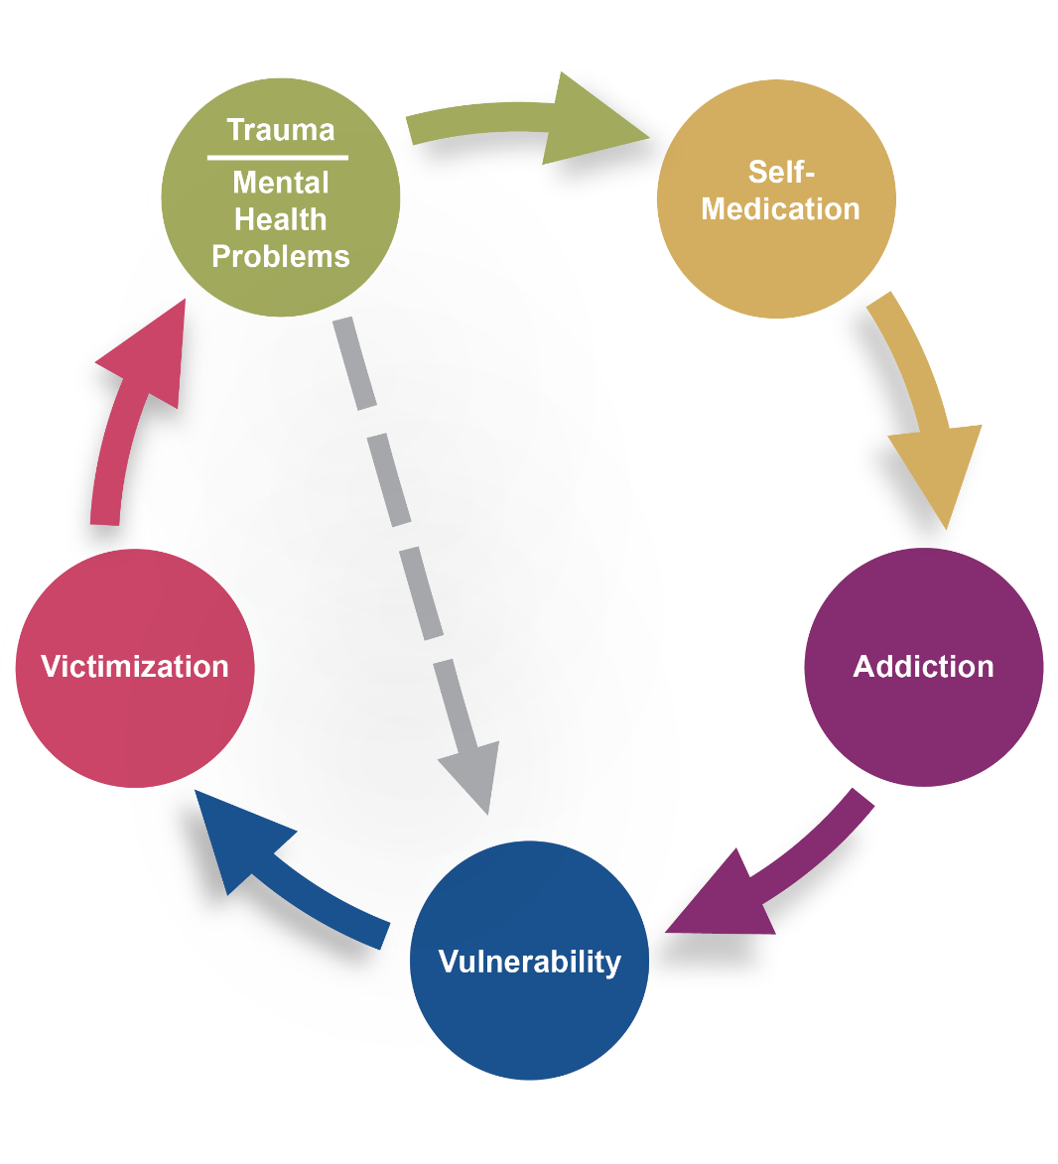
Substance Use, Trauma, and Mental Health Cycle
© Institute for Health and Recovery
Notes:
There is a high prevalence of trauma among women with SUDs, which affects their treatment needs.
Women may initiate substance use as a way of coping with traumatic experiences.
Substance use, though, can then also lead to risky behaviors, which make women more vulnerable to further victimization. If they’re victimized while impaired, it is highly likely that they will be blamed, thus increasing shame, guilt, and stigma.
Conversely, risky substance use can exacerbate mental health concerns and continued trauma/violence, which then re-traumatizes the woman and leads to continued substance use as an escape.
For women with trauma histories, the issues of trauma, substance use, and mental health concerns are interrelated.
RESOURCES
For more information about the link between trauma and mental health concerns and substance use, and trauma prevalence among women with SUDS, see:
Action Steps for Improving Women’s Mental Health (Office on Women’s Health, 2009, pp. 9-10)
TIP 51 (SAMHSA, 2009, pp. 8-9 and Chapter 2), and TIP 57 (SAMHSA, 2014a, p. 89)
Women Matter! webinar titled “Women in the Mirror: Addressing Co-Occurring Mental Health Issues and Trauma in Women with Substance Use Disorders” at http://www.samhsa.gov/women-children-families/trainings/women-matter

Slide 45
Other Risk Factors for Substance Use and SUDs
Easy access
Positive effects
Mood disorders
Lack of positive activities
Home atmosphere
Notes:
Some additional risk factors that can lead to substance use and eventual SUDS in women include:
Easy access. Availability of substances in the home or community, affordability, the ease with which substances can be purchased, and social norms that encourage rather than discourage substance use are all factors that increase the likelihood of women initiating substance use.
Positive effects. If a woman experiences positive effects from her initial substance use such as weight loss, approval of an intimate partner, or stress reduction, her substance use is more likely to continue.
Mood disorders. Women with mood disorders may use substances to self medicate and manage distressing feelings and gain relief. Anxiety disorders and major depression are positively associated with substance use, abuse, and dependence. However, psychiatric disorders may occur as a consequence of substance use, or develop independently, yet at the same time. (Tip 51, p. 24)
Lack of positive activities. Involvement in positive activities is a protective factor, and women who are not involved in activities they enjoy and in which they are successful (such as sports, arts, and religious activities) are more vulnerable to substance abuse.
Home atmosphere. Taking on adult responsibilities as a child, including parenting of younger siblings and emotional support of parents, raises girls’/women’s risk of initiating drug and alcohol use. A chaotic, argumentative, blame-oriented, and violent household is also major risk factor for substance initiation and dependence for women.
RESOURCES
For more information about these risks, see TIP 51, pp 18-26, under “Risk Factors Associated with Initiation of Substance Use and the Development of Substance Use Disorders Among Women” (SAMHSA, 2009).

Slide 46
Consequences/Risks of Substance Use and SUDs
Women with SUDs may experience:
Loss of their children
Loss of relationships
Increased trauma or violence, including rape, assault, or intimate partner violence
Notes:
Children:
Because women are more likely to be primary caregivers, they are typically at higher risk of losing custody of their children due to SUDs.
However, a woman who is the primary caretaker for her family may want to get help so she can be a more effective parent and take better care of her family. Maintaining caring relationships with their children is often sufficient motivation to keep them a woman in treatment (SAMHSA, 2009).
Women are also more likely than men to get SUD treatment because it affects child custody. These women are most likely to complete treatment if they can have their children with them in treatment (Brady & Ashley, 2005; Lungren et al., 2003; Szuster et al. 1996).
Relationship Loss:
SUDs can put a strain on intimate partner and familial relationships, as well as friendships.
However, seeking treatment for an SUD can also affect a woman’s relationship with her partner. For women seeking SUD treatment, there is often difficulty involving partners in the treatment. Partners with SUDs may prevent their female partners from entering or staying in treatment or be unsupportive, unless that partner is also involved in treatment/recovery.
As one example, women with alcohol problems are more likely than men to be left by their partners at time of treatment entry, and their partners are less likely to stay with them after completion (Lex, 1991).
Thus, women who fear losing their partner may not seek or stay in treatment. This is particularly true when substance use is a major part of the relationship and a symbol of intimacy and closeness (SAMHSA, 2009).
Violence/Trauma:
Trauma can be a pathway to initiation of substance use, and substances can be used as a coping mechanism. But SUDs also “increase a woman’s vulnerability to additional trauma, decrease her ability to defend herself, alter her judgment, and draw her into unsafe environments.” (SAMHSA, 2009).
Thus, trauma/violence are both a risk factor for, and a consequence of, substance use disorders.
One survey showed that 60% of women in SUD treatment reported either current or past domestic violence, 47% reported current domestic violence at intake, and 39% reported either physical or emotional abuse in the past year leading up to treatment. (Swan et al., 2000).
RESOURCES
For more information about these risks, see TIP 51 (SAMHSA, 2009, pp. 10, 23, 8-12, 151).

Slide 47
Consequences/Risks of Substance Use and SUDs (cont.)
Women with SUDs risk:
Health problems, including:
SUD-related health conditions
HIV, hepatitis, and other infections
Pregnancy complications
Economic hardship and homelessness
Notes:
Health Conditions:
Women with SUDS often have more health-related conditions than men, including organ damage, cardiac-related conditions, reproductive consequences, breast and other cancers, osteoporosis, and nutritional deficiencies. (This will be discussed in more detail in Module 4).
Infections:
Women with SUDS are at increased risk of contracting HIV/AIDS and hepatitis from sharing needles or having sexual relations with men who inject drugs of have sex with other men. As noted in TIP 51, “Some women may have unrealistic notions about intimacy, assume their partners are monogamous, or fear alienating their partners by demanding safe sex practices. Women with a history of abuse may have particular problems negotiating the use of these practices” (SAMHSA, 2009).
Reproductive/pregnancy:
Pregnant women who continue to use alcohol, illicit, or prescription drugs place their unborn babies at risk for a wide range of health issues, including premature birth, death, fetal alcohol syndrome, neonatal abstinence syndrome, etc. This will be further discussed in the section about pregnancy and parenting.
Abuse of substances such as stimulants, opioids, and some prescription drugs can also cause adverse effects on women’s menstrual cycles and fertility, along with their gastrointestinal, neuromuscular, cardiac systems, etc.
Economic hardship/homelessness:
Women with SUDs may have a difficult time maintaining full-time employment, face financial hardship, and be unable to afford housing.
Women with both SUD and a co-occurring serious mental illness are less likely to be employed full time than women with just an SUD (SAMHSA, 2003).
SUDs are one factor that can contribute to homelessness in women. Lifetime estimates of SUDs among women who are homeless range from 56-63%; current SUDS among women who are homeless range from 38-58% (SAMHSA, 2009).
RESOURCES
For more information about health related problems associated with SUDS, see:
TIP 51, “Physiological Effects of Alcohol, Drugs, and Tobacco on Women” (SAMHSA, 2009, pp. 37-55)
TIP 42: Substance Abuse Treatment for Persons with Co-Occurring Disorders (SAMHS, 2005)
Women Matter! webinar titled “Women’s Health, Wellness, and Recovery: An Introduction to Women’s Substance Use Disorders and Health” at http://www.samhsa.gov/women-children-families/trainings/women-matter

Slide 48
Involvement with the Criminal Justice System
Increasing numbers of women and girls are becoming involved with the criminal justice system.
Many have SUDs, SUD-related arrests, and trauma histories.
Notes:
As with men, one of the consequences for substance use for women is criminal justice involvement:
The number of female inmates in all criminal justice facilities has been increasing at a faster rate than for male inmates. And more than 50% of all female prisoners reported being under the influence of drugs of alcohol when they committed their crime (Greenfield & Snell, 1999). Women are also more likely than men to have a substance-related disorder or offense. (SAMHSA, 2015c)
Women who are in criminal justice facilities have complex issues and needs, in addition to SUDs, including:
Co-occurring mental problems: Rates of mental problems among justice-involved women are significantly higher than among the general population, and are higher in comparison to justice-involved men (SAMHSA, 2015c).
High prevalence of trauma histories and CODs: As many as 78% of justice-involved women report a history of childhood or adult physical, sexual, or emotional abuse (SAMHSA, 2015c). Justice-involved women who have a history of trauma and PTSD also frequently have significant medical problems, such as HIV/AIDS, other sexually transmitted diseases, or hepatitis. By identifying these health issues during screening and assessment, these women can be referred to needed health services/providers (SAMHSA, 2015c).
Increased likelihood of pregnancy and need for prenatal care: Needs can include child care, custody, and parenting issues. In addition, most justice-involved women are primary caretakers of dependent children and may experience significant anxiety, guilt, low self-esteem, and lack of self-efficacy related to their inability to care for children during periods of incarceration (SAMHSA, 2015c).
RESOURCES
For more information about substance abuse treatment for women in the criminal justice system, see:
SAMHSA’s Tip 44: Substance Abuse Treatment for Adults in the Criminal Justice System (2005c)
Screening and Assessment of Co-Occurring Disorders in the Justice System (SAMHSA, 2015c)
Women Matter! webinar titled “Women Unbarred: Recovery and Supports for Women Involved with Criminal Justice” at http://www.samhsa.gov/women-children-families/trainings/women-matter

Slide 49
Barriers to Accessing Help
Top barrier
Self (is not ready or does not feel she needs help)
Other common barriers for women:
Cost (socioeconomic hardship)
Feelings of shame and guilt
Family
Partner
Systemic
Practical
Notes:
Women experience numerous barriers to accessing help. All of these treatment barriers can be interrelated. It is vital to identify each client’s barriers and develop specific strategies to address them as soon as possible. Barriers are keeping women from getting SUD treatment, as the 2014 National Survey on Drug Use and Health revealed that only 20% of women (and 20.5% of men) who identified as needing treatment for an illicit drug problem received treatment (Center for Behavioral Health Statistics and Quality, 2015).
Self. The woman may not be at a point where she is ready and willing to seek and engage in substance use disorder services. She also may not feel she has a substance use problem.
Cost. Women with SUDS often have more economic barriers to entering and staying in SUD treatment. They often have lower incomes, less access to insurance, lack of savings or other financial resources, and less education (SAMHSA, 2009). They are also less likely than women without SUDs to be employed, which makes the costs of treatment more challenging. (SAMHSA, 2003).
Discrimination. Women are typically more harshly judged than men for substance use and may fear being viewed as a bad mother, morally lax, etc., which can lead to feelings of shame and guilt. The societal negative attitude toward women who abuse substances tends to be greater than that toward men, and this stigma can prevent women from seeking or admitting they need help (SAMHSA, 2009).
Family. Including fear of losing custody of children; a belief that change/stopping substance use is not possible; being primary caregivers of children and other family members may limit a woman’s time and ability to get help. Women are more likely than men to encounter difficulties surrounding treatment attendance due to family responsibilities (Brady & Ashley, 2005).
Partner. Including fear of losing partner, fear of partner’s reaction to her seeking help, and lack of a supportive partner. Women may have less support from family/ partners than do men for seeking treatment. Women are also more likely to relapse due to interpersonal problems and conflicts, and relapse is more likely in the presence of a significant other (McKay et al. 1996; Rubin et al. 1996; Sun 2007). However, partners can also be key motivators in getting women into treatment (SAMHSA, 2009). Treatment readiness and willingness to accept help are also higher in women whose partners have been in treatment (Riehman et al., 2000).
Systemic factors can include a woman being involved in multiple social service systems with differing expectations and purposes, including child welfare, the legal system, and social services. Other system challenges can include:
Lack of available services (e.g., such as programs for pregnancy/parenting women, co-occurring disorders)
Lack of housing
Fear of losing employment
Waiting lists or lack of women-only treatment facilities or group
Few residential programs that allow mothers to have their children with them
Lack of child care and few outpatient programs that provide services for children or child care.
Lack of transportation
Disparate requirements between systems (e.g., child welfare, probation, and TANF), which makes it difficult to comply sufficiently with requirements.
DISCUSSION QUESTION:
What are some of the specific barriers women face to accessing help in each of these categories?
What are some resources that may help them access help?
RESOURCES
For more information about barriers to treatment, see:
TIP 51, “Barriers to Treatment Engagement,” (SAMHSA, 2009, pp. 83-87)
Guidance to States: Treatment Standards for Women with Substance Use Disorders (Mandell & Werner, p. 7)

Slide 50
How Women Access Help
The primary sources of referral to SUD treatment for women are:
Self-referral, often with the help or support of family
Social service agencies, such as child protective services
Criminal justice system
Notes:
These are the three primary avenues for women seeking treatment for their SUDs (SAMHSA, 2009).
The co-occurrence of an SUD and involvement in the child welfare system ranges from 50-80 percent for women, and those women may be motivated to keep their families together or reunite with their children (Child Welfare Information Gateway, 2014).
Though women often receive healthcare services before referral to treatment, referrals from healthcare providers are one of the lowest referral routes for treatment (SAMHSA, 2009).
RESOURCES
For more information, see TIP 51: “Characteristics of Treatment Admissions Among Women” (SAMHSA, 2009, p. 31).

Slide 51
Why It Is Important to Be Gender Responsive
Gender-responsive services create an environment that reflects the understanding of the reality of women’s lives and addresses women’s issues.
Gender-responsive services help improve the effectiveness of services for women and girls.
Notes:
Learning about, and implementing, gender-responsive principles will help you improve prevention, treatment, and recovery programs for the women and girls you serve and lead to more positive outcomes. Gender-responsive differs from gender-specific in that gender-specific are services those designed solely for women. Gender-responsive is a broader way of looking at services, environment, and experiences and how they address the lives of women.
The next section will introduce you to the principles of gender-responsive services as they relate to women with SUDs.

Slide 52
Women are at a much higher risk for developing alcohol-related complications at lower levels of consumption than men.
Close to 4 million women ages 18 and older can be classified as alcoholic or problem drinkers; one third that of men; 58% between the ages of 18 and 29.

Slide 53
Co-occurring Disorders
Lifetime rate of mood and anxiety disorders is significantly higher in women than men.
12-month prevalence rates of these disorders in women with SUD were 29.7% and 26.2% respectively.
Important to monitor mood/anxiety during period of abstinence, unless strong family history or symptoms with sustained sobriety.

Slide 54
Post Traumatic Stress Disorder
History of exposure to a traumatic event that meets specific stipulations and symptoms for each of four symptom clusters:
Intrusion
Avoidance
Negative alterations in cognition and mood
Alterations in arousal and reactivity

Slide 55
Post Traumatic Stress Disorder
At least 70% of women entering treatment have been abused; numbers less clear in males.
PTSD is common in many of these patients, but is often confused with bipolar affective disorder and other psychiatric disorders.
Combination of psychosocial therapies and medications indicated.

Slide 56
Post Traumatic Stress Disorder
Combination of an SSRI for anxiolytic effect and prazosin for trauma nightmares
Failure to recognize and treat is significant factor for relapse with incidence increasing proportional to number of remaining PTSD symptoms.

Slide 57
Risk factors for problem drinking in women include:
Influence of partner’s drinking, depression, sexual experience, sexual orientation, sexual dysfunction, and violent victimization.
Over 4 million women need treatment.

Slide 58
70% of drug-using women have been abused sexually before the age of 18.
More than 80% of drug-abusing women have at least one addicted parent.
Addicted women are more vulnerable to rape. 50% of rape victims in one study were under the influence at the time of the attack. 64% of perpetrators were also under the influence.
Over one half of all domestic violence cases involve the use of alcohol, with women most likely being battered when both partners have been drinking.

Slide 59
Health Consequences
The death rate among women alcoholics is higher than males due to increased risk for suicide, accidents, cirrhosis, and hepatitis.
Women develop cirrhosis at much lower cumulative doses of alcohol; with abstinence, the risk of disease progression continues.

Slide 60
Health Consequences
Menstrual disturbances, miscarriages, and infertility increase with the level of drinking.
The risk of death from breast cancer in middle-aged and elderly women is 30% higher in those who report the use of one drink per day.
70% of women with AIDS are addicts.

Slide 61
Treatment Issues
Women are less likely than men to seek treatment.
Alcohol remains the primary substance of abuse.

Slide 62
Gender Differences
Alcohol Use Disorder

Slide 63
Women and Alcohol Dependence
One third of Americans with alcohol use disorders, or about 4.4 million people, are women.
Women metabolize alcohol differently than men due to higher total body fat, lower total body water, changes in absorption with menses, and lower levels of alcohol dehydrogenase.
Women have a more rapid progression to alcoholism and its medical complications.

Slide 64
Medical Complications of Women with Alcohol Use Disorders
Women experience a higher risk of liver disease at a given level of alcohol intake than men.
Relative risk of hypertension is 1.4 compared to women who drank less than two to three drinks per day.
Alcoholic cardiomyopathy occurs at lower levels of alcohol intake than men.
The risk of hemorrhagic stroke is increased in women consuming more than two drinks per day.

Slide 65
Medical Complications of Women with Alcohol Use Disorders
The risk of breast cancer is 40% higher for women who consume over 2 ½ drinks per day, as compared to abstinent women.
For each 10-gram increase in alcohol intake, there is a 9% increased risk of breast cancer up to increases of 60 grams per day.

Slide 66
Medical Complications of Women with Alcohol Use Disorders
There is an increased risk of hip and forearm fractures associated with alcohol consumption; this may be due to increased risk of falls or alterations in bone metabolism.

Slide 67
Psychiatric Co-Morbidities
Only antisocial personality disorder is more common in male alcoholics.
Depression is present is 30-40% of alcohol-abusing women, with depression being primary in 66%.
Alcohol-abusing women attempt suicide four times more often than nonalcoholic women.
Eating disorders are more prevalent (15% to 32%) than in the general population (1.5% to 7%).

Slide 68
Increase in Alcohol-Involved Suicide Deaths
Report from NIAAA
Deaths rates from suicide from 2003 to 2018 increased disproportionately in women with BACs greater than or equal to 0.08.
The greatest increase was in women over the age of 65.
In contrast, only middle-aged men had a significant yearly increase in alcohol-involved suicides.

Slide 69
Psychosocial Consequences
Family and marital conflict are more common in women with alcohol use disorders, whereas job and legal problems are rarer than in men.
Women are more likely to be divorced after entering treatment, with fear of losing custody of children increasing motivation for seeking treatment.
Women are more likely to be victims of alcohol-related aggression.

Slide 70
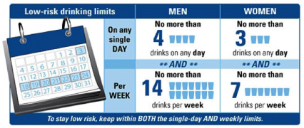

Slide 71
Pharmacotherapy for Alcohol Use Disorder
COMBINE study showed greater efficacy of naltrexone than acamprosate regardless of gender.
Later studies have demonstrated equivalent efficacy.
This presenter’s anecdotal observation: Acamprosate is more effective in women.

Slide 72
Cannabis Use Disorder

Slide 73
Cannabis Use Disorder
Fewer women than men use cannabis, but effects may be different.
Spatial memory is more impaired in women.
Males demonstrate a greater marijuana-induced “high”.
Males have more problems with poor family relationships and problems at school.

Slide 74
Cannabis Use Disorder
In rodent studies, females are more sensitive to the rewarding, pain-relieving, and activity-altering effects.
May be sex differences in the functioning of the endocannabinoid system.
In teenage girls, there may be a higher risk of structural abnormalities as a result of regular marijuana exposure.

Slide 75
Cannabis Use Disorder
In both sexes, addiction to marijuana is associated with at least one mental health issue.
Although the severity of addiction to cannabis is generally higher in men, women develop the disorder more quickly than men after first marijuana use.
Rates of seeking treatment are low for both sexes.

Slide 76
Cannabis Use Disorder
Men | Women
Similarities
At least one other mental health disorder Low rate of seeking treatment
Differences
Other substance use disorders Antisocial personality disorder Severity of disorder | Panic attacks Anxiety disorders Disorder develops more quickly

Slide 77
Stimulants (Cocaine and Methamphetamine)

Slide 78
Stimulants
Women may be more vulnerable to the reinforcing effects, with estrogen possibly playing a role.
In animal studies, females start taking cocaine more quickly and in larger amounts than males.
Females may be more sensitive to effect of cocaine on the vascular system.

Slide 79
Stimulants
Cocaine users, regardless of gender, show similar deficits in learning, concentration, and academic achievement, even if women used it longer.
Female cocaine users demonstrate less abnormalities of blood flow in the frontal regions of the brain, suggesting a protective sex-related effect.

Slide 80
Stimulants
Although some women report using methamphetamine to control weight, physical appearance over time will deteriorate due to damage to the skin and teeth.
Women report using methamphetamine to increase energy.
High rates of co-occurring depression

Slide 81
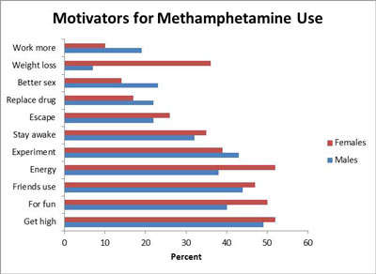

Slide 82
Stimulants
Women begin using methamphetamine at an earlier age than men, thus typically becoming more dependent than men.
Women, however, are less likely to switch to another drug and tend to be more receptive to treatment.

Slide 83
MDMA (Ecstasy, Molly)

Slide 84
MDMA (Ecstasy, Molly)
MDMA produces a stronger hallucinatory effect in women, although men show higher blood pressure increases.
For occasional users, women are more prone to feeling depressed a few days after their last use.
Both sexes demonstrate similar rates of aggression a few days after use.

Slide 85
MDMA (Ecstasy, Molly)
MDMA interferes with the body’s ability to eliminate water (water intoxication), and young women are more vulnerable to death.

Slide 86
Heroin/Fentanyl

Slide 87
Heroin/Fentanyl
Women tend to use smaller amounts and are less likely to inject.
Those women who do inject report social pressure and sexual partner encouragement.
Women are more at risk of overdose death during the first few years of using.

Slide 88
Prescription Drugs
Opioids

Slide 89
Opioids
Women may be more sensitive to pain, which may account for high rates of opioid prescriptions in reproductive-age women.
More likely to take without a prescription to cope with pain, as well as anxiety and tension

Slide 90
Prescription Drugs
Anti-Anxiety Medications and Sleep Aids

Slide 91
Anti-Anxiety and Sleep Aids
Women are more likely to die from overdoses of medications for mental health disorders, including antidepressants and anxiolytics.
It is possible that women are prescribed more of these due to higher risk of anxiety, depression, and insomnia.

Slide 92
Nicotine (Tobacco)

Slide 93
Nicotine (Tobacco)
Women smoke fewer cigarettes/day, tend to use lower nicotine products, and don’t inhale as deeply as men.
Women may smoke more to regulate mood and stress.
Risk of death from lung cancer is approaching that of men.

Slide 94
Nicotine (Tobacco)
Some dangers (blood clots, heart attack, or stroke) increase in women using oral contraceptives.
Decline in smoking rates has been greater in men than women.
Women are less likely to quit and more likely to relapse if they do.

Slide 95
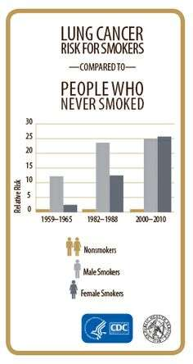

Slide 96
Sex and Gender Differences in the Treatment of SUD

Slide 97
Sex and Gender Differences in the Treatment of SUD
More men than women in treatment; however, women are more likely to seek treatment for sedative-hypnotics.
By 2010, there were nearly equal numbers of men and women seeking treatment for heroin use.

Slide 98
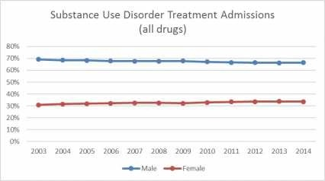
Substance Use Disorder Treatment Admissions (all drugs)

Slide 99
The TEDS Report (SAMHSA)
In 2011, 609,000 of the 1.84 million treatment admissions were female (33.1%).
A larger proportion of females ages 12-17 reported alcohol as the primary substance of abuse. In 25-34 yo women, a smaller proportion than men did so.
Fewer women than men reported THC as DOC.

Slide 100
The TEDS Report (SAMHSA)
Methamphetamine primary use was similar in both.
Prescription opioids as DOC were similar across all age groups but over age 65, where women had nearly 3 times the rate of men.

Slide 101
Sex and Gender Differences in the Treatment of SUD
Women progress from first use to dependence more quickly than men, but typically enter treatment with more severe medical, behavioral, psychological, and social problems,
Barriers to access for women include childcare and fear that authorities will remove their children.

Slide 102
Women and Smoking Cessation
Women are less likely to quit smoking and more likely to relapse.
Nicotine replacement therapies are not as effective in women.
Nicotine craving and withdrawal vary across the menstrual cycle, which may complicate efforts to quit.
The stress on the heart due to smoking one pack of cigarettes per day is the equivalent of being 90 pounds overweight.

Slide 103
Gender Differences
Drugs Other Than Alcohol

Slide 104
Gender Differences and Drug Abuse
Women typically progress from first use of cocaine, heroin, and marijuana to dependence more quickly than men.
Cocaine-induced cognitive impairments and risk of stroke are more severe in women.
Although the incidence of depression in the general population is higher in women, this discrepancy is far less pronounced in substance abusers.

Slide 105
Gender Differences
Process Addictions

Slide 106
Gender Differences in Process Addictions
Essential feature of all is lack of control with continued use despite adverse consequences.
Co-occurrence with SUD is common.
Both respond to 12-Step facilitation, CBT, and motivational interviewing.
Process (behavioral) addictions include: food, sex, gambling, spending, debting, exercise, work, Internet, relationships, and compulsive cleaning.
With Internet addiction, men tend to prefer Cybersex, whereas women choose anonymous romantic sites.

Slide 107
Gender Differences in Process Addictions
Women have a higher prevalence of eating disorders.
90% of all eating disorders are women.
Lifetime ED behaviors co-occurring with SUD approach 40%.
Very few treatment centers address both disorders.

Slide 108
Gambling Addiction
Male gamblers are at higher risk of becoming addicted to “face-to-face” forms of gambling whereas women prefer less interpersonal forms of gambling such as slot machines and bingo.

Slide 109
Diagnosis of Substance Use Disorders
In primary care settings, the lifetime rate of alcohol use disorder is as high as 25%! Yet, the likelihood of diagnosis in women is much less likely.
Screening tests effective for women include: CAGE, TWEAK, and AUDIT; however, all three are influenced significantly by sex and ethnicity.

Slide 110
Diagnosis of Substance Use Disorders
All three are more sensitive for black women than white.
The CAGE and AUDIT miss 41-62% of white women.
The TWEAK is more sensitive than the other two in white women.
Therefore, for all women, TWEAK is the preferred diagnostic screening instrument.

Slide 111
TWEAK Questionnaire
Tolerance. “How many drinks does it take before you begin to feel the effects of alcohol?” (>2 indicates tolerance.)
Worry. “Have close friends or relatives worried about or complained about your drinking in the past year?”
Eye Opener. “Have you ever taken a drink to steady your nerves or to get over a hangover?”
Amnesia. “Has a close friend or relative ever told you about things you said or did while you were drinking that you could not remember?”
Kut Down. “Have you ever felt the need to cut down on your use of alcohol?”

Slide 112
TWEAK Questionnaire
Assign 2 points for Tolerance and 1 point for each other “Yes” response.
Greater than or equal to 3 points: positive for alcohol use disorder for both men and women

Slide 113
CAGE Questionnaire
Cut Down
Annoyed
Guilty
Eye Opener
For each “yes”, assign 1 point.
A total of 2 or more points is diagnostic.

Slide 114
Other Diagnostic Tools
Positive family history for substance use
Heavy tobacco use
For alcohol:
Hypertension, especially that unresponsive to traditional therapy
Abnormal liver function, especially GGTP elevation
Elevated MCV

Slide 115
“FRAMES”
An intervention tool for physicians with their patients
Feedback about adverse effects of alcohol and drugs
Responsibility for a change in drug-using behavior
Advice about consequences of use
Menu of options
Empathy for patients
Self-efficacy to reward positive attempt

Slide 116
Management
After brief intervention in the primary care setting, abstinence rates in women were superior (31% reduction at 1 year) to men (14%).
In residential treatment settings, men and women of comparable demographic and disease stage characteristics do equally well.

Slide 117
Management
Special considerations for treatment in women include: self-esteem, sexism, sexual abuse/trauma issues, and interpersonal relationships.
Treatment alternatives may be necessary to address child care and other responsibilities.
Twelve Step referral may be appropriate for women in a stable home environment.

Slide 118
Response to Treatment
Success in treatment is directly associated with length of stay, regardless of gender.
However, women often spend less time than men in treatment, probably reflecting differences in social and economic circumstances.
Women entering treatment are more likely than men to be custodial parents with fewer economic resources and are less likely to have a high school education, be employed, and have supportive social networks.

Slide 119
Response to Treatment
Relapse to drug use occurs for different reasons; in males, due to anxiety and positive feelings; in females, depression and negative feelings.
Studies on nicotine addiction demonstrate marked differences in gender with men getting more relief from nicotine replacement in any form (neurochemically-driven) and women doing better with nicotine inhalers (sensory-driven).
Furthermore, women increase their chances of smoking cessation if the quit date coincides with the first half of the menstrual cycle.

Slide 120
In Summary…
Women with substance use disorders demonstrate unique physiological, psychological, and sociological characteristics.
The diagnosis and treatment of these women should focus on these inherent gender differences.

