Slide 1
Know the Disease of Addiction Know the Treatment of Addiction
Burns M. Brady, MD, FASAM

Slide 2
Know the Treatment
Abstinence based
12 Step participation
Additional therapeutic intervention as revealed

Slide 3
Chronic Progressive Fatal
Treatable
Relapse as failure of treatment, aftercare, and/or non commitment of participant

Slide 4
Biopsychosocial
Disease

Slide 5
Social Change playmates, playthings, and playpens
Society promotes – create new support society
Introduce simple kit of spiritual tools
A. Fellowship
1. Sponsor
2. Meetings
B. Design for living
Peer Pressure – create new accountability structure

Slide 6
Psychological
I. Alcoholic Personality
II. Mental Illness
A. No increase in schizophrenia or bipolar disease
B. Significant increase in affective and mood disorders
1) Anxiety
OCD
Panic
Agoraphobia
PTSD
Generalized anxiety
2) Depression
Situational (exogenous)
Familial (endogenous)
III. Apparent increase in ADD and ADHD – no stimulants
IV. Parent of the same sex relationship impaired coping skills – sponsor critical
V. 100% of patients entering treatment have anxiety/depression syndrome
A. 40% significantly improved 3 months off toxin
B. 50% significantly improved 1 year with new way to live
C. 5% - 15% will need medication
D. No comorbid diagnosis for one year short of dysfunctional break

Slide 7
Biological
Genetics
Biochemistry

Slide 8
Genetics
I. Adoption studies 1935 – 1950
4 X Greater
II. Blood Platelets Monomide Oxidase Second
DNA - RNA Adenolate Cyclase Messengers
gene effect cAMP
III. Stimulus Augmentation
Brain Waves P3 Alpha Affective Mood
IV. Cloninger, C.R. – 1981 extended studies Type I
Type II

Slide 9
Type I – A) later onset crescendo of drinking
B) lose control of quantity consumed
C) attempt to maintain social control
Type II – A) highly heritable – 9 x ↑ in males
4 x ↑ in females
B) early onset - < 25 years of age can see in geriatric
population if began
late age onset initially
C) do not lose control of amount consumed – drugs have accelerated process
D) antisocial behavior when drinking
E) severe up-regulated serotonin transport (reuptake site) – therefore ↓ serotonin entire picture affected by ondansatron
F) brain maturity – impulse control
G) types of meetings

Slide 10
V. Epigenetic (Non-DNA Affected)
Transgenerational Gene Expression
It’s significance to addiction
VI. Neuropharmacology – determined by genetics
and/or epigenetics
A. D2R – regulation (trauma and isolation) Volkaw
B. Dopamine regulation
C. Serotonin regulation
D. Noradrenaline regulation

Slide 11
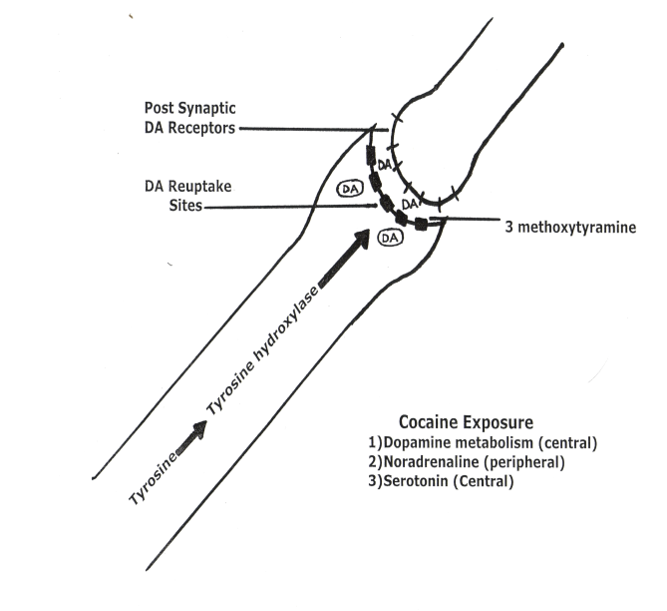
Neuropharmacology
NEUROPHARMACOLOGY

Slide 12
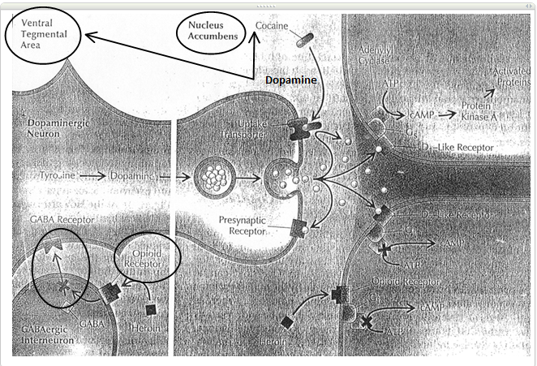

Slide 13
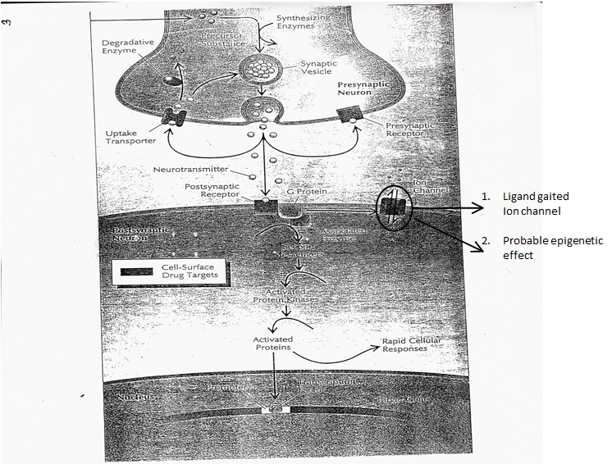

Slide 14
NEUROTRANSMITTORS
I. Single Amino Acid Receptors Acaprosate
AMPA
90% A. Glutamate KA
NMDA
B. GABA GABA_{A} Gabapentin (Neurontin)
Alcohol GABA_{B} Pregabalin (Lyrica)
BZ
Sedative Hypnotic withdrawal
II. Neuropeptides (Narcotics) Receptors MU Buprenorphine 8% A. Endorphin – Beta Kappa Methadone
B. Enkeflin Delta
C. Dynorphin Orphan
D. Orphanin

Slide 15
III. Aminergics 8% A. Dopamine Receptors
(Alcohol, Cocaine, Pot, D₁ D₂ D₃ D₄ D₅
Narcotics, Nicotine)
B. Serotonin Receptors
(SSRI Drugs) withdrawal effect 5HT3 5HT2 5HT1A
C. Acetyl Choline Receptor
(Nicotine, Pot) Nicotinic AC Chantix
D. Noradrenaline (Alcohol, Combination SSRI)
Effexor
IV. Neurosteroids Cholesterol
Godanal Hormones
GABA_{A}
NMDA

Slide 16
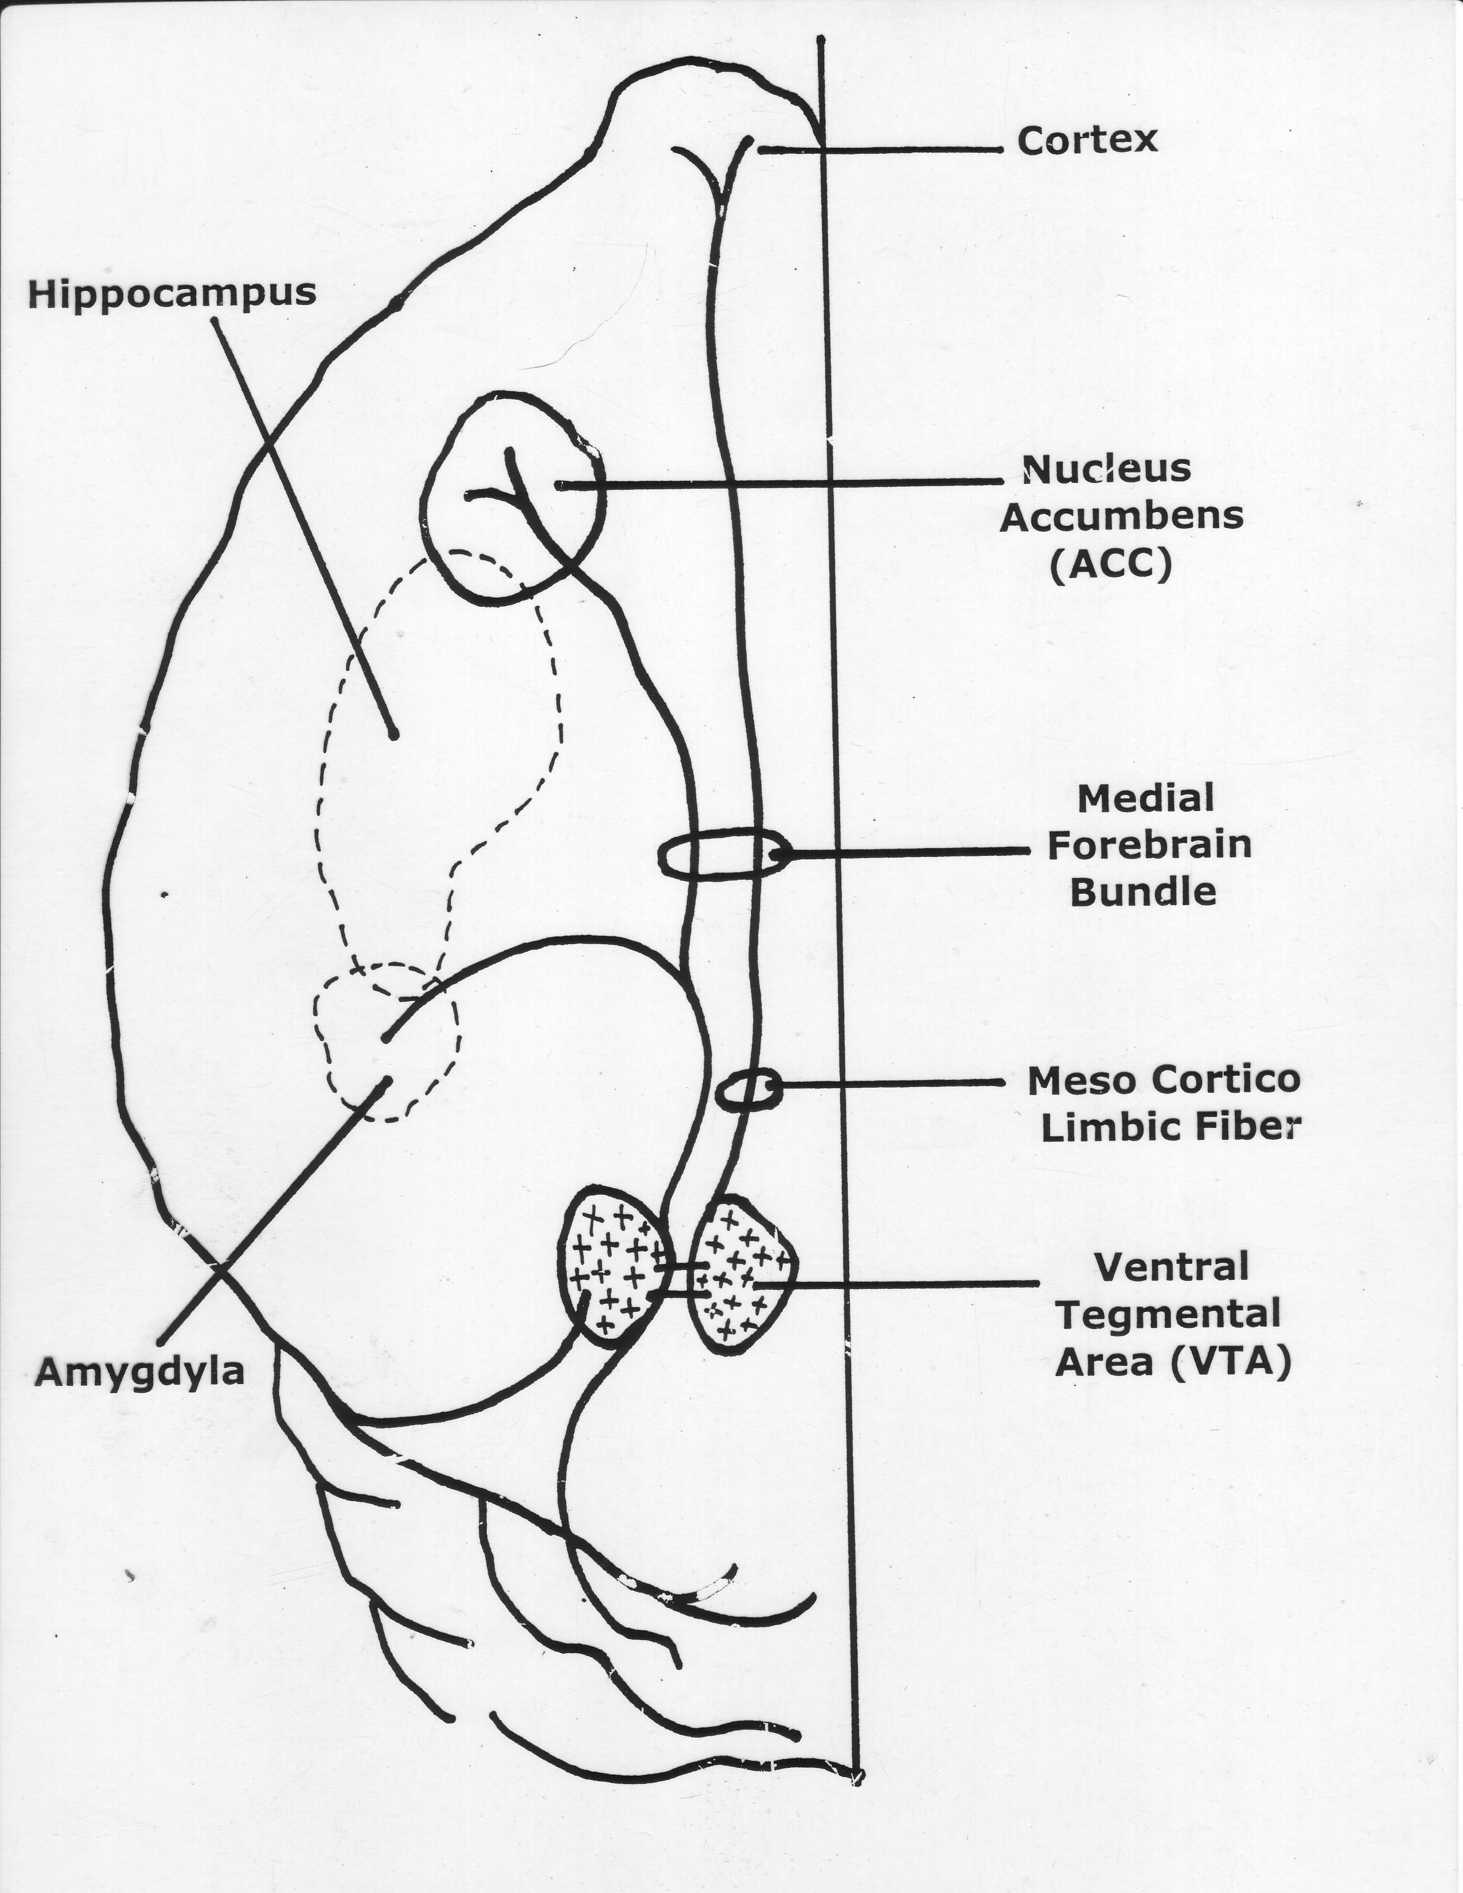

Slide 17
Table 3. Overview of Major Neurotransmitters: Functions and Alcohol-Related Behaviors
Neurotransmitter General Function Specific Action by Alcohol Alcohol-Related Function
___________________________________________________________________________________________________________
Dopamine (DA) Regulates motivation, Initiates a release at the NAC either Mediates motivation and reinforcement and fine directly or from projections via the reinforcement of alcohol
motor control mesolimbic system from the VTA consumption. Drugs that
increase DA are drugs of reward.
PET scan – D₂ receptor and transporter (↑density) relapse
________________________________________________________________________________________________________________________________
Serotonin (5-HT) Regulates bodily rhythms, The brain 5-HT system may modulate May influence alcohol consumption,
appetite, sexual behavior, alcohol intake by 2 different mechanisms: intoxication and development of
emotional states, sleep, (1) modulation of the DA-mediated tolerance through 5-HT₁ receptors;
attention and motivation. reinforcing properties of alcohol via 5-HT₂ may contribute to withdrawal
and 5-HT₃ receptors; and (2) suppression symptoms and reinforcement
of alcohol intake by activation of 5-HT_{1A} through 5-HT₂ receptors;
transporter receptors. and may modulate DA release
(reuptake site) through 5-HT₃ receptors,
Type II (Cloninger) thereby increasing alcohol’s
rewarding effects.
_________________________________________________________________________________________________________________________________
ƴ-aminobutyric acid Serves as the primary Causes tonic inhibition of dopaminergic May contribute to intoxication and
(GABA) (GABA) inhibitory neurotransmitter projections to the VTA and NAC. sedation; inhibition of GABA in the brain. Prolonged alcohol use causes a down- function following drinking
regulation of these receptors and a may contribute to acute
potential for decreased inhibitory withdrawal symptoms.
ion channels neurotransmission.
chloride influx

Slide 18
_______________________________________________________________________________________________________________________________________________
Glutamate Serves as the major excitatory Alcohol inhibits excitatory neuro- May contribute to acute withdrawal
neurotransmitter in the brain. transmission by inhibiting both NMDA symptoms; inhibition of glutamate
and non-NMDA(kainite and AMPA) function following drinking
receptors. Up-regulation of these receptors cessation may contribute to
ion channels to compensate for alcohol’s antagonistic intoxication and sedation.
calcium influx effect occurs after prolonged exposure to
alcohol, resulting in an increase in neuroexcitation.
_____________________________________________________________________________________________________________________________________________
Opioid peptides Regulates various functions and Alcohol stimulates β-endorphin release Contributes to reinforcement of
produced morphine-like effects, in both the NAC and VTA area. Alcohol consumption, possibly
including pain relief and mood β-endorphin pathways can lead to increased through interaction with DA.
elevation. DA release in the NAC via 2 mechanisms:
(1) β-endorphins can disinhibit the tonic
inhibition of GABA neurons on DA cells in
the VTA area, which leads to a release of DA
in the NAC area; and (2) β-endorphins can
stimulate DA in the NA directly. Both
mechanisms may be important for alcohol
reward.
_
AMPA = α-amino-3-hydroxy-5-methisoxizole-4-propionic acid; NAC= nucleus accumbens;
NMDA = N-methyl-D-aspartate; VTA = ventral tegmentum.
Adapted from Swift RN. Alcohol Res Health. 1999;23:209.18

Slide 19
Chromosomal “Hot Spots”
1 2 7 11 - risk
4 - protection
Multiple Chromosomes Affecting Neuropharmacology
9 15 16

Slide 21
Biochemistry
Antabuse
Alcohol Acetaldehyde
Alcohol (Acetaldehyde dehydrogenase)
Dehydrogenase
(female effect)
CO₂ + H₂0 Acetic Acid
Acetaldehyde Dehydrogenase I and II
Populations affected
1) Native American
2) Oriental

Slide 22
Post Acute Withdrawal
Prolonged Recovery
I.
A. Retentive memory
B. Sleep
C. Simple Problem Solving
D. Stress Management
II. Be Aware
A. Choice of Therapist
B. Comorbid diagnosis
C. Use of medication?

Slide 23
Treatment
A B S T I N E N C E
A. Short-Term
B. Intermediate
C. Long-Term

