Slide 1
Adult ADHD: The Problems, the Tests, the Treatments, the Challenges
Quintin T. Chipley, M.A., M.D.

Slide 2
DISCLOSURES:
Quintin Chipley has no financial investments or interests in any of the products or treatments presented in this program. He is an employee of the University of Louisville, but that institution is no condoning or endorsing the statements made in this program.

Slide 3
Review of the DSM-IV –TR: Inclusion Criteria
I. Either A or B:
A. Six or more of the following symptoms of inattention have been present for at least 6 months to a point that is inappropriate for developmental level:
Inattention
1.Often does not give close attention to details or makes careless mistakes in schoolwork, work, or other activities.
2. Often has trouble keeping attention on tasks or play activities.
3. Often does not seem to listen when spoken to directly.
4. Often does not follow through on instructions and fails to finish schoolwork, chores, or duties in the workplace (not due to oppositional behavior or failure to understand instructions).
5. Often has trouble organizing activities.
6. Often avoids, dislikes, or doesn't want to do things that take a lot of mental effort for a long period of time (such as schoolwork or homework).
7. Often loses things needed for tasks and activities (e.g. toys, school assignments, pencils, books, or tools).
8. Is often easily distracted.
9. Is often forgetful in daily activities.

Slide 4
Review of the DSM-IV –TR: Inclusion Criteria: Cont.
B. Six or more of the following symptoms of hyperactivity-impulsivity have been present for at least 6 months to an extent that is disruptive and inappropriate for developmental level:
Hyperactivity
1. Often fidgets with hands or feet or squirms in seat when sitting still is expected.
2. Often gets up from seat when remaining in seat is expected.
3. Often excessively runs about or climbs when and where it is not appropriate (adolescents or adults may feel very restless).
4. Often has trouble playing or doing leisure activities quietly.
5. Is often "on the go" or often acts as if "driven by a motor".
6. Often talks excessively.
Impulsivity
7. Often blurts out answers before questions have been finished.
8. Often has trouble waiting one's turn.
9. Often interrupts or intrudes on others (e.g., butts into conversations or games).

Slide 5
Review of the DSM-IV –TR: Inclusion Criteria: Cont.
II. Some symptoms that cause impairment were present before age 7 years.
III. Some impairment from the symptoms is present in two or more settings (e.g. at school/work and at home).
IV. There must be clear evidence of clinically significant impairment in social, school, or work functioning.

Slide 6
Exclusion Criteria:
V. The symptoms do not happen only during the course of a Pervasive Developmental Disorder, Schizophrenia, or other Psychotic Disorder. The symptoms are not better accounted for by another mental disorder (e.g. Mood Disorder, Anxiety Disorder, Dissociative Disorder, or a Personality Disorder).

Slide 7
Review of the DSM-IV –TR: Inclusion Criteria: Cont.
Based on these criteria, three types of ADHD are identified:
IA. ADHD, Combined Type: if both criteria IA and IB are met for the past 6 months
IB. ADHD, Predominantly Inattentive Type: if criterion IA is met but criterion IB is not met for the past six months
IC. ADHD, Predominantly Hyperactive-Impulsive Type: if Criterion IB is met but Criterion IA is not met for the past six months.
(American Psychiatric Association: Diagnostic and Statistical Manual of Mental Disorders, Fourth Edition, Text Revision. Washington, DC, American Psychiatric Association, 2000. as found on http://www.cdc.gov/ncbddd/adhd/diagnosis.html )

Slide 8
Notice the big gap here:
There is no explicit mention of
Substance Abuse/ Dependence!!
Perhaps such is implied under the category of any other psychiatric or neurological condition.
But the evaluator had better know to ask.

Slide 9
Prevalence
There are really no good studies
Some suggest that the Adult ADHD figure may be around 4% of the population, but those studies only use clinical interviews for the diagnosis.

Slide 10
Best Practice Evaluation
Best Practice requires full psychological testing
Clinical evaluation normally should only be the “triage” to determine if a full psychological evaluation is warranted
Beware “check lists” that have turned the symptoms from “”Present/ Not Present” into some Likert-Scale of “rate from 1 through 5”: This is a statistical sin. The DSM-IV-TR criteria may not be great, but they were tested on the assumption of “blocked variables” and not “continuous variables.”

Slide 11
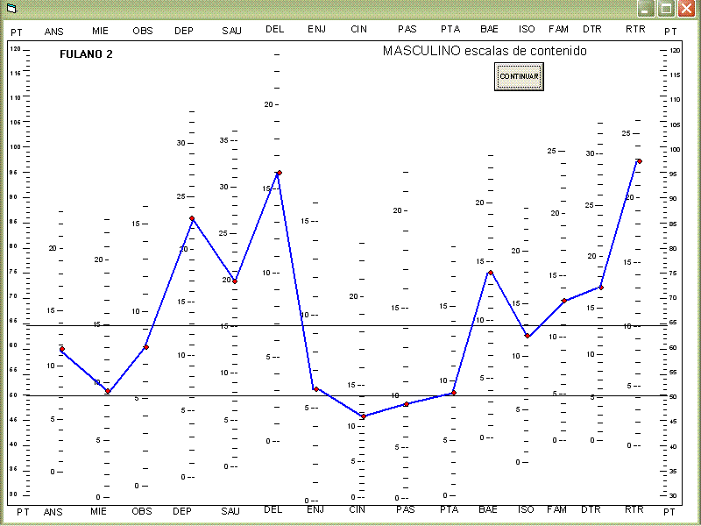
A typical Full Psychological Battery Includes:
A. Beck Depression Index
B. Beck Anxiety Index
C. A Personality Inventory (MMPI-2 most often used)
D. Full Scale Intelligence test (Wechsler Adult Intelligence Scale – IV age 16 – 69)

Slide 12
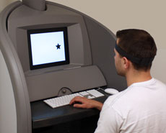
A typical Full Psychological Battery (Cont.):
E. Achievement Test
F. Executive functioning (I,e, - frontal lobe processes) test such as the Delis-Kaplan Executive Function test
G. Computer-monitor visual tracking test (E.G. – Quotient)

Slide 13
A typical Full Psychological Battery (Cont.):
H. Some special needs situation: If trying to present a student for accommodations on exams such as the LSAT, special tests are required. (e.g. Nelson-Benny , a reading test)

Slide 14
“Sono facile, ma sono Cara”
Translation: “I’m easy, honey, but I ain’t cheap.”
A Full Psychological for Adult ADHD can cost about $1500-1700 in private practices. Our student counseling service charges about $500
Insurance coverage sucks

Slide 15
Psychological Treatments
Mindfulness approaches derived from John Cabot Zen's work
12 Step programs do exist, but are not widely established
Practiced control of environmental demands

