Slide 1
Burns M. Brady, MD FASAM Greg L. Jones, MD CAPTASA 2012
A Case Presentation- 54 YO Female

Slide 2
Hx of Present Illness
54 yo White Female in ER with severe,
boring epigastric pain
N & V for approx 6 hours duration
W/U shows no biliary tract or GB disease
Normal Triglycerides
No current Rx meds

Slide 3
Hx of Present Illness
Hx of approx 20 years of alcohol use
Increased drinking in past month of up to
a fifth of Scotch daily
Daily drinker of 4-6 drinks prior to last
month
Husband filed for Divorce one month ago

Slide 4
Hx of Present Illness
Diagnosis- Acute Alcoholic Pancreatitis
Stabilized in ER
Admitted to Internal Medicine ward
Addiction Medicine Consult obtained

Slide 5
Drug and Alcohol Hx
Grew up affluent and attended prep school
1st drink in High School- occasional beer with
friends. 1-2 times a month
College- drank at parties and on weekends,
none during week
Occasionally intoxicated- peers never noted
a problem
Met husband Sr year of college- he was in
medical residency. She went to nursing school

Slide 6
Drug and Alcohol Hx
Married after 3 years- they drank similarly
Drinking on weekends only, no consequences
Had 2 children over next 5 years- no issues
with Alcohol noted
After 2nd child she stopped working outside
home (age 33)
At about age 35 she began to drink more
often and during the week

Slide 7
Drug and Alcohol Hx
By age 40 she was drinking more and was
concerned her husband would find out.
Was drinking at noon, 3-4 drinks daily
Was trying to control by not drinking at
dinner
Began to drink wine throughout the day
Husband noted increased irritability and
forgetfulness

Slide 8
Drug and Alcohol Hx
She was surprised at home by husband and
found to be intoxicated
He asked her to see a Psychiatrist- He Rx’d
Klonopin for anxiety and marriage counselor
Counselor felt she should cut back her
drinking
Continued Klonopin for Anxiety
For a year she limited public Alcohol use, but
drank in secret throughout the day

Slide 9
Drug and Alcohol Hx
She was surprised again by husband and
found intoxicated
Following an Intervention by her Psychiatrist,
Counselor and husband she began Out-Pt Tx
She began to go to AA and was abstinent
Klonopin was discontinued
She was now in her mid-40’s

Slide 10
Drug and Alcohol Hx
Her daughters were busier with school and other
activities
She felt unfulfilled and returned to nursing at a
hospital
After about 6 months she began to have Headaches
Saw a Neurologist- Dx Tension type Headaches
occasional migraine variant
Neurologist was told of her Alcohol Hx-felt since
sober two years occasional opiate was safe
Tx’d with ASA, Tylenol and NSAID’s with an opiate
as rescue medication

Slide 11
Drug and Alcohol Hx
After about 2 or 3 months of occasional use of the
opiate, she began to increase her Hydrocodone
use
She began to Doctor shop, even going to other
communities for Hydrocodone Rx’s
After about 1 year of this her family physician was
contacted by a pharmacist
During this time she did not resume Alcohol use,
but Hydrocodone use was 4-6 pills daily

Slide 12
Drug and Alcohol Hx
There was an Intervention and she entered a
3 month residential Tx program for addiction
Following the residential Tx she increased her # of
Recovery meetings
Prior to in-pt TX she had decreased her meetings
to about one per week
She went back to work and did well for 2 or 3
years
At 50 years old she had significant dental work
done with extractions and crowns

Slide 13
Drug and Alcohol Hx
Several of her dental procedures resulted in short
courses of opiates
Her Hx with opiates and Alcohol had been reviewed
with her dentist and oral surgeon
It was felt short-term use of opiates should be no
problem
Initially she was appropriate and confided in her
sponsor
Over the next 2 years she began to hoard medication
and obtain Rx’s from multiple sources- some who Rx’d
inappropriately

Slide 14
Drug and Alcohol Hx
At 52 years of age she began to drink again
Within 2 months she was discovered by her
husband with slurred speech and smelling of Alcohol
She immediately disclosed her opiate use- since her
Alcohol use was short term, it was determined by her
and her physician she would be seen by an Addiction
Specialist for Suboxone
There was a feeling by her and her Addiction doctor
that 12-step Tx had failed her
Her therapist did strongly recommend she return to
12-step activity, but she did not

Slide 15
Drug and Alcohol Hx
During the next year her drinking increased back to
4-5 drinks daily
Her husband had attended Al-Anon in the past and
continued to participate in his own Recovery
He and the family did another Intervention
She refused their recommendation for abstinence
and a return to long-term residential Tx
He moved out of the house and began divorce
proceedings- which brings us to now

Slide 16
Medical History
No Major medical diagnoses except those above
Hx of oral surgery as noted
No other surgical Hx
G2 P2 with two healthy daughters

Slide 17
Family History
Father 75- generally good health, has coronary
disease Angioplasty x1
Mother 70- generally good health
Father never had Alcohol problem and stopped
drinking when pt. developed her problem
Mother had no Alcohol issues, but her mother did
and died prematurely
Mother’s sister had problems with Alcohol,
Meprobamate and Benzo’s
Mother’s Grandmother died in her 40’s, had
“nervous disorder”

Slide 18
Family History
Patient has one brother age 52. He has no
alcohol or drug issues, but his daughter did and
is currently in 12-step program
Patient has one sister age 50. She also is free of
alcohol or drug issues. Her son is known to have
a problem and is currently missing. Her daughter
has some mood problems

Slide 19
Family History
Patient’s husband continues to practice
medicine
He is willing to be of support during her current
illness, but intends to follow through with
divorce
Oldest daughter (28) is an LCSW. Has no alcohol
or drug problems. Is mother of 2 girls herself
Youngest daughter (25) is Jr. in medical school.
Plans career in Psychiatry

Slide 20
Hospital Course
Uncomplicated medical recovery from Acute
Alcoholic Pancreatitis
Consented to be seen by an Angel Team from
local 12-step homeless shelter for women
Agreed to see another Addiction Specialist
recommended by the Hospitalist and her Family
Physician

Slide 21
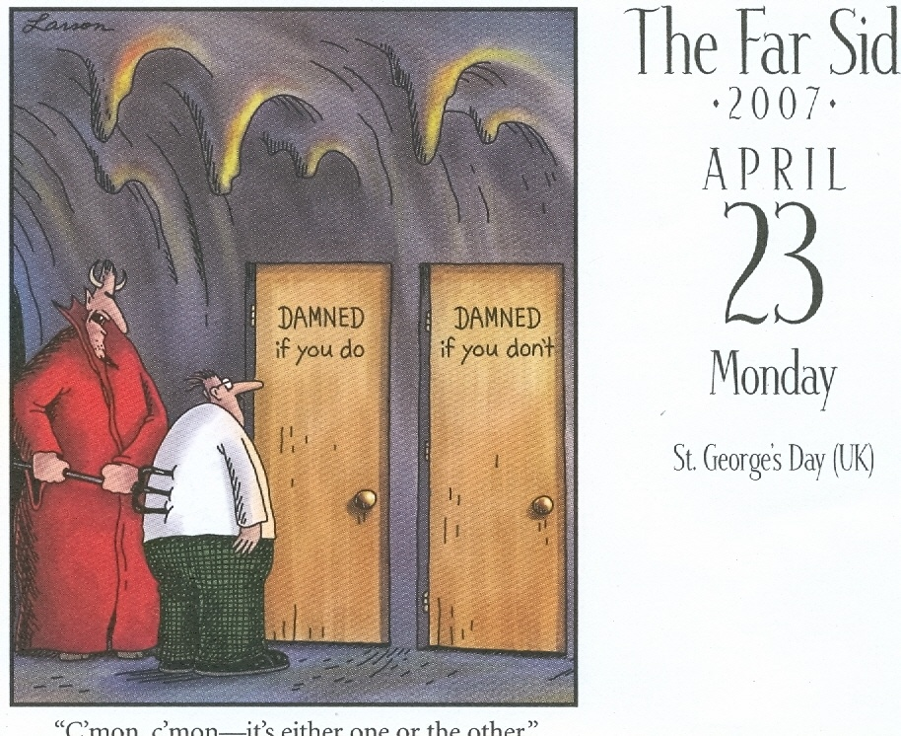

Slide 22
Alcoholics Anonymous, page 22 from ‘There is A Solution”
Perhaps he goes to a doctor who gives
him morphine or some sedative with
which to taper off. Then he begins to appear at hospitals and sanitariums.
This is by no means a comprehensive
picture of the true alcoholic, as our behavior patterns vary. But this
description should identify him
roughly.
Notes:
Alcoholics and Addicts have known for years that there is a connection between alcohol and other drugs.

Slide 23
Most common reasons for Relapse
Cutting back or stopping
Recovery activities- Meetings
Beginning to take another
Substance

Slide 24
Which drugs are Addictive ?
Alcohol
Sedative/hypnotics
Opiates
Cocaine
Amphetamines
Cannabis

Slide 25
Drugs that are problems for Addicts
Stimulants
Sedating Antihistamines
Cough suppressants
Sedating Antipsychotics
Muscle relaxants

Slide 26
Abstinence and Spiritual based Recovery isn’t sexy nor profitable
It can be a lonely and unpopular message, but it is the Truth…
Notes:
Very lonely and very unpopular. With so much pressure for fast, easy results this gets forgotten, at the expense of our patients. Remember they are the ones with the problem.

