Slide 1
Tobacco: Addiction’s Smoking Gun?
Marc J. Myer, MD FASAM
Director, Health Care Professionals Program
Hazelden Betty Ford Foundation

Slide 2


Slide 3
Question: What percentage of the U.S. population currently consider themselves “smokers”?
  a. 8%
  b. 12%
  c. 18%
  d. 37.5%

Slide 4
Objectives
Tobacco history
Tobacco epidemiology
Smoking and mental illness
Basic nicotine neurobiology
Gateway drug hypothesis
Why nicotine cessation is so important for those with other (non-tobacco) substance use disorders

Slide 5
Objectives
What makes nicotine (smoking) cessation particularly difficult
The main treatments for smoking cessation and any contraindication(s) to their use
E-cigs

Slide 6
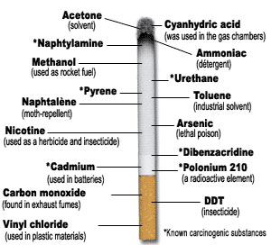

Slide 7
Tobacco is native to the western hemisphere
It was touted as a plant of the gods in ancient middle-American cultures
The use of tobacco didn’t occur in Europe and Asia until the late 1400s
Initial use was largely medical rather than recreational; thought to be a panacea, including treatment for indigestion, abscesses, fistulas, and sores

Slide 8
Originally, smoking tobacco in pipes was the most common form of use
In the 18th Century, chewing tobacco and using snuff became popular in Europe and America
Cigarettes became more popular by the end of World War I (1918) because there was a common belief that chewing tobacco caused consumption (pulmonary tuberculosis)

Slide 9
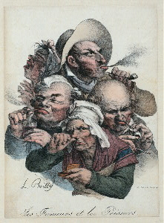
Les Fumeurs et les Priseurs
F.W Fairholt

Slide 10
The use and popularity of smoking has changed significantly over time
After WWI and especially around WWII, cigarette companies supplied free or cheap cigarettes to soldiers, college students, etc.
In the late 1800s, average use for most smokers was 40 cigarettes per year
An average heavy smoker today: 20-40 per day or >10,000 per year

Slide 11
NSDUH 2014:
  81.1 million Americans aged >12 years used tobacco products in the year prior (80.8 2013)
  66.9 million used tobacco products in the month prior (similar 2013)
  55.2 million smoked cigarettes in the month prior (55.8 in 2013)
  11.9 million smoked cigars (12.4 in 2013)
  8.66 million used smokeless tobacco (8.81 in 2013)
SAMHSA 2013, 2014

Slide 12
CDC 2013:
  17.8% of all adults current smokers (20.5% males, 15.3% females)
  Each day, >3200 people aged <18 years smoke their 1st cigarette
  Approximately 2100 people convert from casual to daily smoking
  7 in 10 want to quit
  4 in 10 have made attempt in last year
  Economic toll is high, > $300B annually
  In 2015, states collect $25.6B in taxes and settlements, spending <2% on prevention and cessation
MMWR 2014

Slide 13
Smoking and alcohol/drug treatment (historical perspective):
  1960s and prior - alcohol and drug problems treated separately
  1974 – National Drug/Alcohol Collaborative Project (Gardner, 1980, NIDA DHEW Pub)
    All drugs of dependence need to be addressed concomitantly to improve abstinence rates
  Not addressed: nicotine and caffeine

Slide 14
True or False: Nicotine is more addictive than cocaine.
  a. True
  b. False

Slide 15
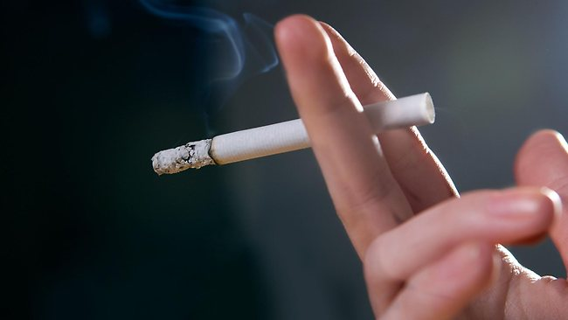
So, what is it about tobacco?

Slide 16
Nicotine
  The crucial ingredient in tobacco, responsible for psychoactive and cardiovascular effects and dependence
  It is a bitter, colorless, and highly poisonous alkaloid that acts as a powerful insecticide
  Average cigarette contains 12-14 mg of nicotine, but only delivers 1-3 mg to the lungs (one chew of tobacco delivers ~4.5 mg of nicotine)
    Average nicotine yield increased from 1.65 mg/cigarette in 1999 to 1.89 mg/cigarette in 2011
    Not due to agricultural variations

Slide 17
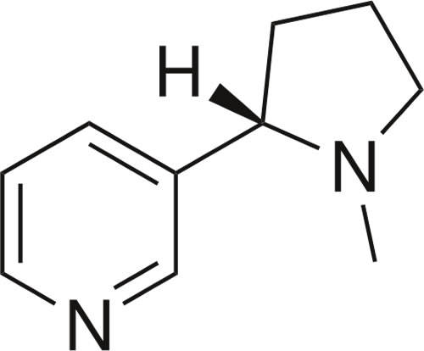
Nicotine (chemical formula C₁₀H₁₄N₂)

Slide 18
Nicotine begins to reach the brain within 20 seconds after inhalation (within 3 minutes with smokeless tobacco)
It attaches to nicotine receptors throughout the brain (and body) and disrupts the balance of neurotransmitters (endorphins, adrenaline, dopamine, and acetylcholine)
Acetylcholine affects heart rate, blood pressure, alertness, memory, sleep, etc.

Slide 19
The first cigarette of the day raises the heart rate by 10-20 BPM and BP by 5-10 units
The release of dopamine makes the smoker feel more calm, relaxed, satisfied
The enzyme monamine oxidase [MAO] (important in maintaining dopamine levels) diminishes over time, which may partly explain why smokers continue to smoke

Slide 20
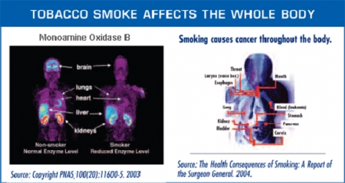

Slide 21
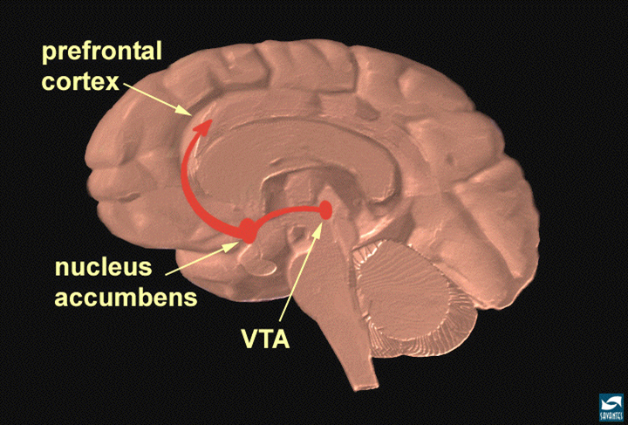

Slide 22
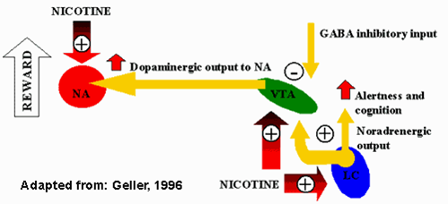

Slide 23
Gateway drug hypothesis:
Tobacco, alcohol MJ cocaine, “hard” drugs
Common liability hypothesis:
Tobacco, alcohol ADDICTION cocaine, “hard” drugs
MJ

Slide 24
Nicotine as a gateway drug
  Nicotine exerts a priming effect on cocaine in the sequence of drug use (nicotine cocaine) through global acetylation of histones in the striatum, increasing FosB levels
  Long-term potentiation in the nucleus accumbens (ventral striatum) is blocked when long-term exposure to nicotine is followed by cocaine use (priming effect depended on nicotine being given for 7 days, 24h did not)
  Reversing the order (cocaine nicotine) was ineffective: cocaine did not enhance effect of nicotine

Slide 25
Nicotine cocaine histone acetylation
FosB

Slide 26

And, why do we care?

Slide 27
Nicotine is addictive!
Tobacco Use Disorder:
Impaired Control
  Substance taken in larger amounts or for longer periods of time than intended
  Persistent desire to use or unsuccessful efforts to cut down
  Great deal of time spent in activities to obtain, use, or recover from use of the substance
  CRAVINGS

Slide 28
Tobacco Use Disorder (cont.):
Social Impairment
  Recurrent use resulting in a failure to fulfill major role obligations at work, school, or home
  Continued use despite having persistent or recurrent social or interpersonal problems related to use of the substance
  Important social, job, or recreational activities given up or reduced because of use

Slide 29
Tobacco Use Disorder (cont.):
Risky Use
  Recurrent use in physically hazardous situations
  Continued use despite negative physical, mental, and/or emotional consequences

Slide 30
Tobacco Use Disorder (cont.):
Pharmacological
  Tolerance (needing more of the substance to have the same effect)
  Withdrawal (headaches, nervousness, fatigue, depression, irritability, sleep disturbance, constipation)
    2-3 symptoms – Mild
    4-5 symptoms – Moderate
    6+ - Severe
  Specifiers: “in early remission, in sustained remission, on maintenance therapy, in a controlled environment”

Slide 31
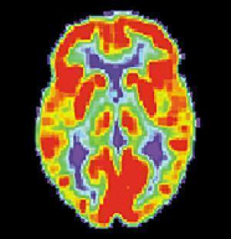
Why is tobacco so addictive?

Slide 32
Nicotine is rapidly absorbed and delivered to the brain causing its pleasurable effects
It sticks around for a few hours and then is gone
Tolerance develops rapidly and begins within a few hours (probably more rapidly than to cocaine or heroin)
Withdrawal symptoms are very unpleasurable, especially the irritability, depression, and anxiety

Slide 33
Indications of nicotine’s addictive nature, in 2006:
  23 million tried cocaine; 600,000 used weekly (2.6%) and only a fraction used daily
  72 million tried marijuana; 6.8 million used weekly (9.4%) and smaller fraction used daily
  198 million tried alcohol; <48 million drank weekly (27%) and 20 million drank daily (11%)
  162 million tried smoking; 60 million in the past month (37%) and 37 million smoked daily (22.7%)
SAMHSA 2006

Slide 34
Cigarette and tobacco use becomes rapidly associated with every day events (driving, drinking coffee, talking on the phone, taking a “break”)
This conditioning (drug-associated memories) is extremely powerful, is fairly unique to cigarette smoking, and is one of the reasons it is so difficult to quit

Slide 35
Nicotine addiction and continued use is a wonderful example of NEGATIVE REINFORCEMENT*
    *The removal of an aversive (unpleasant) stimulus which reinforces/increases a certain behavior or response
When the smoker/nicotine addict ingests nicotine, it attaches to receptors releasing acetylcholine, dopamine, etc., which alleviates the withdrawal symptoms

Slide 36
Risk factors for tobacco addiction:
  Age at first use
    An individual who starts using nicotine between the age of 8-12 is 5 times more likely to become addicted than someone who starts after the age of 18-19
  Genetics
    Twin studies show that about half of smoking behavior is attributed to genetic effects
  Psychiatric history
    Lifetime prevalence of depression is 59% among those who had ever smoked compared to 17% in the general population

Slide 37
Risk factors for tobacco addiction (cont.):
  Psychiatric history (cont)
    Rates of nicotine dependence are 40% in those with ADHD (more than double the general population)
    Smoking occurs at rates well above the population average in those that abuse drugs and alcohol (>70%)
    Up to 84% of those in treatment for alcohol and/or drugs are smokers
      Higher in those being treated for opioid use disorder compared with alcohol [OR 2.52, 95% CI, 2.00-3.17]

Slide 38

Again, who cares?

Slide 39
Well, tobacco use kills!
Overall, adult smokers in the U.S. lose an average 14 years of life
Cardiovascular disease
  Heart attack
  Stroke
  Peripheral arterial disease
Lung disease
  Emphysema
  Chronic bronchitis

Slide 40
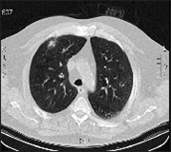
Cancer
  Men who smoke are 22 times more likely to develop lung cancer than those who don’t (for women it is 12 times)
  85% of men with lung cancer smoke
  75% of women with lung cancer smoke

Slide 41
Patient (20 pack-year smoking history, now at 2 ppd) in IOP treatment for AUD presents to your office and wants to quit, but is worried about doing so while undergoing treatment. Your best advice to him would be:
  a. Continue smoking for now and even increase the number of cigarettes per day if it helps him to cope.
  b. Take up chewing tobacco instead.
  c. Delay until he has at least 6 months of abstinence, giving him the best chance of maintaining long-term sobriety.
  d. It is safe to stop smoking now and will improve his chances of staying clean and sober.

Slide 42

What are the benefits of quitting?

Slide 43
Benefits of smoking cessation
  Within 20 minutes, BP and pulse rate drop to normal
  In 8 hours, carbon monoxide decreases and oxygen levels increase to normal
  Within 1 week, risk of MI drops, breathing improves, and constricted blood vessels relax
  In 1 year, risk of coronary artery disease and MI is cut in half
  Within 10 years, lung cancer death rate returns to that of a nonsmoker

Slide 44
Benefits of smoking cessation (cont.)
  It increases the chances of staying clean and sober!!!
    One study (Stuyt, 1997) showed overall that 48% of nontobacco users maintained sobriety at 12 months compared to only 14% of tobacco users
  Quitting smoking at the same time as alcohol and other drugs does not increase rates of relapse into non-nicotine chemical use
  Addicts/alcoholics in and out of recovery are at high risk for tobacco-related death (>50%)

Slide 45


SMOKING CESSATION STRATEGIES

Slide 46
Smoking cessation is difficult, with the average smoker attempting to quit 5 times before permanent success
“Cold turkey” without any help has an initial success rate in the range of 3-10%
Behavioral treatments (counseling, therapy, group support, telephone quitlines) increase the quit rate by ~20%
Pharmacologic support along with behavioral therapies can double the success rate

Slide 47
Pharmacologic therapies
  Nicotine replacement (patch, gum, lozenges)
    May be used in combination (patch plus method) and with other medications
  Bupropion (Zyban or Wellbutrin)
    Antidepressant that may act to block the nicotine receptor
    Start 1-2 weeks before quit date and continue for 3-6 more months
    Adding NRT provides additional benefit

Slide 48
Pharmacologic therapies (cont.)
  Varenicline (Chantix)
    Acts as both a partial nicotine receptor activator and a partial blocker
    Begin 7 days before quit date and continue for 3-6 months
    Shouldn’t be used with nicotine replacement therapy
    Shouldn’t use with unstable coronary artery disease
    Can worsen depression and lead to increased agitation, aggression, or suicidal thoughts

Slide 49

Electronic Nicotine Delivery Systems (ENDS)
  Insufficient evidence
  2/3 of physicians believe are
  helpful, 35% recommend
  56% of users report using them to reduce or quit, 26% use so they can smoke in church
  2 RCTs evaluating efficacy in smoking cessation showed mixed results
  Concern about unknown components and mixtures
  None has received FDA approval for cessation

Slide 50
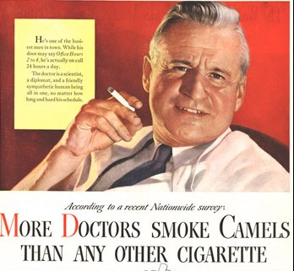

Slide 51

SUMMARY
Smoking is BAD
It is the major killer of people with the disease of addiction
The physical and emotional benefits that come with smoking cessation begin within hours and continue for years
Quitting will double the chances of staying clean and sober
Patients don’t have to do it alone!!!

Slide 52
References
Cahill K, et. Al. Nicotine receptor partial agonists for smoking cessation. Cochrane Database of Systematic Reviews, 2012; 3: CD006103.
Centers for Disease Control and Prevention. Current Cigarette Smoking Among Adults – United States, 2005-2013. MMWR 2014; 63(47): 1108-12.
Fiore MC, et al. Treating tobacco use and dependence: 2008 update. Clinical Practice Guideline. Rockville, MD: U.S. Department of Health and Human Services. Public Health Service, 2008.
Gulliver SB, et. al. Smoking cessation and alcohol abstinence: what do the data tell us? Alcohol Research & Health, 2006; 29(3): 208-12.
Guydish J, et al. An international systematic review of smoking prevalence in addiction treatment. Addiction 2015; doi: 10.1111/add.13099

Slide 53
References
Inaba DS, Cohen WE. Nicotine. Uppers, Downers, and All Arounders. 7th ed. Medford, OR: Paul J. Steinbroner Publishing, 2011; 3.40-3.59.
Jha P, et al. 21st Century Hazards of Smoking and Benefits of Cessation in the United States. NEJM 2013; 368: 341-50.
Kandel ER, et al. A molecular basis for nicotine as a gateway drug. NEJM 2014; 371: 932-43.
Levine A, et al. Molecular mechanisms for a gateway drug: epigenetic changes initiated by nicotine prime gene expression by cocaine. Sci Transl Med 2011: 3(107): 107ra109.
Lindson-Hawley N, et al. Motivational interviewing for smoking cessation. Cochrane Database of Systematic Reviews, 2015; 3: CD006936.

Slide 54
References
SAMHSA, Center for Behavioral Health Statistics and Quality. National Survey on Drug Use and Health, 2013 and 2014, available at http://www.samhsa.gov/data/sites/default/files/NSDUH-DetTabs2014/NSDUH-DetTabs2014.pdf
Stead LF, et al. Combined pharmacotherapy and behavioural interventions for smoking cessation. Cochrane Database of Systematic Reviews, 2012; 3: CD008286.
Stead LF, et al. Nicotine replacement therapy for smoking cessation. Cochrane Database of Systematic Reviews, 2012; 3: CD000146.
Stuyt, E. Understanding the impact of tobacco on recovery. Circle Program. Colorado Mental Health Institute at Pueblo.

Slide 55
References
U.S. Preventive Services Task Force. Tobacco smoking cessation in adults and pregnant women: behavioral and pharmacotherapy interventions. Annals of Internal Medicine, 2015, available at http://www.uspreventiveservicestaskforce.org/Page/Document/RecommendationStatementFinal/tobacco-use-in-adults-and-pregnant-women-counseling-and-interventions1#copyright
Xu X, et al. Annual healthcare spending attributable to cigarette smoking: an update. American Journal of Preventive Medicine 2014; 48(3): 326-33.

