Slide 1
THE ADOLESCENT BRAIN UNIQUE Not an Older Child Brain Nor a Younger Adult Brain
Burns M. Brady, MD, FASAM, FAAFP

Slide 2
ADOLESCENT BRAIN
I. Development
A. Plasticity (changing brain)
B. Mismatch in maturity of limbic system vs prefrontal cortex
Enormous strides in thinking (cognition)
prior to strides in impulse control
II. Neuropharmacology of Addiction
A. Genetics (DNA)
1. D₂R (Dopamine) down regulated
2. Serotonin reuptake transporter up regulated (Cloninger)
B. Epigenetic (non DNA)
1. Environment
2. Unknown

Slide 3
ADOLESCENT BRAIN
III. Adolescent Brain + Addiction Risk
A. Cognition (4+)
B. Braking system minimal
C. Stimulus Augmentation (4+)
D. Variables
1. Family
2. Peers
3. Environment

Slide 4
ADOLESCENT BRAIN
III. Adolescent Brain + Addiction Risk
A. Cognition (4+)
B. Braking system minimal
C. Stimulus Augmentation (4+)
D. Variables
1. Family
2. Peers
3. Environment

Slide 5
ADOLESCENT BRAIN
IV. Treatment Focus
A. Peer Pressure
B. Adult Role Models
C. Realistic insight into medication assisted intervention
D. Family involvement (all)
E. Therapist – knowledgeable, experienced adolescent focused trained individual

Slide 6
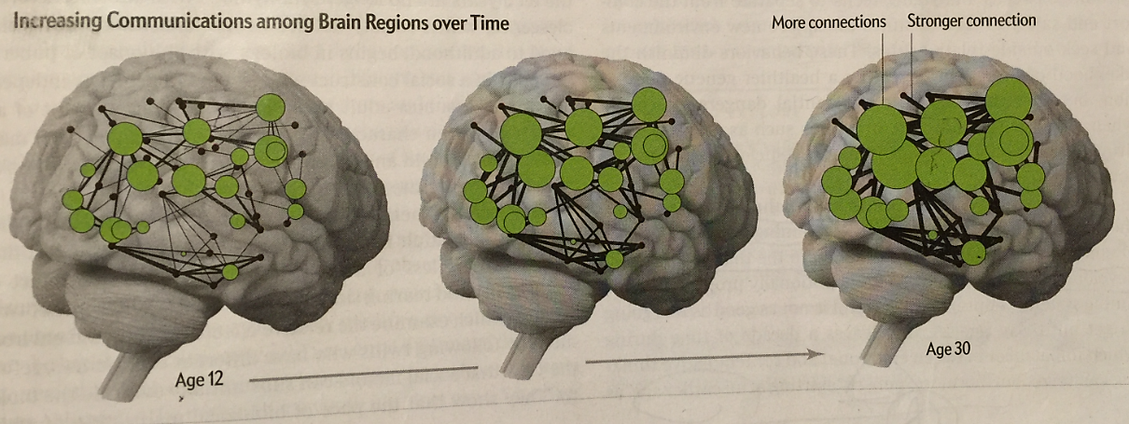
ADOLESCENT BRAIN
I. Development MRI
A. Plasticity
1. Greater connectivity
Larger volumes of white matter
Fatty substance – myelin – sheath (axon)
Childhood --------- adulthood

Slide 7
ADOLESCENT BRAIN
I. Development
A. Plasticity
a. Speeds up conduction time – (100x) neuron - neuron
b. Accelerates information processing by helping axons recover more quickly after firing (up to 30x faster)
a. + b. = 3000x h in brain computational speed between infancy and adulthood
c. Simultaneous arrival of impulses at a neuron (critical for learning)
Special math for above
Graph Math
Most brain circuits develop in the womb and change throughout life – greatest changes occur in adolescence

Slide 8
ADOLESCENT BRAIN
I. Development
A. Plasticity (cont’d)
2. Specialization
a. Pruning and strengthening
gray matter – out with unused keep the used
b. Overall gray matter h in childhood – maximum at 10 years
i in adolescence (pruning):
levels in adulthood

Slide 9
ADOLESCENT BRAIN
I. Development
A. Plasticity
2. Specialization (cont’d)
c. Gray matter for brain regions maturity varies
Primary touch, sight, sound, smell,
taste - first
Prefrontal cortex – executive function (regulation emotions, impulse control, decision making and planning) – last
This significant delay at the PFC to age 20-25

Slide 10
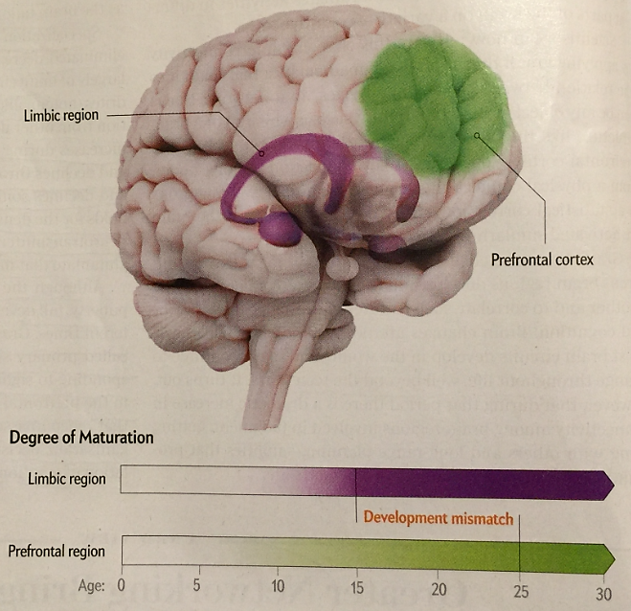
ADOLESCENT BRAIN
I. Development
A. Mismatch in maturity of brain
1. Limbic system vs prefrontal cortex (cognition/reward) over (impulse control)

Slide 11
ADOLESCENT BRAIN
I. Development
A. Mismatch in maturity of brain (cont’d)
1. Cognition/reward – risk taking (instinct)
Limbic peer culture, relationships; as deep as
age 10-12 our genes – as potentially destructive as our relatively new environment and culture
Prefrontal cortex
age 20-25 Impulse control – significantly delayed over above
2. Onset puberty (reward system) in our culture has onset as early as age 7-9 rather than 10-12.
Causes obesity Epigenetics? Unknown ----

Slide 12
ADOLESCENT BRAIN
II. Neuropharmacology of Addiction
A. Genetics (DNA)
1. D₂R (Dopamine) down regulated
2. Serotonin reuptake transporter up regulated (Cloninger)
B. Epigenetic (non DNA)
1. Environment
2. Unknown

Slide 13
ADOLESCENT BRAIN
III. Adolescent Brain + Addiction Risk
A. Cognition (4+)
B. Braking system minimal
C. Stimulus Augmentation (4+)
D. Variables
1. Family
2. Peers
3. Environment

Slide 14
Neuropharmacology

Slide 17
NEUROTRANSMITTORS
I. Single Amino Acid Receptors
AMPA
90% A. Glutamate KA
NMDA
B. GABA GABA_{A}
Alcohol GABA_{B}
BZ
Sedative Hypnotic withdrawal
II. Neuropeptides (Narcotics) Receptors MU 8% A. Endorphin – Beta Kappa
B. Enkeflin Delta
C. Dynorphin Orphan
D. Orphanin

Slide 18
III. Aminergics
8% A. Dopamine Receptors
(Alcohol, Cocaine, Pot, D₁ D₂ D₃ D₄ D₅
Narcotics, Nicotine)
B. Serotonin Receptors
(SSRI Drugs) 5HT3 5HT2 5HT1A
C. Acetyl Choline Receptor
(Nicotine, Pot) Nicotinic AC
D. Noradrenaline (Alcohol, Combination SSRI)
IV. Neurosteroids Cholesterol
Godanal Hormones
GABA_{A}
NMDA

Slide 19
Table 3. Overview of Major Neurotransmitters: Functions and Alcohol-Related Behaviors
Neurotransmitter General Function Specific Action by Alcohol Alcohol-Related Function
_________________________________________________________________________________________________________
Dopamine (DA) Regulates motivation, Initiates a release at the NAC either Mediates motivation and reinforcement and fine directly or from projections via the reinforcement of alcohol
motor control mesolimbic system from the VTA consumption. Drugs that
increase DA are drugs of reward.
PET scan – D₂ receptor and transporter (↑density) relapse
______________________________________________________________________________________________________________________________
Serotonin (5-HT) Regulates bodily rhythms, The brain 5-HT system may modulate May influence alcohol consumption,
appetite, sexual behavior, alcohol intake by 2 different mechanisms: intoxication and development of
emotional states, sleep, (1) modulation of the DA-mediated tolerance through 5-HT₁ receptors;
attention and motivation. reinforcing properties of alcohol via 5-HT₂ may contribute to withdrawal
and 5-HT₃ receptors; and (2) suppression symptoms and reinforcement
of alcohol intake by activation of 5-HT_{1A} through 5-HT₂ receptors;
transporter receptors. and may modulate DA release
(reuptake site) through 5-HT₃ receptors,
Type II (Cloninger) thereby increasing alcohol’s
rewarding effects.
______________________________________________________________________________________________________________________________
ƴ-aminobutyric acid Serves as the primary Causes tonic inhibition of dopaminergic May contribute to intoxication and
(GABA) (GABA) inhibitory neurotransmitter projections to the VTA and NAC. sedation; inhibition of GABA in the brain. Prolonged alcohol use causes a down- function following drinking
regulation of these receptors and a may contribute to acute
potential for decreased inhibitory withdrawal symptoms.
ion channels neurotransmission.
chloride influx

Slide 20
____________________________________________________________________________________________________________________________________________
Glutamate Serves as the major excitatory Alcohol inhibits excitatory neuro- May contribute to acute withdrawal
neurotransmitter in the brain. transmission by inhibiting both NMDA symptoms; inhibition of glutamate
and non-NMDA(kainite and AMPA) function following drinking
receptors. Up-regulation of these receptors cessation may contribute to
ion channels to compensate for alcohol’s antagonistic intoxication and sedation.
calcium influx effect occurs after prolonged exposure to
alcohol, resulting in an increase in neuroexcitation.
____________________________________________________________________________________________________________________________________________
Opioid peptides Regulates various functions and Alcohol stimulates β-endorphin release Contributes to reinforcement of
produced morphine-like effects, in both the NAC and VTA area. Alcohol consumption, possibly
including pain relief and mood β-endorphin pathways can lead to increased through interaction with DA.
elevation. DA release in the NAC via 2 mechanisms:
(1) β-endorphins can disinhibit the tonic
inhibition of GABA neurons on DA cells in
the VTA area, which leads to a release of DA
in the NAC area; and (2) β-endorphins can
stimulate DA in the NA directly. Both
mechanisms may be important for alcohol
reward.
_
AMPA = α-amino-3-hydroxy-5-methisoxizole-4-propionic acid; NAC= nucleus accumbens;
NMDA = N-methyl-D-aspartate; VTA = ventral tegmentum.
Adapted from Swift RN. Alcohol Res Health. 1999;23:209.18

Slide 21
Biochemistry
Alcohol Acetaldehyde
Alcohol (Acetaldehyde dehydrogenase)
Dehydrogenase
(female effect)
CO₂ + H₂0 Acetic Acid
Acetaldehyde Dehydrogenase I and II
Populations affected
1) Native American
2) Oriental

Slide 22
Genetics
I. Adoption studies 1935 – 1950
4 X Greater
II. Blood Platelets Monomide Oxidase Second
DNA - RNA Adenolate Cyclase Messengers
gene effect cAMP
III. Stimulus Augmentation
Brain Waves P3 Alpha Affective Mood
IV. Cloninger, C.R. – 1981 extended studies Type I
Type II

Slide 23
Type I – A. later onset crescendo of drinking
B. lose control of quantity consumed
C. attempt to maintain social control
Type II – A. highly heritable – 9 x ↑ in males
4 x ↑ in females
B. early onset - < 25 years of age can see in geriatric
population if began
late age onset initially
C. do not lose control of amount consumed
D. antisocial behavior when drinking
E. severe up-regulated serotonin transport (reuptake site) – therefore ↓ serotonin entire picture affected by ondansatron

Slide 24
V. Epigenetic (Non-DNA Affected)
Transgenerational Gene Expression
It’s significance to addiction
IV. Neuropharmacology – determined by genetics and/or
epigenetics
A. D2R – regulation (trauma and isolation) Volkaw
B. Dopamine regulation
C. Serotonin regulation
D. Noradrenaline regulation

Slide 25
ADOLESCENT BRAIN
IV. Treatment Focus
A. Peer Pressure
B. Adult Role Models
C. Realistic insight into medication assisted intervention
D. Family involvement (all)
E. Therapist – knowledgeable, experienced adolescent focused trained individual

