Slide 1
Evidence-Based Addiction Treatment: How Research Supports the Use of the Twelve Steps
Marc J. Myer, M.D.
Director, Health Care Professionals Program
Hazelden Center City

Slide 3
Why Examine AA?
~30% lifetime prevalence of any alcohol disorder.
NESARC 2001-02
~10% of those needing treatment actually receive it. NSDUH 2008

Slide 4
Why Examine AA?
In 2010, 4.1 million received help for substance abuse problem, 2.3 million using twelve step fellowships exclusively or along with treatment.
NSDUH 2010
More people use AA than any other resource to address problems with alcohol. McCrady & Miller 1993
Weisner, Greenfield, Room 1995

Slide 5
12 Step Programs
Accessible
Inclusive
Adaptable/diverse
Growing
Inexpensive
Successful

Slide 6
Estimated AA Membership (January 2011)
Members in U.S. 1,279,664
Groups in U.S. 57,905
Members Worldwide 2,057,672
Groups Worldwide 107,976
(AA is found in over 150 countries)
www.aa.org (2013)

Slide 7
“To alcohol! The cause of…and solution to…all of life’s problems…”
Homer Simpson

Slide 8
Who Attends AA?
No study has shown that there is more of one demographic group than any other in AA – true cross section.
Severity of alcohol-related problems is the strongest predictor of AA attendance.
Those with family and friends providing weak or inconsistent support for addressing alcohol problems are more likely to join AA.

Slide 9
Who Attends AA?
Gender has not been found to be a predictor of AA membership.
Project MATCH showed no gender differences in rates or patterns of AA meeting attendance.
AA data: 65% Male
35% Female

Slide 10
In 1989, a Committee of the Institute of Medicine concluded:
“Alcoholics Anonymous, one of the most widely used approaches to recovery in the United States, remains one of the least rigorously evaluated.” IOM 1989

Slide 11
A Review of the Early Research
…”AA research has been mostly pre-experimental in design, has failed to use instrumentation of established reliability, has usually not attempted to check for the validity of the self report data obtained, has inadequately assessed the nature of subjects’ alcohol problems, has been deficient in describing demographic characteristics of the sample and has sampled an unrepresentatively large number of middle-aged people and an unrepresentatively small number of women.”
Emrick, Tonigan, Montgomery, Little 1993

Slide 12
However…
“Professionally treated patients who attend AA during or after treatment are more likely to improve in drinking behavior than are patients who do not attend AA, although the chances of drinking improvement are not overall a great deal higher.”
Emrick, Tonigan, Montgomery, Little 1993

Slide 13
Another Review
“From the perspective of experimental rigor, the quality of many AA studies was poor.”
Tonigan, Toscova, Miller, J Stud Alcohol 1996

Slide 14
However…
“Better designed studies report moderate and positive relationships between AA attendance and improved psychosocial functioning.”
Tonigan, Toscova, Miller, J Stud Alcohol 1996

Slide 15
Cochrane Review
“There is no conclusive evidence to show that AA can help patients to achieve abstinence, nor is there any conclusive evidence to show that it cannot.”
“People considering attending AA or TSF programmes should be made aware that there is a lack of experimental evidence on the effectiveness of such programmes.”
Ferri, Amato, Davoli, CDSR 2006

Slide 16
However…
The Cochrane conclusion was heavily
weighted on the study by Diana Chapman
Walsh randomizing individuals to hospital
inpatient treatment, AA meetings, or “choice”.

Slide 17
Alcohol abusers that were EAP referred
n=227: n=73 hospital, n=83 AA, n=71 choice
Walsh et al., NEJM 1991

Slide 18
Why is AA difficult to study?
Anonymous organization
Steeped in tradition
Singleness of purpose in AA
Bias that “I know this works and no studies are needed”
Difficult/impossible to randomize individuals to one treatment vs. the other → contamination
Difficult/impossible to determine which aspects of AA are critical and which are not

Slide 19
Why is AA difficult to study?
Critics of AA and 12-step research:
AA is a cult that relies on God as a mechanism of action
Individuals self-select to AA
More motivated alcoholics attend AA which leads to better outcomes
Those with less severe psychopathology go to AA

Slide 20
Research About AA: 2 Types
AA as a mutual help organization that supports abstinence
AA philosophy as a treatment modality (Twelve Step Facilitation Therapy) – Project MATCH

Slide 21
12-Step Facilitation Therapy
Goals
Acceptance
Surrender
Principles and objectives are:
Behavioral
Emotional
Cognitive
Spiritual
Social
Nowinski and Baker 2003

Slide 23
How do we establish causation?
Strength of association
Dose-response relationship
Consistency
Temporally correct
Specificity
Coherence with existing knowledge
Adapted from Epidemiology: an introductory text Kaskutas, J Addictive Diseases 2009

Slide 24
Establishing causation
Strength of association
Dose-response relationship
Consistency
Temporally correct
Specificity
Coherence with existing knowledge

Slide 25
1. Strength of association
3,018 male veterans at 1 year follow up;
AA/NA attendance from months 9-12 was associated with:
More abstinence
Freedom from substance use problems
Freedom from significant distress and psychiatric symptoms
More employment
Ouimette et al., J Stud Alcohol 1998

Slide 26
Summary
“Overall, 12 Step attendance and involvement were more strongly related to positive outcomes than was outpatient treatment attendance.”
“The overall finding was that patients who participated in both outpatient treatment and 12 Step groups combined fared the best on 1 year substance use and psychosocial outcomes.”
Ouimette et al., J Stud Alcohol 1998

Slide 27
1. Strength of association
One and three-year abstinence rates among those attending formal treatment alone and those attending formal treatment plus AA

Slide 28
Establishing causation
Strength of association
Dose-response relationship
Consistency
Temporally correct
Specificity
Coherence with existing knowledge

Slide 29
2. Dose-response relationship
During treatment (Tonigan, Treatment Matching in Alcoholism 2003)
---Number of meetings during treatment predicts attending AA/NA/CA after treatment
3+ per week
After treatment
---More meetings, more abstention (Moos et al., J Clin Psychol 2001)
---Weekly attendance predicts abstinence (Fiorentine, Am J Drug Alc Abuse 1999; also see Hoffman et al, IJA 1983; Toumbourou, JSAT 2002; Gossop et al, Alc&Alc 2003; Bottlender, Fort.derNeur.Psych 2005; for adolescents, see Alford et al, JSA 1991: 2yrs, 84% abstinent if weekly)
Never in past 6 mos. 30% abstinent at 2 years
Less than weekly 40% abstinent
Weekly 75% abstinent
Kaskutas 2007

Slide 30
2. Dose-response relationship Frequency of Meetings
AA meetings | Abstinence
Year 1 | Year 1 | Year 8
No AA | 21% | 35%
2-4 mtgs/week | 43% | 57%
5+ mtgs/week | 61% | 73%
Moos & Moos, J Consult Clin Psychol 2004

Slide 31
2. Dose-response relationship Duration of meetings
Duration of AA meeting attendance |  | % Abstinent, 8 yrs
Year 1 | none | 35
 | 1-16 wks. | 43
 | 17-32 wks. | 56
 | 33+ wks. | 71
Years 2-8 | none | 48
 | 1-12 mos. | 33
 | 13-48 mos. | 64
 | 49+ mos. | 89
Moos & Moos, J Clin Psychol 2006

Slide 32
2. Dose-response relationship
Of those followed up at 8 years (#395) it was found that the number of AA meetings attended during the first 3 years was positively related to:
Remission from alcohol problems
Lower levels of depression
Higher quality relationships
Compared with professionally delivered inpatient or outpatient treatment, “AA probably helped more people more substantially in this sample.”
Humphreys, Moos, Cohen 1997

Slide 33
The frequency of AA attendance above a certain threshold and involvement in AA activities are clearly related to drinking outcomes.

Slide 34
Establishing causation
Strength of association
Dose-response relationship
Consistency
Temporally correct
Specificity
Coherence with existing knowledge

Slide 35
3. Consistency
ªVA inpatients (Ouimette et al., JSA 1998) ^{b}Problem Drinkers (Timko et al., JSA 2000)

Slide 36
Establishing causation
Strength of association
Dose-response relationship
Consistency
Temporally correct
Specificity
Coherence with existing knowledge

Slide 37
Project MATCH
The first scientifically rigorous demonstration of the effectiveness of Twelve Step Facilitation, which is based on the 12 Steps, but remarkably different than attending a 12 Step program and working the Steps.

Slide 38
Project MATCH
952 outpatients at 5 sites
774 aftercare patients at 5 sites (had completed residential treatment or intensive day treatment)
The largest psychotherapy trial in history.
Used 3 methods of treatment
Cognitive Behavioral Therapy (CBT)
Motivational Enhancement Therapy (MET)
Twelve Step Facilitation (TSF)

Slide 39
Project MATCH Study Design:
98% 97% 95% 94% 92% 85%
86%
CBT
MET
TSF
Screen Randomize FU3 6 9 12 15 (39) (120)
Two Arms: Aftercare Sample N = 774, Outpatient Sample = 952
Tonigan 2004

Slide 40
4. Temporally correct
Project MATCH showed that the frequency of AA meeting attendance as well as overall AA involvement in months 1-6 significantly predicted the percentage of days of alcohol abstinence during months 7-12

Slide 41
5. Specificity Project MATCH: Posttreatment & Three-Year Drinking Outcomes
Longitudinal, RCT of 12-step vs other tx. Approach
Outpatient arm, abstinent for 3 months prior to:
 | 1-yr follow-up (p=.0024) | 3-yr follow-up (p<.007)
TSF | 36% | 36%
CBT | 25% | 24%
MET | 30% | 27%
 | PMRG, JSA 1997 | PMRG, ACER 1998

Slide 42
5. Specificity Selection bias?
Baseline 1 year 2 years
2,319 male VA patients McKellar et al., J Consult Clin Psychol 2003
Motivation
positive
AA
involvement
Alcohol
problems
negative
negative
no diff
Psycho-
pathology
no diff

Slide 43
Project MATCH Determined Three Conclusions About Client Matching
For those drinkers whose social system is supportive of ongoing alcohol use, facilitating participation in AA (TSF) resulted in better outcomes than use of MET or CBT.
Angry alcohol dependent clients have better outcomes using MET.
Inpatients with high dependence on alcohol appear to do better with TSF group oriented aftercare than CBT.
Project MATCH Research Group 1998

Slide 44
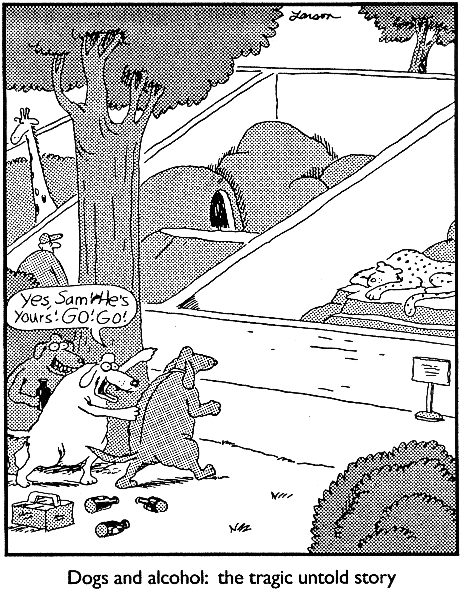

Slide 45
Establishing causation
Strength of association
Dose-response relationship
Consistency
Temporally correct
Specificity
Coherence with existing knowledge

Slide 46
6. Coherence with existing knowledge
Why does AA work?
What are the mediators that support positive outcomes?

Slide 47
Mechanisms of Efficacy
Self Efficacy – the confidence to reduce and stop drinking
In Project MATCH, AA participation predicted self efficacy which predicted percentage of days abstinent in the 7-12 month period after treatment.
Connors, Tonigan, Miller 2001
This was also shown at 3 year follow up.
Owen, Slaymaker, Tonigan, McCrady,
Epstein, Kaskutas, Humphreys, Miller 2003

Slide 48
Mechanisms of Efficacy
Increased Social Support
Involvement in self help groups predicted reduced substance use at 1 year follow up. “Both enhanced friendship networks and active coping responses appeared to mediate these effects.”
Humphreys, Mankowski, Moos, Finney 1999
Follow up of men and women found “AA involvement and the type of support received from AA members were consistent contributors to abstinence 3 years following a treatment episode.”
Bond, Kaskutas, Weisner 2003

Slide 49
Mechanisms of Efficacy
Improved Coping Skills
Proximal outcomes (1 and 6 month) were predicted by increased active coping efforts.
Morgenstern, Labourie, McCrady, Kahler, Frey 1997
Active coping responses resulting from AA participation predicted reduction in substance use at 1 year follow up.
Humphreys, Mankowski, Moos, Finney 1999

Slide 50
Multiple studies have examined 12 Step Affiliation vs Involvement
General outcome:
Attendance at 12 Step meetings is not likely to be as helpful as becoming actively involved in the 12 Step community.

Slide 51
Which Activities Matter Most?
Summarizing across 16 studies
Strongest evidence for:
having a sponsor
being more involved in AA than in the past
Next-strongest evidence is for:
leading an AA meeting
doing 12-step work
Weaker relationships for:
sponsoring others
working last 7 steps
Kaskutas 2007

Slide 52
National Practice Guidelines Support AA Participation Based on This Research
ASAM: Public Policy Statement – Self Help Groups and Professional Treatment
Department of Veteran Affairs: Clinical Practice Guidelines for Substance Use Disorder
SAMHSA/CSAT: Treatment Improvement Protocols
NIAAA: Helping Patients Who Drink Too Much

Slide 53
Summary
AA research has improved and expanded.
Most of your clients with alcohol or drug problems will use 12 Step programs.
Regular participation in 12 Step groups, especially during and after professional treatment, promotes abstinence and improved psychosocial functioning.
Active involvement over long periods is beneficial.
Self efficacy, increased social support and improved coping skills are related to AA attendance and positively correlated to abstinence.
TSF works well for severe alcohol dependence and those with little social support for abstinence, while MET is better for angry alcohol dependent clients.

Slide 54
Clinician Guidelines
We need to prepare clients for 12 Step program participation and refer them to 12 Step groups.
Learn the 12 Steps and principles associated with 12 Step recovery
Learn the language and culture of 12 Step programs
Learn about Twelve Step Facilitation Therapy
Distinguish religion from spirituality
Address myths associated with 12 Step groups
Help clients find appropriate 12 Step groups
Encourage active membership and attendance at least three times a week (evidence supports AA frequency)
Encourage long-term attendance (evidence supports AA duration)

